Slide 1


Sandra De Leon, Career Counselor-Diverse Students, SJSU
Maggie Morales, Director Veterans Resource Center, SJSU

Slide 2
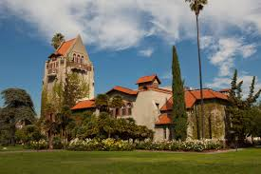
AGENDA
Introduction of the SJSU Veterans Career Readiness Program
Why create a VCRP?
How it was implemented
Timeline of program
How it supports student veteran success
Lessons learned

Slide 3
VETERANS CAREER READINESS PROGRAM
What is the VCRP?
Partnership between SJSU’s VRC and Career Center, under the Division of Student Affairs, the VCRP is a program designed to empower student veterans at SJSU to earn meaningful internships by providing professional career advice, tools, and mentoring/networking opportunities.
Program Outcomes, students will:
Gain the skills, knowledge, and understanding of the career exploration process
Fine-tune their marketing tools for their job search
Identify their career goal (s)
Receive guidance on obtaining a professional mentor
Receive support to gain an internship
Awarded $500.00 stipend upon completion of required activities

Slide 4
POLL
What are the top 7 reasons employers hire veterans?
Institute for Veterans and Military Families/SVA, Higher Education Research Report, 2017

Slide 5
POLL
What are the top career transition challenges veterans face when entering the workforce?
Older than traditional student
Married
Have children
Have a disability
Working full or part-time
First-generation student
Institute for Veterans and Military Families/SVA, Higher Education Research Report, 2017

Slide 6
WHY CREATE IT?
Purpose of the Veterans Career Readiness Program
Identify career goals for veterans
Internship/job search strategies
Resume support
Marketing tools (ex: LinkedIn)
Networking/mentorship
Interviewing
Alumni/employer connections
Confidence booster
Cohort/bond
Campus Strategic Plan

Slide 7
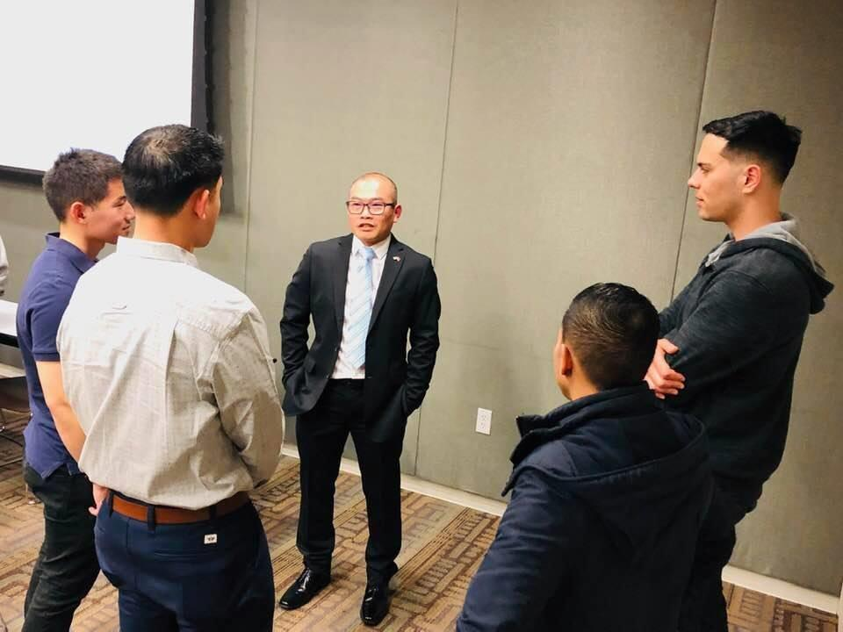
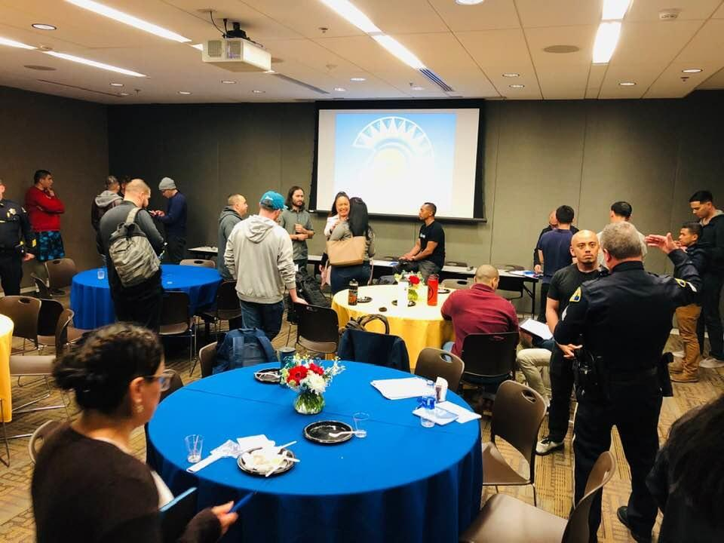
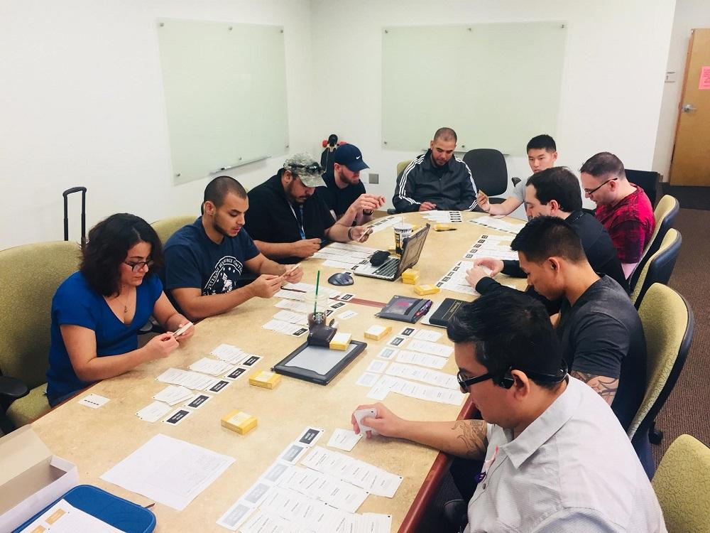
Networking
Confidence
Career Exploration

Slide 8
IMPORTANCE OF INTERNING
Across all degree programs and socioeconomic levels, internships are a known high impact practice that positively affects academic performance
(Binder, Baguley, Crook, & Miller, 2015)
Having a related internship displayed on your resume resulted in a 14% higher employer response rate
(Nunley, Pugh, Romero & Seals Jr., 2016)
Allows you to test drive the industry: confirm or reject career options (Rothman & Sisman, 2016)
Get paid more upon graduation (6.5% on average) (NACE Class of 2019 Student Survey)

Slide 9
INTERNSHIPS & CAREER OUTCOMES

Slide 10
IMPLEMENTATION
How did we get program started
Funding
Collaboration with VRC and Career Center
What were deciding factors in program implementation:
Size of cohort
Space issue/room reservations
Staff time
Marketing program for first cohort

Slide 11
TIMELINE
SEP-MAY
JUNE
JULY
AUG
Begin Marketing Program
Applications Due
Review & Notify Participants
Begin cohort/workshops
Market via email, social media & website to all registered student veterans
Students submit application via Google form
Review applicants via Google sheet.
Attend program orientation before start of term.
4 workshops/ events in Fall
4 workshops/ events Spring

Slide 12
PROGRAM SYLLABUS
Topics covered in Workshops (syllabus)
Participant Expectations:
Attendance: *Must attend AT LEAST 6 out of 8 workshops throughout the program.
Participation: Actively participate in your career exploration process by way of the workshop activities and complete required assignments.
Teamwork: Treat your cohort as you would someone you care about. Get to know their goals and keep an open eye out for opportunities and resources that could be helpful.
For learning/working sessions-please bring a laptop.

Slide 13
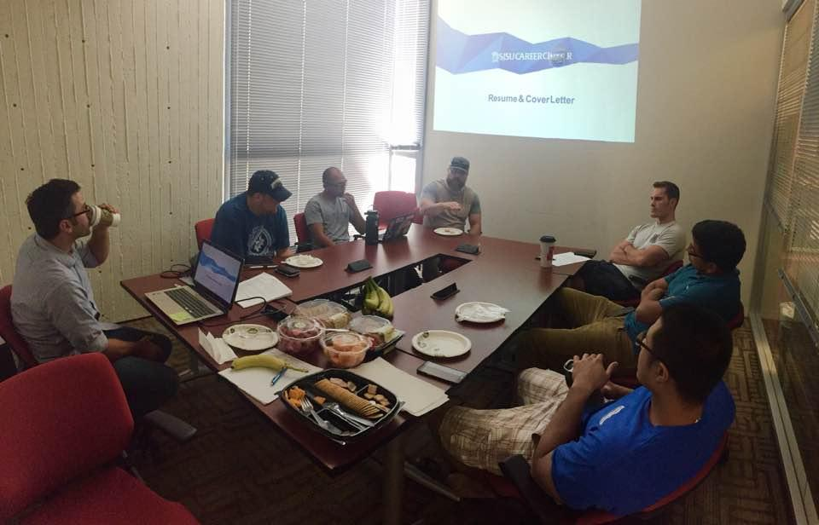
PROGRAM GROWTH
First Year Cohort: small and mighty

Slide 14
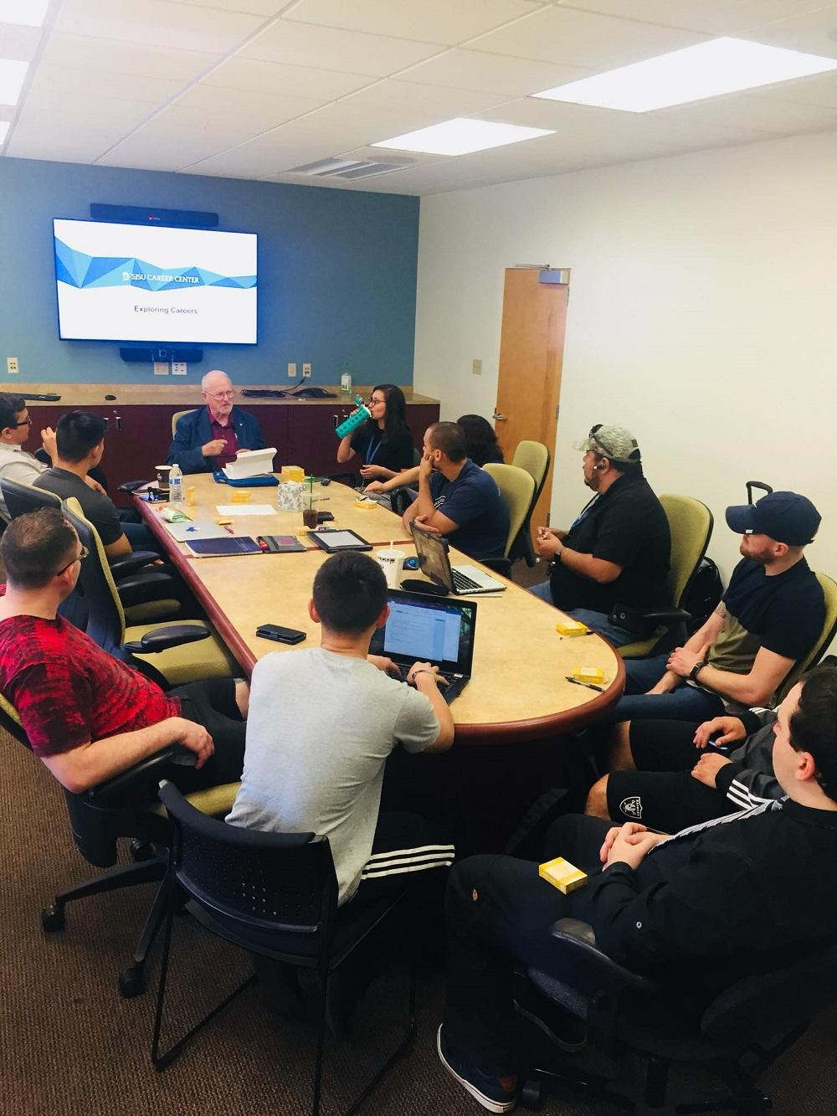
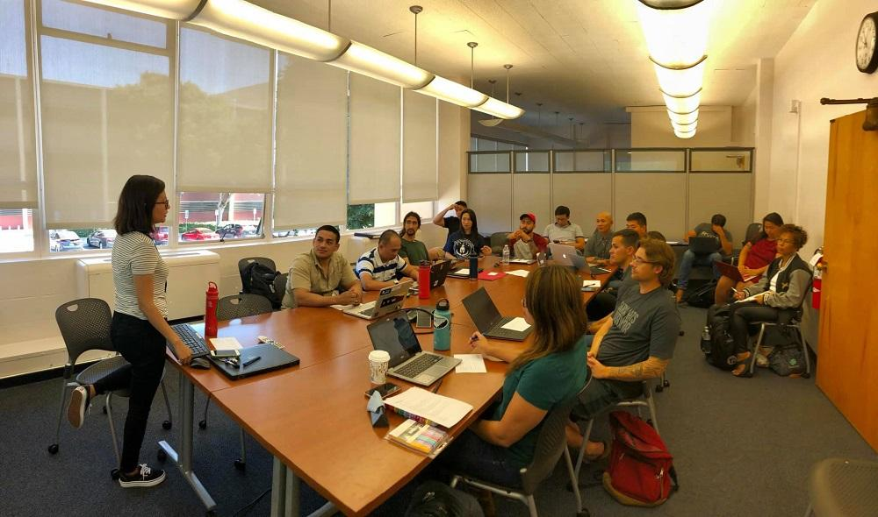
PROGRAM GROWTH
Participation is key!
Year 2
Year 3

Slide 15
ADDITIONAL RESOURCES
Using Alumni as a resource
Special events for program
Career Counselor in VRC office hours
Employer Info Sessions in VRC
Collaborate with Bay Area Veterans Coalition of Employers (vet ERG’s)

Slide 16
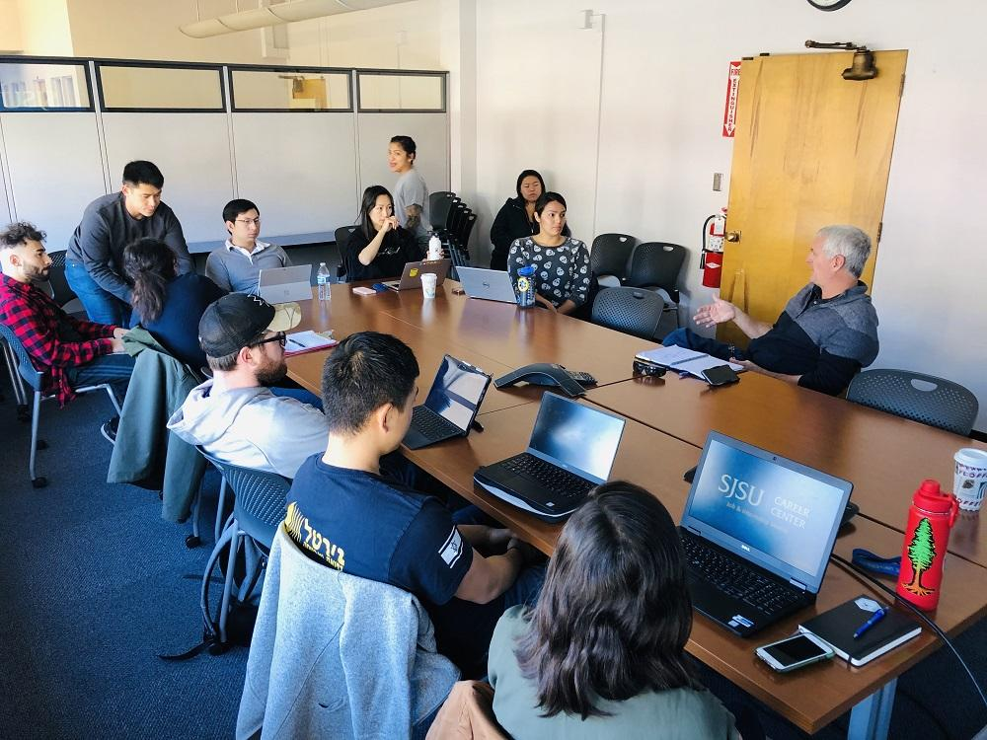
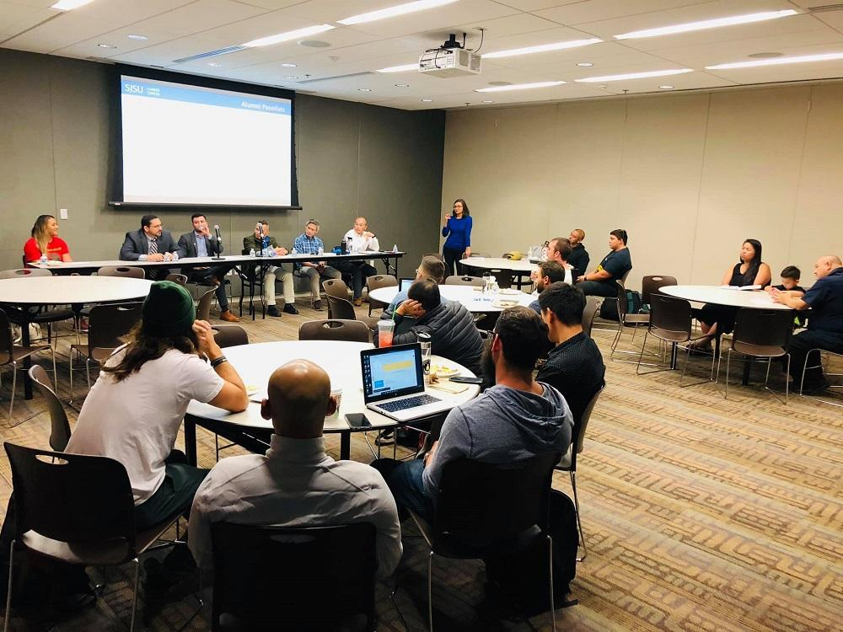
Alumni Events/Mentorship

Slide 17
PROGRAM FEEDBACK
“This program is great and useful to all veterans! thank you!”
“Great program thank you so much! Loved the LinkedIn and resume workshops!”
“One suggestion I would make is that if you could invite those Veteran Alumni to the regular meetings just to network with us throughout the course that'll be awesome. That way, every meeting, we can start socializing with each of them.”

Slide 18
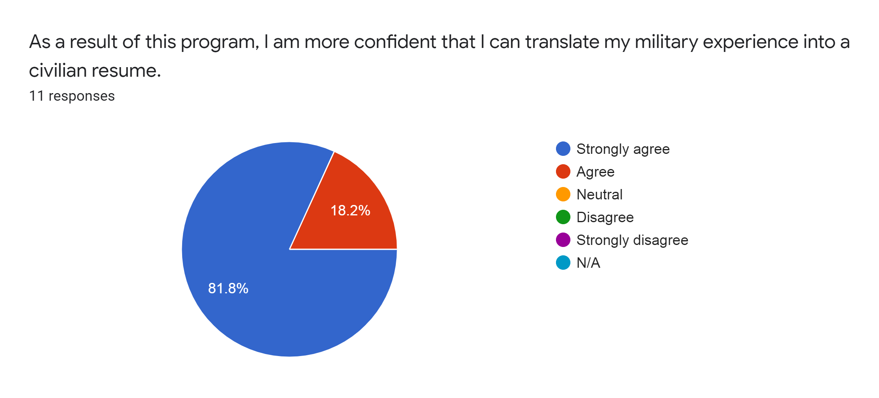
PROGRAM SUCCESS

Slide 19
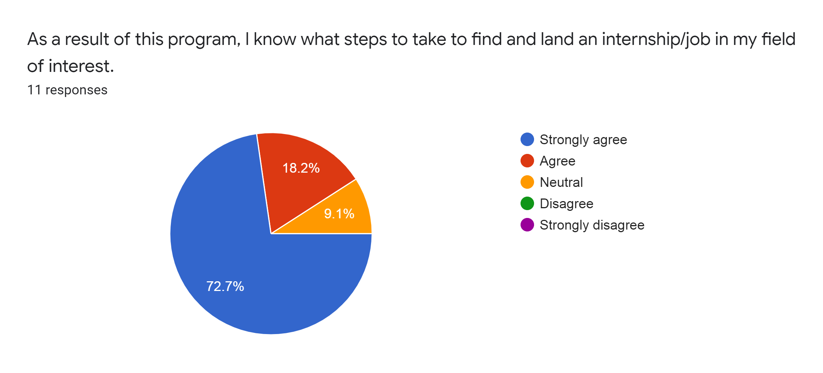
PROGRAM SUCCESS

Slide 20
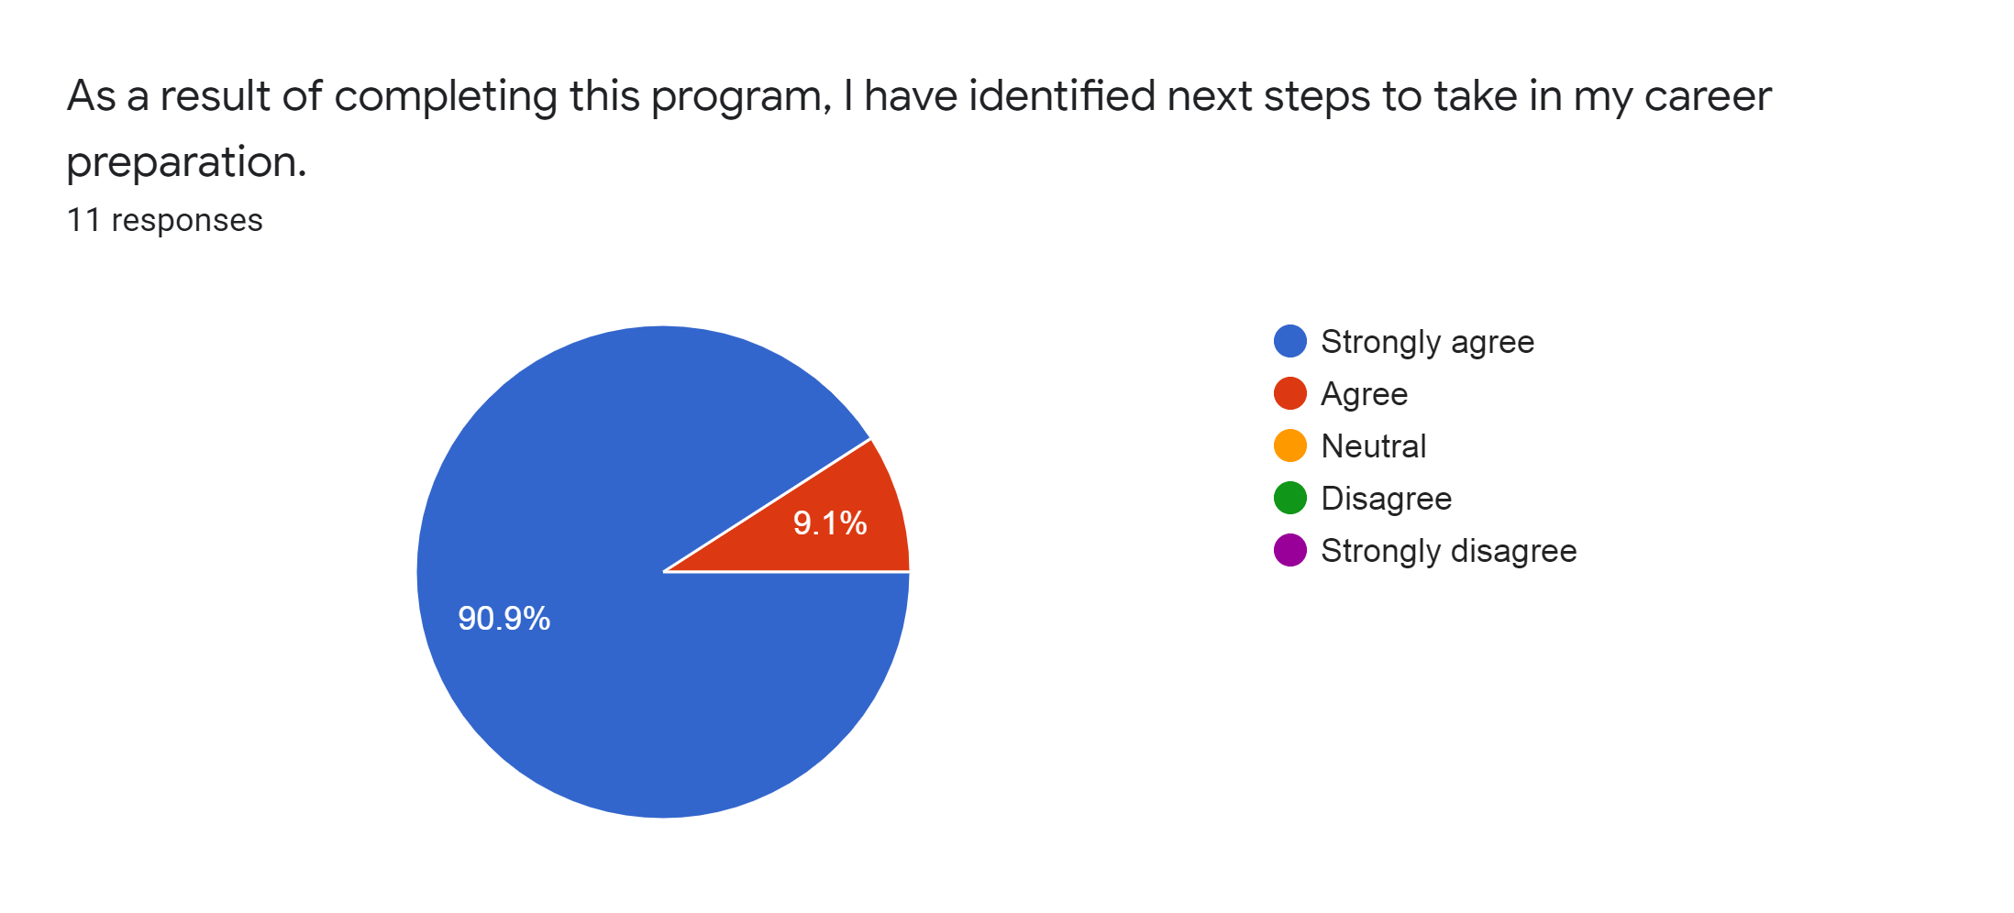
PROGRAM SUCCESS

Slide 21
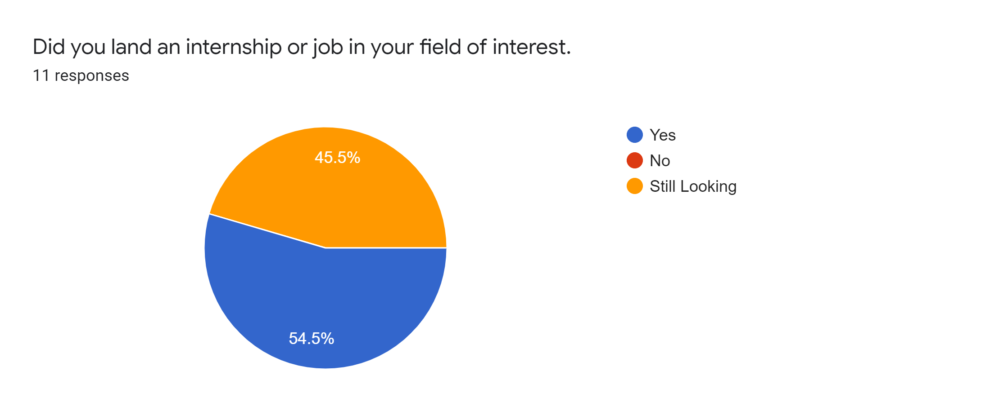
PROGRAM SUCCESS

Slide 22
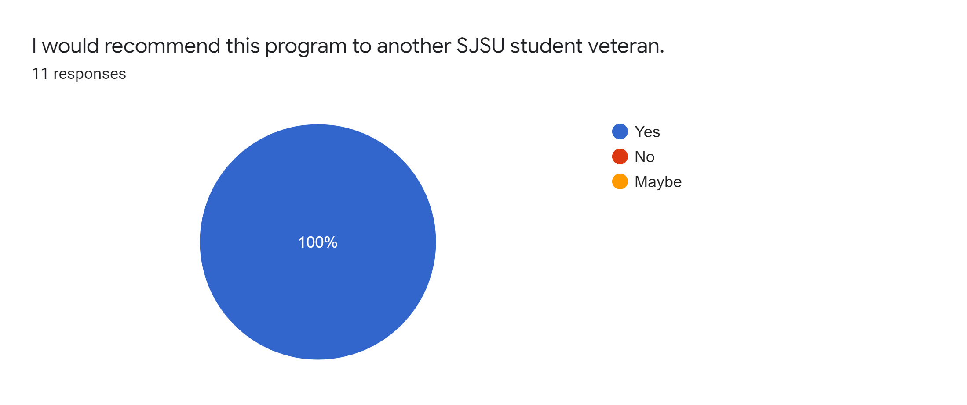
PROGRAM SUCCESS

Slide 23
MODIFICATIONS
What we’ve learned
Notes:
Invited more mentors/alumni to workshops/events on a regular basis
Added all materials to Google Drive post workshops
Allowed for 1:1 make-up sessions for those that missed workshops
Increased program enrollment:
2017-2018: 22 applicants, accepted 10, 7 completed all requirements
2018-2019: 27 applicants, accepted 17, 12 completed all requirements
2019-2020: 27 applicants, accepted 27, in-progress but consistently about 17-18 attending
What we’ll need to work on this year: grow Donor relations for long-term sustainability and Department funding

Slide 24
IN CLOSING
Any Questions?
sandra.deleon@sjsu.edu
maggie.morales@sjsu.edu

