Slide 1

Getting Connected: Bringing Together Student Veterans and
Services Under One Roof
Rachel Nachlas, Director, Veteran and Military Services
Dr. Amy Coldren, Academic Advisor, Veteran and Military Services
Frederick Community College - Frederick, Maryland
February 2-4, 2020 | Seattle, WA

Slide 2
Student Panelists
Andrew (USMC Veteran)
John (USMC Active Duty)
Clemencia (Navy Veteran Spouse)

Slide 3
Frederick Community College
Veteran and Military Services
Mission Statement: Frederick Community College Veteran and Military Services offers programs and support services for veterans, military personnel, and their families as they pursue their academic, career and personal goals.
Veteran and Military Services (VMS) Program Goal: to provide a respectful and inclusive link for our returning veterans and military-connected students to assist them in developing academic plans consistent with their degree and/or career objectives.

Slide 4
Frederick Community College
Veteran and Military Services
About Us
  Location
  Our students
Our Current Model
  Staffing
  Dedicated Space
  Services & Programs
  Processes & Tools
  Campus & Community Collaborations
How We Got Here
  Campus, State and Federal Influences
  Leveraging Resources
  Incremental Changes
  Persistence
Benefits
  Students
  Institutional
Wrap Up/Q & A

Slide 5
Frederick Community College VMS - About Us
Location
  Frederick Community College (FCC) is located approximately 45 miles north of Washington D.C. and 50 miles west of Baltimore
  Frederick County is home to Fort Detrick, a U.S. Army Medical Command installation, and Camp David, the Naval Support Facility - Thurmont, more commonly known as the U.S. President’s country retreat

Slide 6
FCC VMS - About Us
Our Students
  We serve ~360 students each academic year, including veterans/dependents, active duty personnel, National Guard members and Reservists
  Demographics
  85% have served or are currently serving in the Armed Forces
  15% are dependents/military affiliated
  35-60% are first generation
  40-45% are students of color
  65-70% are male
  55-60% report having a service-connected disability
  Benefits
  Our students use VA, TA, myCAA and Maryland state benefits

Slide 7
FCC VMS - Our Current Model
Staffing
  Staffing
    Director of Veteran and Military Services
    Academic Advisor, Veteran and Military Services
    Veterans and Military Services Specialist (School Certifying Official/SCO)
    Department of Veteran Affairs Work Study Students

Slide 8
FCC VMS - Our Current Model
Veteran and Military Student Center
Veteran and Military Student Center Provides a Space…
  where students can get connected
    socially
    with peer mentors
    with VMS staff
    to campus services
  for studying and tutoring
    Computer stations
  for Veterans Club meetings

Slide 9
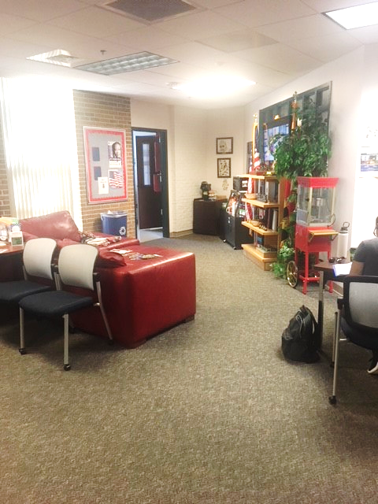
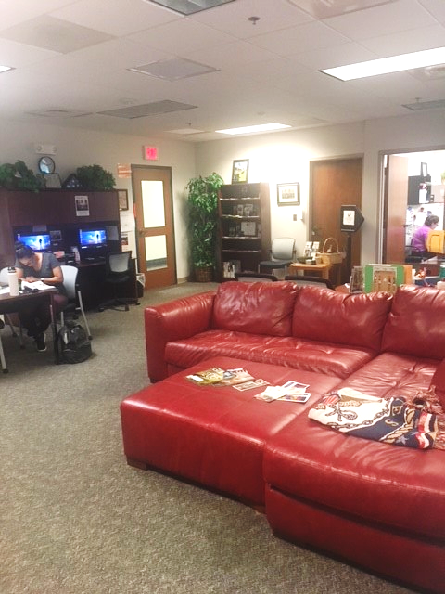
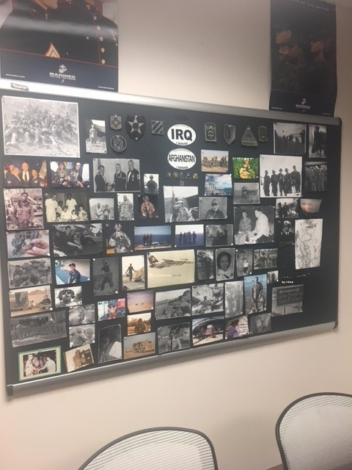
Veteran and Military Student Center

Slide 10
FCC VMS - Our Current Model
Services and Programs
Case Management Approach
  Central Point of Contact
  Intake
  Benefit-Informed Academic Advising
    Academic planning
    Registration
    Intervention
    Career counseling
    Transfer advising

Slide 11
FCC VMS - Our Current Model
Services and Programs
Case Management Approach
  VA Certification (closing the loop)
  Mental Health Counseling
  Referrals (to campus & community services)
  New Student Orientation
  Workshops
  Graduation Celebration

Slide 12
FCC VMS - Our Current Model
Processes and Tools
Processes
Use of Data
  Daily Queries
  Tracking data
Monthly meeting with staff from Student Accounts Office
Tools
Website
Bookings
Perfect Forms/Vouchers
Student Success Alerts
BlackBoard Community Resource
Electronic Manual/OneNote

Slide 13
FCC VMS - Our Current Model
Campus & Community Collaborations
Campus Collaborations
  Records and Registration
  Student Accounts
  Services for Students with Disabilities
  Bookstore
  Curriculum Committee
  Policy Committees
  Strategic Advisory Committee
  Faculty
  Marketing Department
Notes:
R & R
Priority registration
JST
Bookstore
Vouchers 31 & 33

Slide 14
FCC VMS - Our Current Model
Campus & Community Collaborations
Community Collaborations
  VET Center
  CVEB (Community Veterans Engagement Board)
  FVSN (Frederick Veteran Support Network)
  FVAC (Frederick County Veterans Advisory Council)
  Serving Together
  Goodwill of Monocracy Valley
  Lviv Polytechnic
Notes:
R & R
Priority registration
JST
Bookstore
Vouchers 31 & 33

Slide 15
FCC VMS - Our Current Model
Staff and Student Relationships
  Trust
  Celebrations
  Family
  Support
  Community events
  Supporting our students for both on and off campus ventures

Slide 16
Frederick Community College VMS – How We Got Here
Factors that Influenced the Creation of VMS
  Campus Task Force
    2011-2012
  Maryland Campus Compact for Student Veterans
    Designated “One Door” service, transition support, coordination of services, referrals for mental health support, and peer support
    Signed by FCC President on January 31, 2011
  Executive Order 13607
    Established Principles of Excellence for Educational Institutions Servicing Service Members, Veterans, Spouses and Other Family Members
    Ensures access to information needed to make informed decisions concerning use of educational benefits
    Signed by FCC President on July 31, 2012

Slide 17
Frederick Community College VMS – How We Got Here
Timeline: FY13
  Veteran Services Department Created
    All academic advising (for VA benefit eligible students) and VA certifying moved to this office from Counseling and Advising and Financial Aid
    Created a partnership with the Student Accounts office
  Staffing – 1 employee
    Full-time Coordinator of Veteran Services
      Provided program direction and oversight
      Ensured compliance with the VA rules and regulations
      Provided academic advising to all student veterans
      Served as the School Certifying Official, completing all VA certifications
      Connected students to support services

Slide 18
Frederick Community College VMS – How We Got Here
FY14
  FCC Veterans Center Opened
  VA Work Study Program Approved
  Staffing – 1.5 employees
    Full-time Coordinator of Veteran Services
    Half-time Office Associate
FY15
  Veterans Commemorative Garden dedication
  Formal collaboration with SSD (Services for Students with Disabilities)
  Staffing – 2 employees
    Full-time Coordinator of Veteran Services
    Full-time Office Associate (received training for SCO duties)

Slide 19
Frederick Community College VMS – How We Got Here
FY16
  Registration & Records Project
  Student Veteran Success Grant Program initiated
  Staffing – 2.5 employees
    Full-time Director of Veteran Services
    Full-time Veteran Services Specialist (formerly Office Associate)
    Half-time Veterans Academic Advisor
FY17
  “Vet Center” site approved (MOU)
  Staffing – 2.5 employees
    Same as above

Slide 20
Frederick Community College VMS – How We Got Here
FY18
  SALUTE Veterans Honor Society
  Staffing – 2.5 employees
    Full-time Director of Veteran Services
    Full-time Veteran Services Specialist
    Half-time Veterans Academic Advisor
FY19
  Changed name and focus to Veteran and Military Services/Veteran and Military Student Center
  Staffing – 3 full time employees
    Director of Veteran and Military Services
    Veteran and Military Specialist/SCO
    Veteran and Military Services Academic Advisor

Slide 21
Frederick Community College VMS – How We Got Here
Leveraging Resources
  How to Get Institutional Buy-In and Support
    Start at the top!
    Present Data
    Include Student Testimonials
    Ask your Foundation
    Find individuals and organizations in the community who want to support veterans

Slide 22
Frederick Community College VMS – How We Got Here
Incremental Change
Persistence

Slide 23
Frederick Community College VMS – Benefits
Benefits to our Students and the Institution
  Informed case management supports completion and maximizes VA benefits
  VA Benefits processed in a timely manner
  Access to support services
  Sense of community and belonging
  Increased graduation rates!!!
    Higher GPA than general student population
  Dedicated Alumni

Slide 24
Student Reflections
Andrew
Clemencia
John

Slide 25
Wrap Up
Questions & Answers

