Slide 1

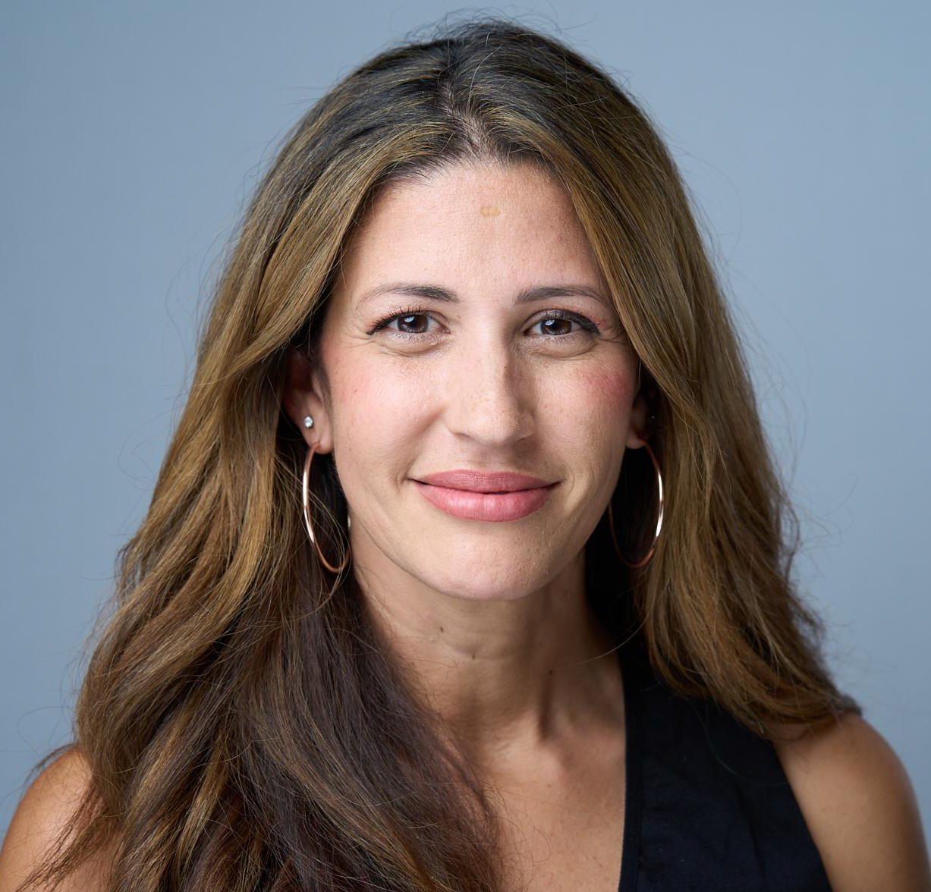
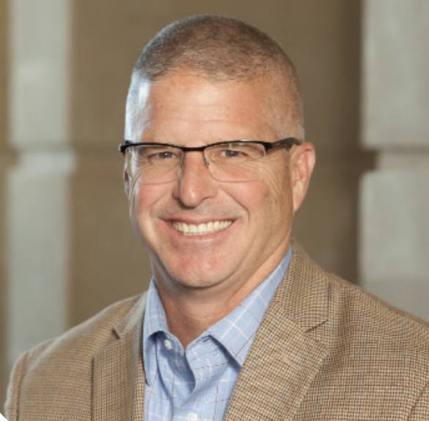



Post-Education Employment: Employer & Higher Education Collaboration Is Key
Michael Piper
Kandi Tillman
David Ottavianelli

Slide 2









a collaborative, industry-led effort made possible by support from
enabling & connecting at-scale
EMPLOYERS.
PATHWAYS.
MILITARY TALENT.
launched August 2020

Slide 3



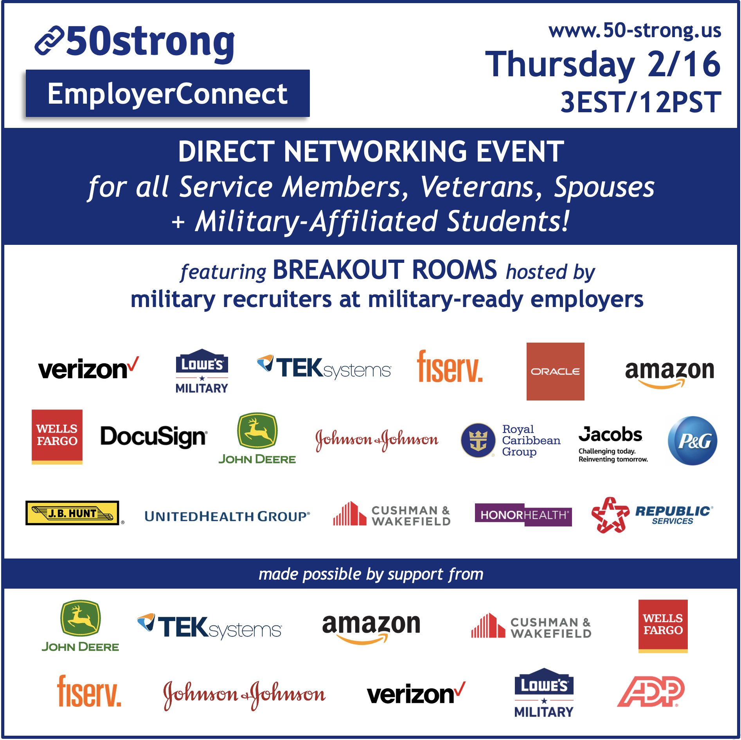

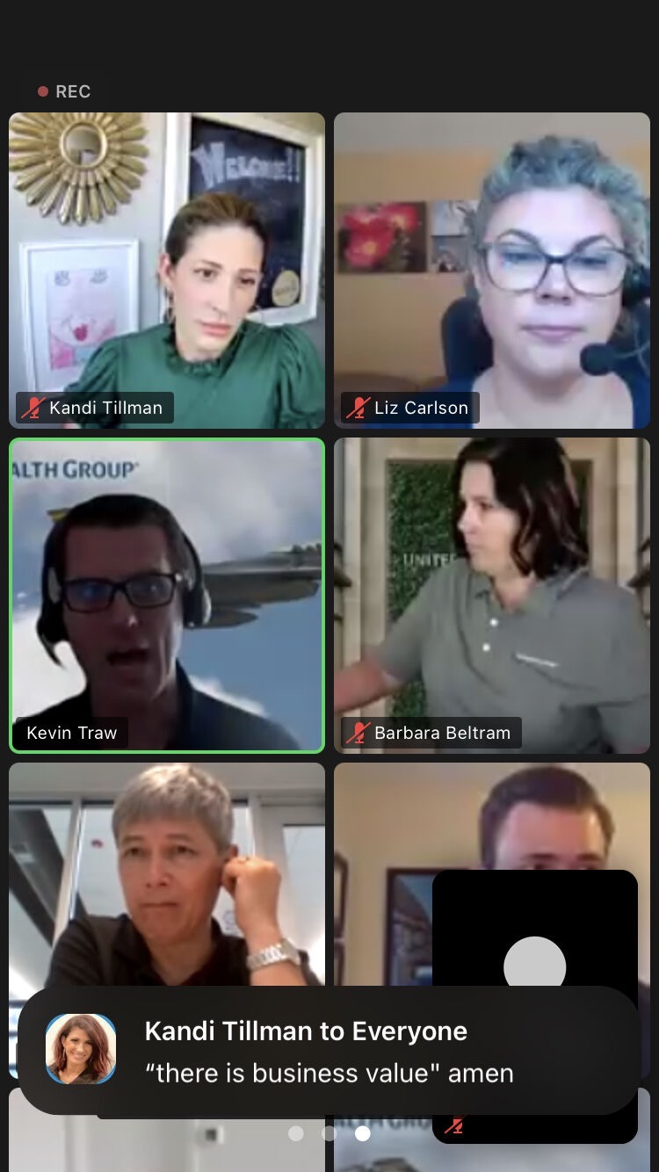
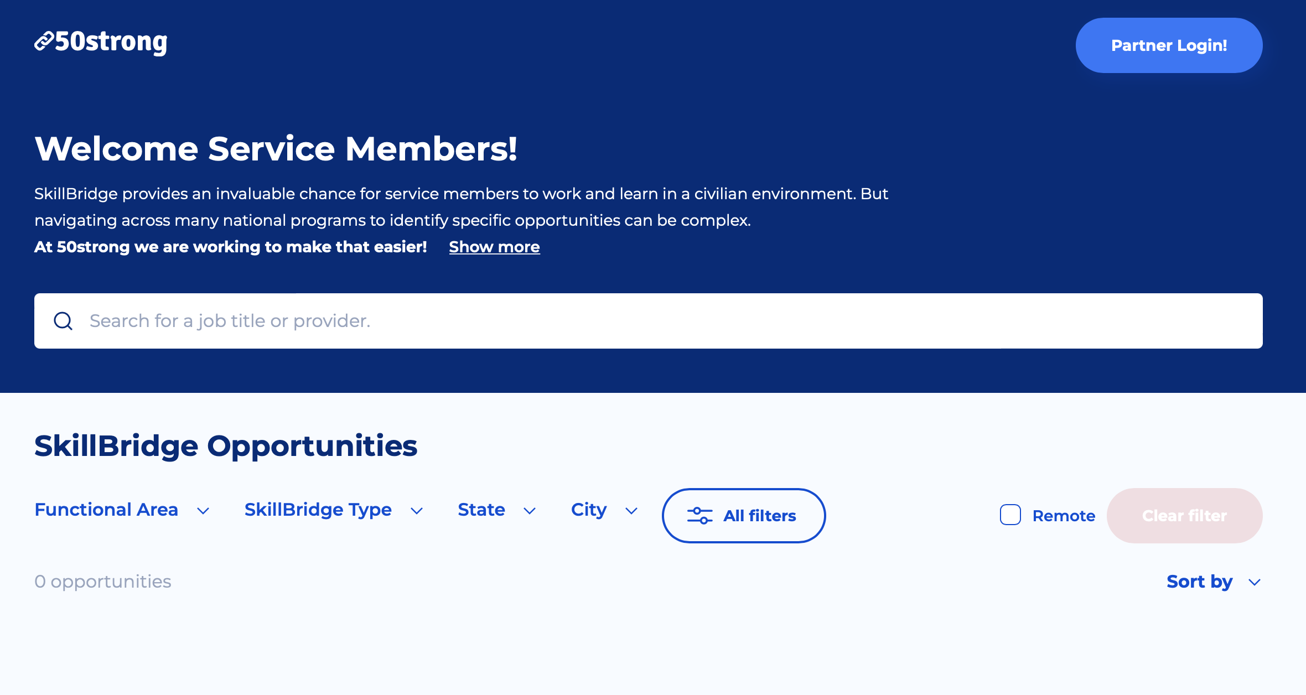
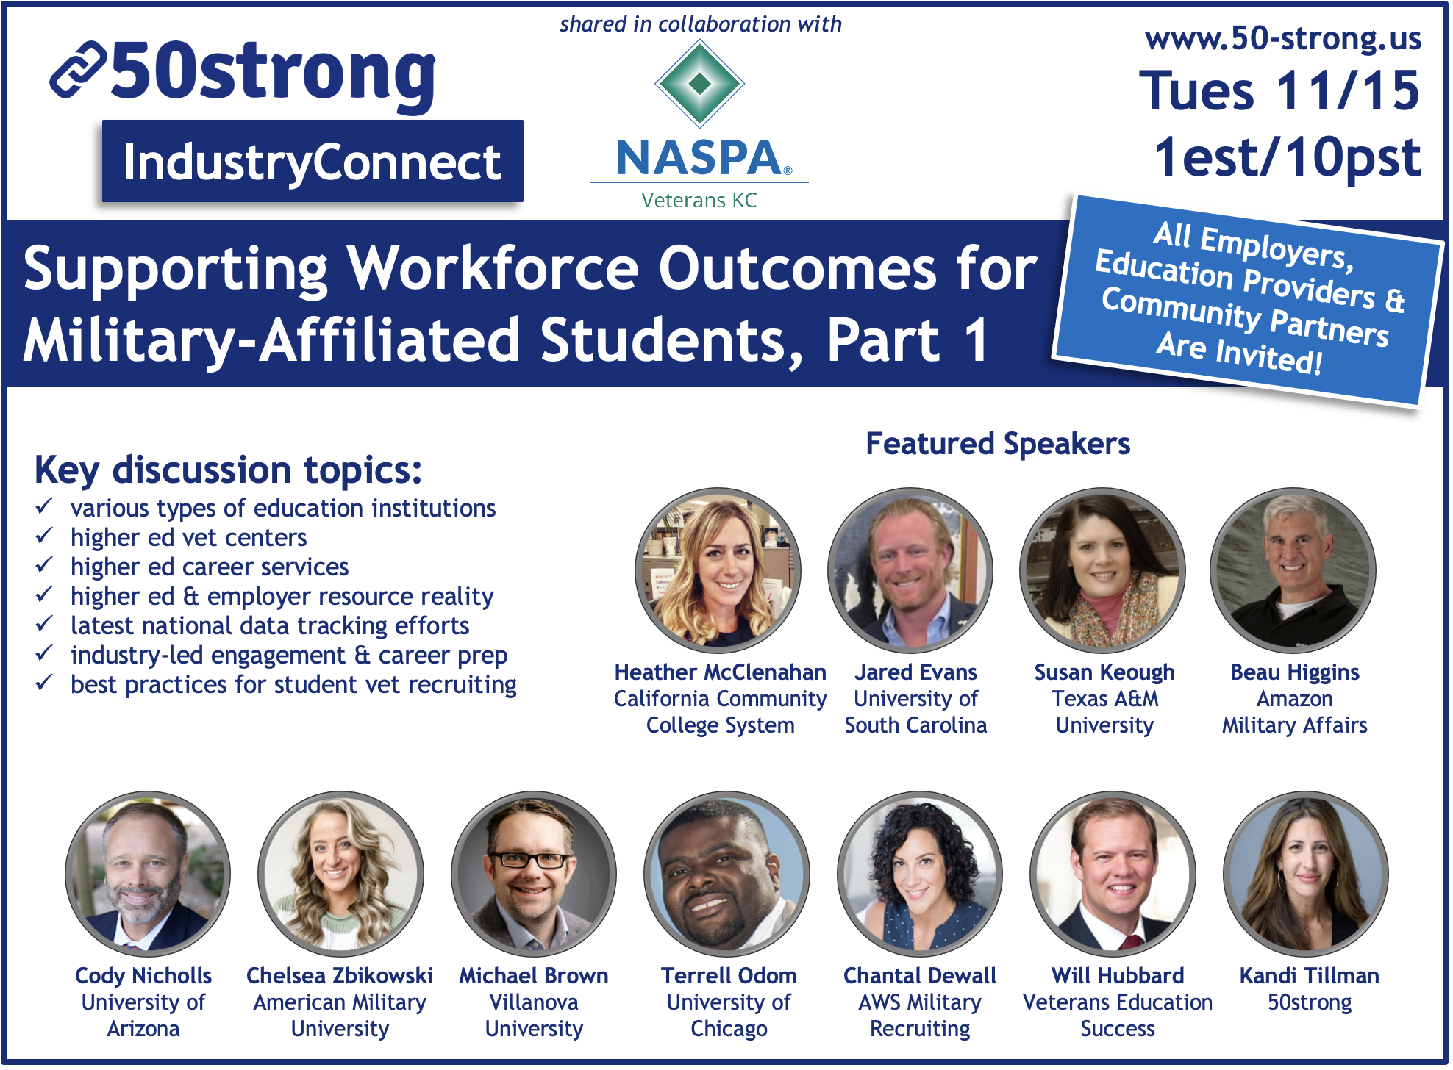
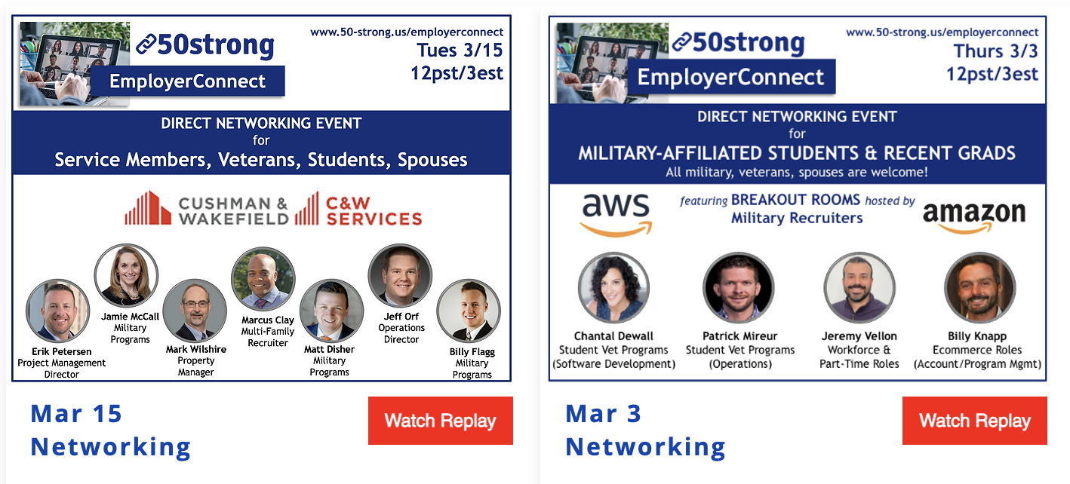
How We Do It
a collaborative, industry-driven workforce effort
made possible by support from
info + RSVPs: www.50-strong.us
MANY participating military-ready employers
virtual & 3-4:30EST/12-1:30PST unless noted *
FOR JOBSEEKERS.
EmployerConnect
All pathways for mil-affiliated students, veterans, spouses, active duty, reserve, guard
SkillBridgeConnect
Specifically for SkillBridge opportunities for active duty service members
FOR INDUSTRY PARTNERS.
IndustryConnect
Based on employer-driven opportunities, pathways, etc
Note: The Department of Defense and Service Departments do not endorse any company, sponsor, or their products or services.
All replays available!!!

Slide 4
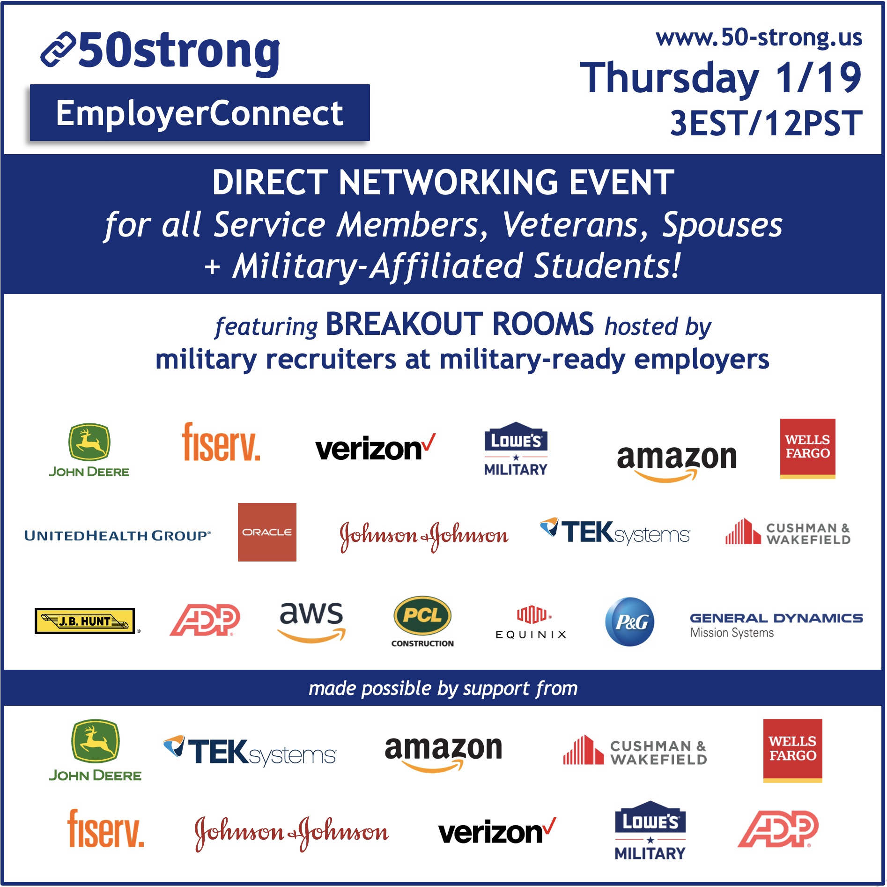
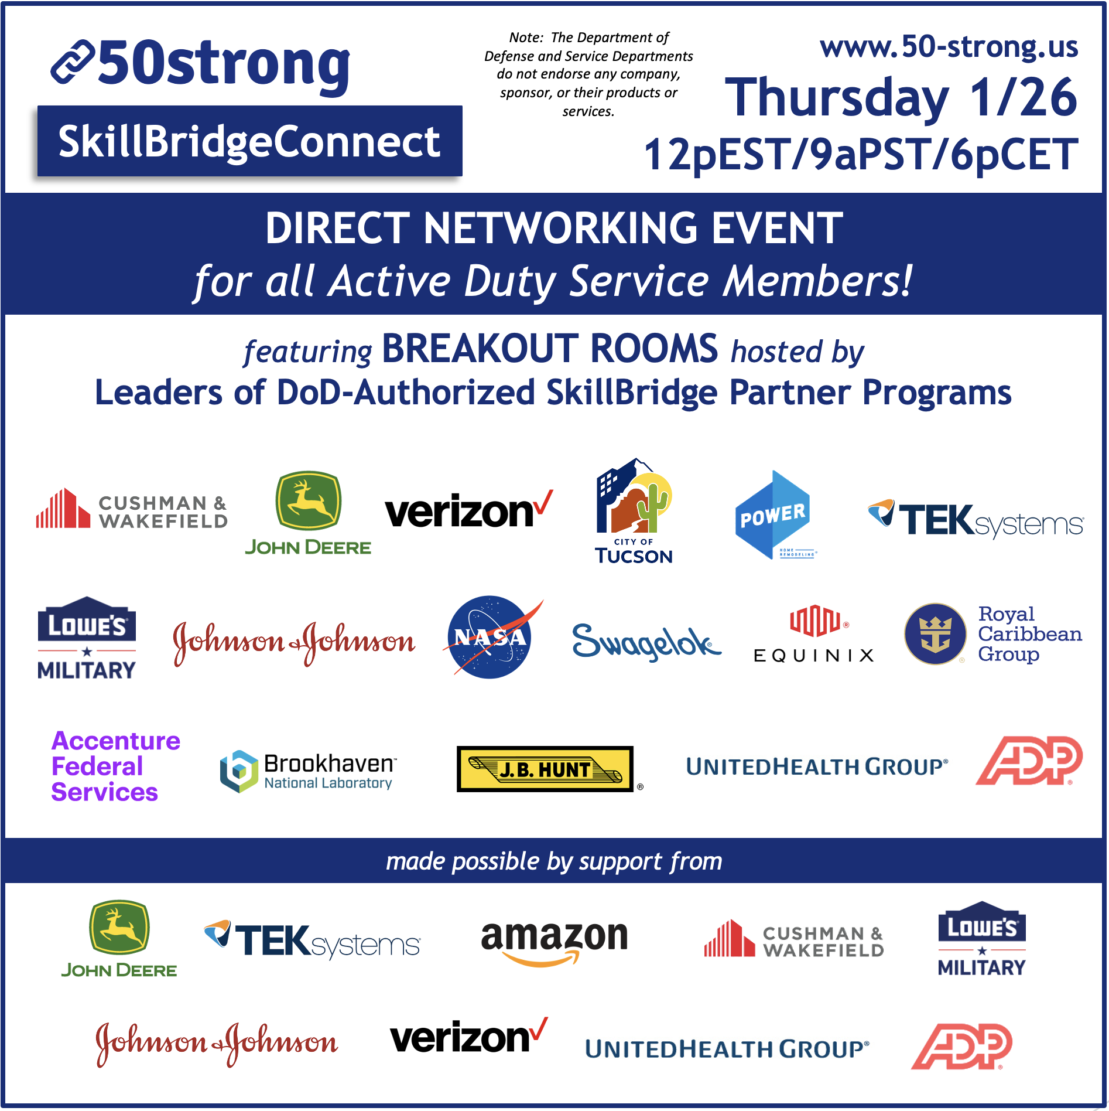

Slide 5
An Example: January 19, 2023
CASUAL. EASY. VIRTUAL.
699 registrants
418 unique logins
64% first-timers

Slide 6
*pre-event registration for
1/19/23 50strong EmployerConnect

Slide 7
“It was an exhilarating experience to have 17 of America's largest corporate employers in one room.
They all shared insightful information about the hiring process, how to search corporate careers pages, and ways to reach out to network with military recruiters on LinkedIn.
I enjoyed that most recruiters in attendance were former service members or veterans themselves."

Slide 8
“Getting an opportunity to learn, listen, and share with 10-15 STRONG companies AND their military talent reps in the span of 60 mins is monumental in the search for my next chapter in life, helping me and my family.
There is nothing more important...”
“This virtual networking event was awesome. I really appreciate that participants were encouraged to ‘come as you are.’ This took the pressure off of being presentable...”

Slide 9
98%
said they found out about new employment pathways at the 50strong event.
*post-event survey for
1/19/23 50strong EmployerConnect

Slide 10
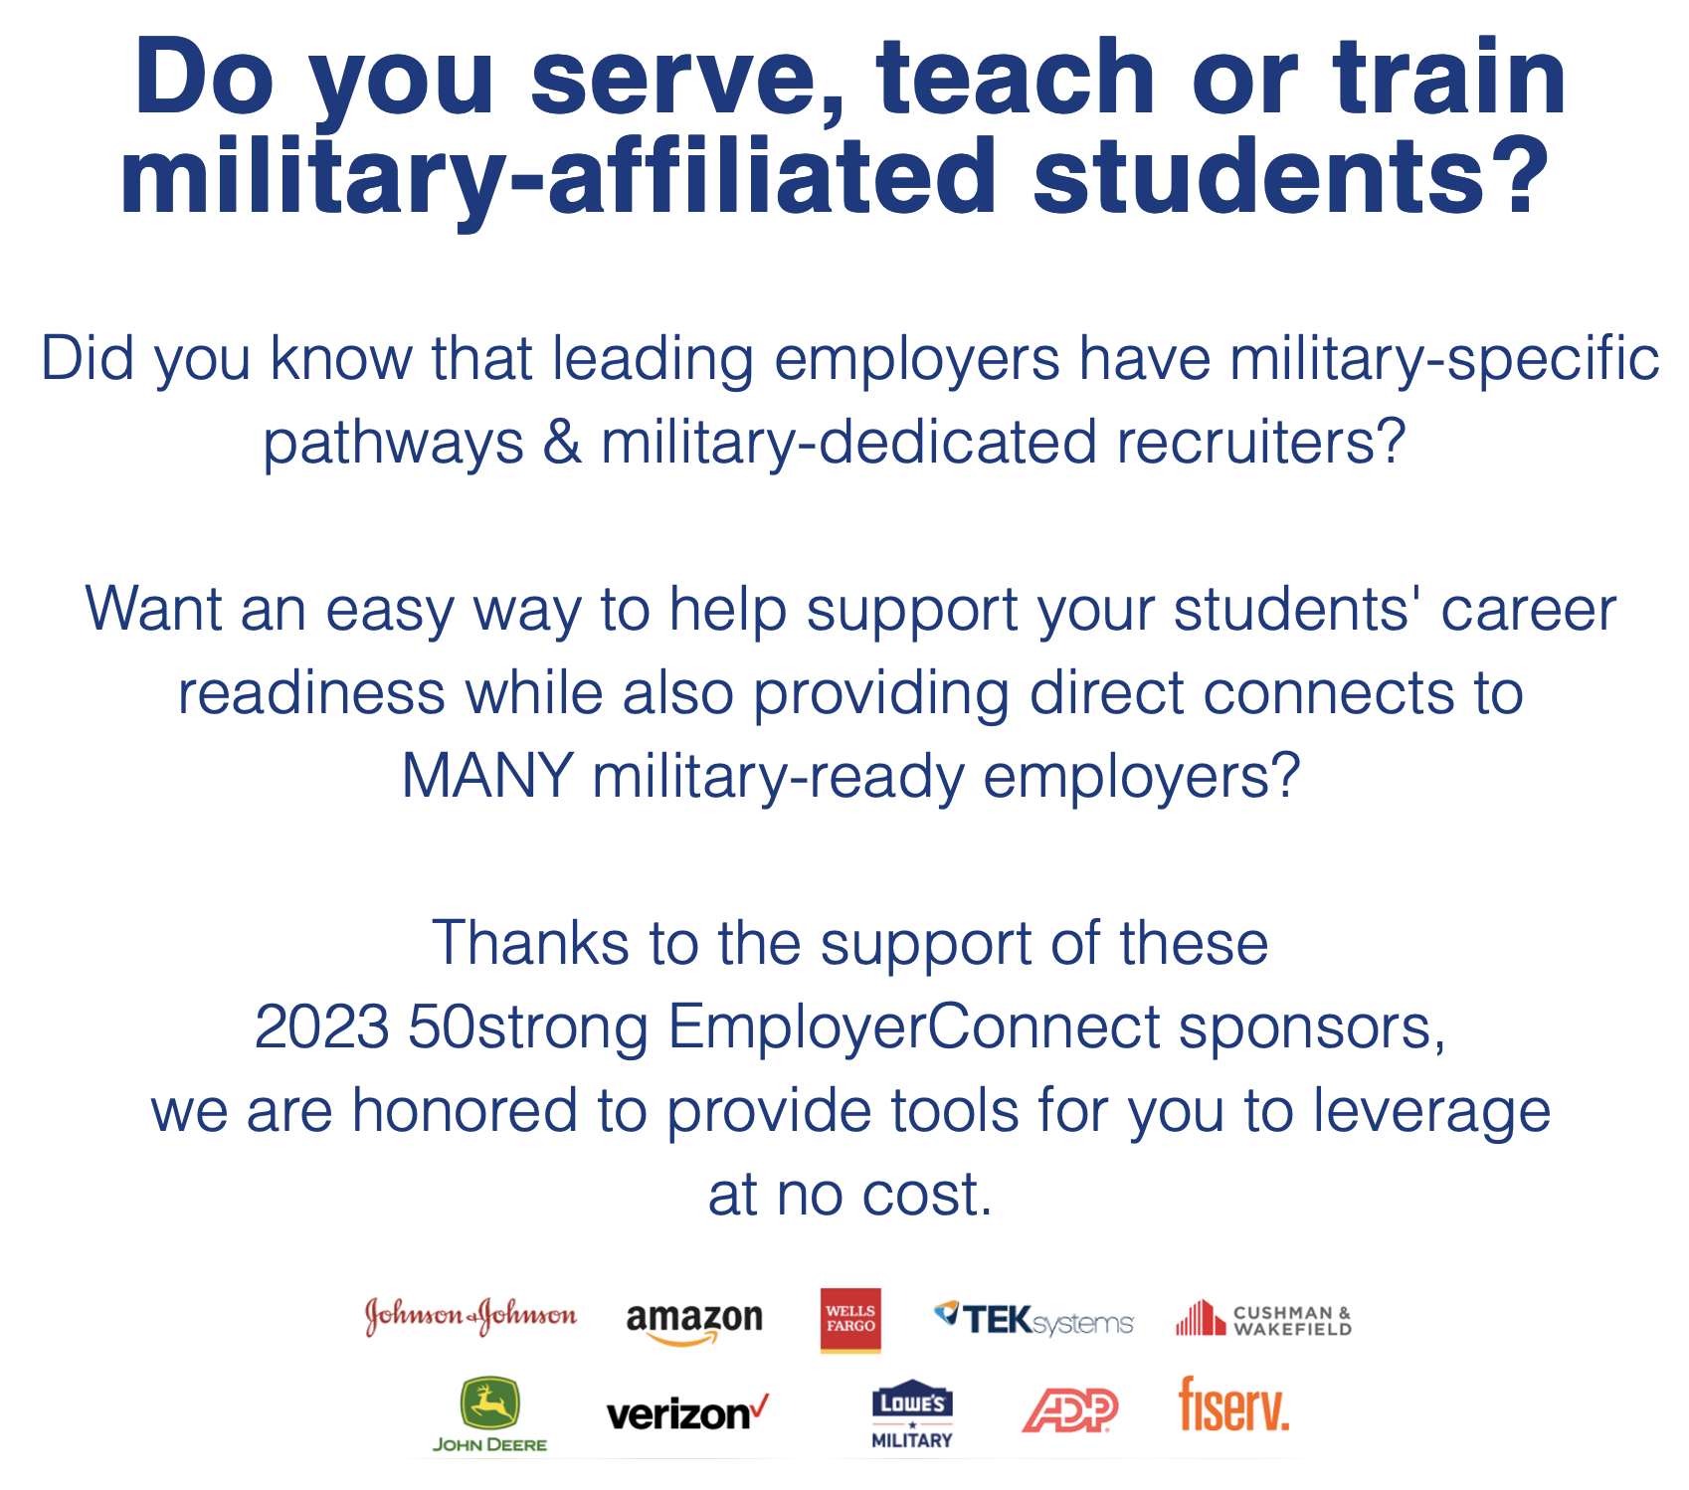
Easily opt into no-fee additional career readiness for military-affiliated students
Focused on Vet Lead/Faculty/Staff enablement vs student-to-student enablement
Collaborate with nationally-leading, military-ready corporate employers
Showcase support for career readiness to drive overall brand affinity
Support community-wide engagement as a workforce leader
www.50-strong.us/
educationpartners

Slide 11
Open Sharing & Dialogue
What is your background?
What is your current role?
How many dedicated Military Talent teammates do you have?
What are your main Military Talent pathways & engagement tools?
How are you thinking about the role of Student Veterans in your talent efforts?
How can Higher Ed partners help?
Michael Piper
David Ottavianelli

