Slide 1
Veteran Services 101:
Pitfalls and Possibilities
Seth Gordon, Ph.D.
February 19, 2023

Slide 2
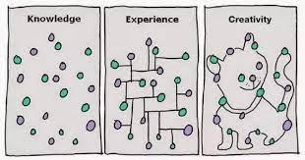
Notes:
What do you know? There is a lot.
What have you learned?
How do we connect them?

Slide 3
Agenda
Introductions – 20 minutes
Theory:
  Strayhorn’s Sense of Belonging
  Wert’s Service Model
  Veterans’ Critical Theory
Practice
  Money: Educational Benefits and Financial Literacy
  Fundraising
  Student Workers and Organizations
  Academic and Social Programming
  Student Employees and Peer Advising
Pitfalls and Possibilities

Slide 4
Introductions
Please take 90 seconds and write down what you hope this session will address.
Please introduce yourself by:
  Your name and title
  Provide a 30 second summary of what you wrote down

Slide 5
Theory

Slide 6
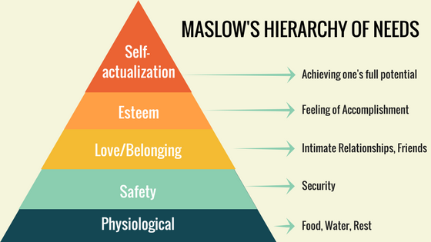

Slide 7
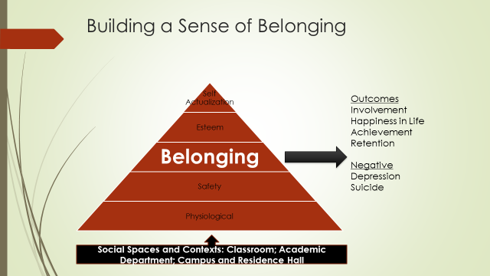

Slide 8
Wert Transition Success Model
Career Employment
Academic Success
Social Support
Medical and Mental Health
Financial Stability

Slide 9

Vision Statement
“Wright State University will be an environment where veteran and military-connected students feel like they belong.”
Self Actualization
Esteem
Belonging
Safety
Physiological

Slide 10
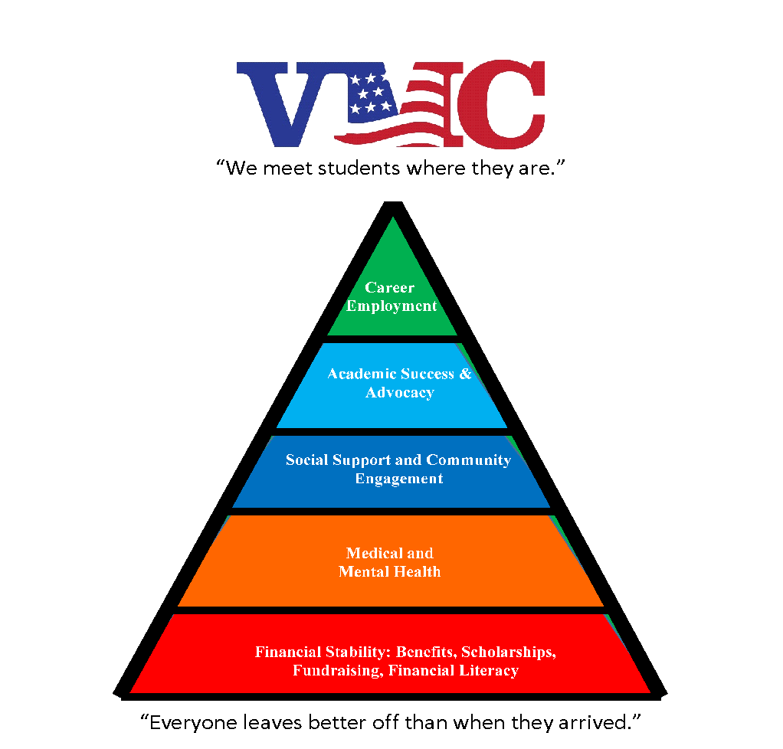
The VMC supports WSU veteran and military connected students in reaching their academic, professional, and personal goals by:
the Efficient Stewardship of Educational Benefits
Providing Academic Support and Advocacy
Supporting Career Development
Facilitating Community Engagement

Slide 11
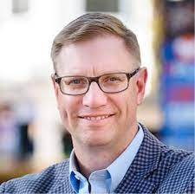
1. What is military friendliness?
“As veterans transition their identities, accommodating spaces and services, along with supportive personal relationships enhance campus veteran-friendliness and by extension student veteran success. (Vacchi, 2020, p.163)”

Slide 12
Critical Theory Perspectives
Feminist Theory
Critical Race Theory
Queer Theory
Disability Theory
Veterans Critical Theory
  Why are women not equal to men?
  What happens when we challenge a patriarchal ideology?
  Why are their systemic inequalities in the execution and resulting implementations of the law?
  Intersectionality
  Why is heterosexuality the norm?
  What happens when it isn’t?
  What is gender?
  Why is gender?
  Is this space accessible?
  Deficit mentality?
  What is universal design?
  Civilian Privilege
  Who has access to their story?
  Don’t thank me for my service.

Slide 13
Tenets of Veterans Critical Theory
Structures, policies, and processes privilege civilians over veterans.
Veterans Experience various forms of oppression and marginalization, including microaggressions.
Veterans are victims of deficit thinking in higher education
Veterans Occupy a third space (country) on the border of multiple conflicting and interaction power structures, languages, and systems.
VCT values narratives and counternarratives of veterans.
Veterans experience multiple identities at once.
Veteran are constructed (written) by civilians, often as deviant characters.

Slide 14
Why do we do what we do?
Do you know what the mission of your office is?
What is your vision?
How well does it align with your institutions mission and vision?
How often do you actually have time to think about your mission?
Has anyone articulated what success for your organization or office looks like?
If yes – can you operationalize it?
If no – can you ask someone?

Slide 15
Wert Transition Success Model
Career Employment
Academic Success
Social Support
Medical and Mental Health
Financial Stability

Slide 16
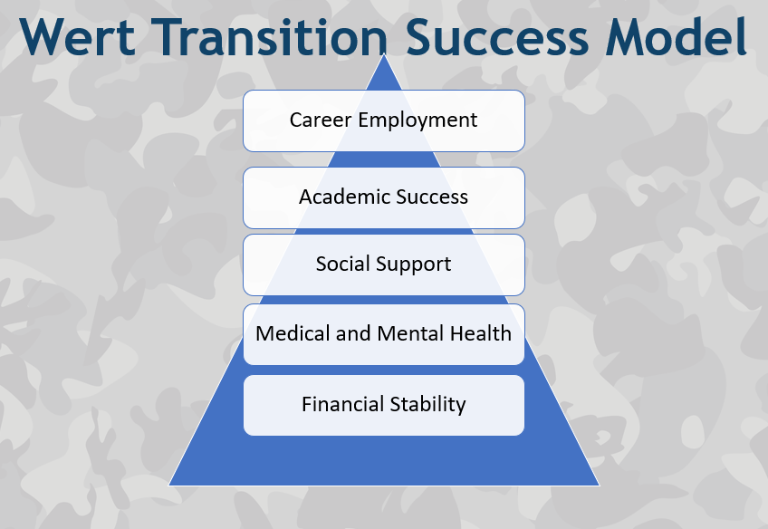
Financial Stability
1. FAFSA
2. Maximizing Benefit Use
3. Emergency Funds
4. Financial Literacy Training
5.
Medical and Mental Health
1. Campus Counseling Center
2. Vet Center
3. Physical Activity
4. Mindfulness
5.
Social Support
1. SVA Chapter
2. Student Orgs
3. External Fraternal Orgs
4. Informal Collision Space
5.
Academic Success
1. Academic Support Awareness
2. School Supplies
3. Book Fund
4. Student Success Intervention & Coding
5.
Career Employment
1. Resume Workshops
2. Internships
3. Work Study Opportunities
4. Career Assessments
5.

Slide 17
Practice

Slide 18
Who are our Veteran and Military Connected Students
Facts about WSU Student Veterans and Military Connected Students:
About 70% Men/ 30% women
Age range is between 19-60; Average is age is close to 30
About 90% are former enlisted
About half may be from the Air Force followed by the Army, Marines and Navy. Not many Coast Guard.
About a Third of the individuals we Certify are Spouses or Dependents
In the Fall about 50 Ohio National Guard Students
Top Ten Majors:
  Biology
  Business Administration and Management, General (#1)
  Computer and Information Systems Security/Information Assurance,
  Computer and Information Systems Services
  Management
  Criminal Justice/Police Science
  Engineering, General,
  Finance, General
  Nursing Practice/Registered Nurse (#2)
  Psychology
  Social Work

Slide 19
Drivers of Practical Success
Compliance
Education
Engagement
Advocacy
Notes:
This is one way to tell this story.

Slide 20
Wert Transition Success Model
Career Employment
Academic Success
Social Support
Medical and Mental Health
Financial Stability

Slide 21
Important Drivers for our offices and for our students
Compliance with:
  The VA and our State Approving Agencies and Auditors
    Reporting enrollment changes, grades, and dismissals
    The cascade that one change can have on all of the others.
  The DOD MOU and its requirements.
    the Principles of Excellence and
    the Eight Principles of Success.
    Use of TA and windows for use
  The National Guard scholarship deadlines for applications
  Title IV Funding and deadlines
  Internal Scholarships and their interactions with all of the above.

Slide 22
Military Educational Benefits
You must know more than the basics
If it’s not a little bit confusing you are probably doing it wrong.
Know how to find information and how to send people to it.
Have your students users make guides for the peers
Understand your own campus policies and processes.
Understand timelines and implications of change.
If you are not the SCO or an SCO on your campus then get to know that person.

Slide 23
Military Education Benefits Sources
GI Bill Comparison Tool
Your ELR (ours can be)
TA Decide
The SCO Handbook
Your State Approving Agency
The DOD MOU
The VA Website – Google by Benefit
Military.Com
And most importantly – each other!

Slide 24
Drivers of Practical Success
Compliance
Education
Engagement
Advocacy
Notes:
This is one way to tell this story.

Slide 25
What do we need to educate students about?
Compliance-
  What do they have to do to be students?
    Using their benefits?
    How to maximize their benefits and not use them up before they graduate?
    How are their benefits influenced by their academic performance?
      We cannot serve them if they are not students.
How to be successful students?
  Campus academic support resources
    Tutoring, Writing, the Library (private study spaces)
  The best guides are other students who are met in informal ways.
    How do you create opportunities to orchestrate that?

Slide 26
How best to educate our population?
Communicate, Communicate, Communicate.
Get to them early and often
Plan your communication around three things:
- The Enrollment Funnel
- The Academic Calendar
- Your campuses cultural touch points and expectations around veteran and military culture.

Slide 27
Educating Your Colleagues
Who
  Fellow Staff Members:
    Advisors – Focus on the tactics of benefits use; if they do “X” then “Y”
    Admissions – How do military educational benefits mix with other financial aid – like scholarships, and financial aid
    Office of Disability Services – what ever it takes. Avoid the “H” word
  Trainings
    A well rounded Green Zone training that covers benefits and basic knowledge of the military and what it means to be a veteran or a citizen soldier.
      The Student Panel is the most important part
    Faculty: How to work with veterans and military connected in the classroom
      How does the VA work with medical appointments
    Encourage veteran specific mental health trainings.

Slide 28
Communication
Use ALL means of communication:
  Email – fast, cheap and easy – focus on small bites
  Text – very sparingly
  Phone – have a good method to track
  Social Media – single messages
  Print – expensive, use when needed
  In person – beware of “mandatory”

Slide 29

Your future students have questions about how their benefits will work at your school.
Plan communications and activities around each element.
Attend All Open Houses and Admissions events. Be prepared.
Create or attend information sessions.
Have Yield Events that focus on admitted students. Drive them to your veteran and military specific orientation.
Your academic calendar has specific benchmarks related to registration, add/drop, and other markers like:
Dropping without a grade
Next semester registration
Graduation Applications
Financial Aid Deadlines
Scholarship Deadlines
These drive other deadlines for:
Federal Tuition Assistance
VA Ed Benefits
National Guard Scholarships
Communicate by segment to your constituents. Teach them.
Remind them.

Slide 30
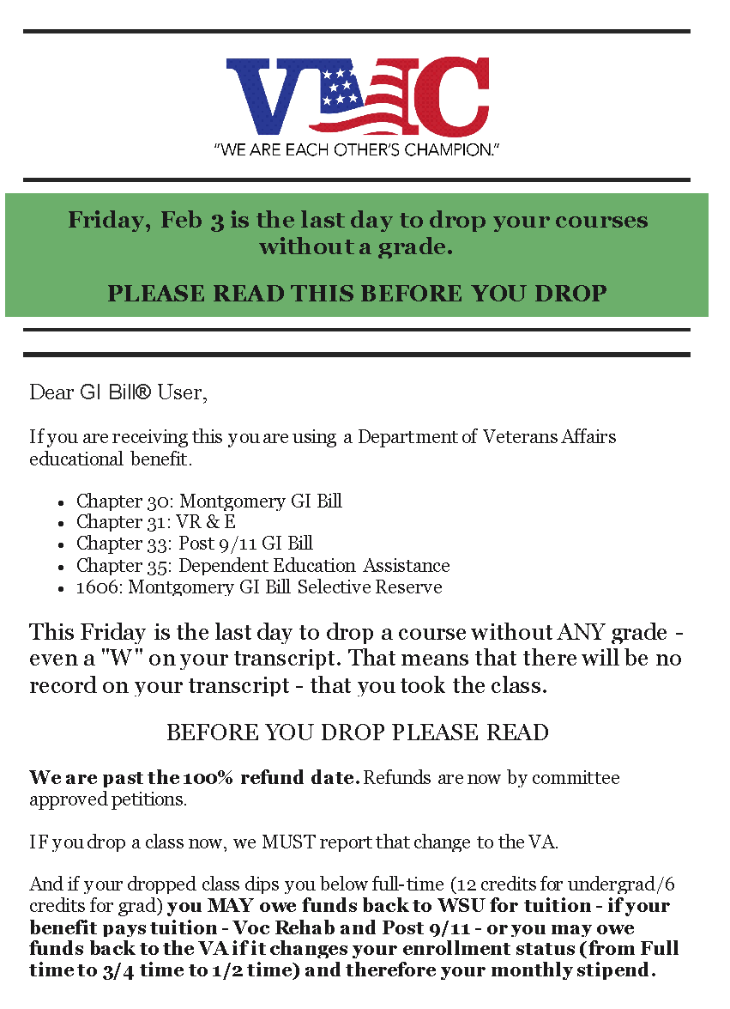
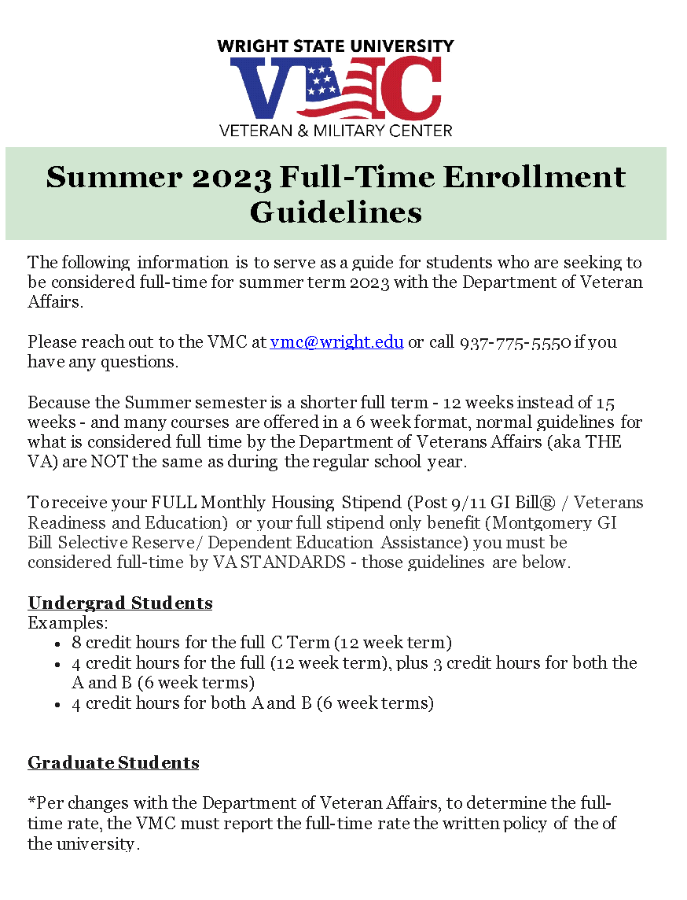

Slide 31
Academic Calendar | Compliance | Social/Cultural | Current Students | New Students

Slide 32
Academic Calendar | Compliance | Social/Cultural | Current Students | New Students
Term registration | First Certs | Major Mixer – Social with Alumni | Open certification for next term | Introductions - Prospective
First day of school | FTA Windows | Service Open House | Reminders for 100% Refund | What resources do you have - applied
100% Refund | Reporting Graduation | Campus Events | Event notifications | You need to do this - Accepted
Last day to Drop without a grade | Reporting Non-Attendance Grades | Superbowl Potluck | Check-ins | How to activate your GI Bill
Last day to drop with a W | Reporting Dismissals | Graduation Pictures |  | How to use the Ohio War Orphan Scholarship
Mid-Term Grades | National Guard Deadlines | Alumni Golf Outing
 |  | Fall Fest
 |  | April Craze

Slide 33
Drivers of Practical Success
Compliance
Education
Engagement
Advocacy
Notes:
What do they need to know?
How are they gonna get to know it?

Slide 34
Wert Transition Success Model
Career Employment
Academic Success
To get to this
You need this
Social Support
Medical and Mental Health
Financial Stability
  Sense of Belonging + Motivation = Persistence
  Course Completion + Persistence = Progression
  Repeated Progress = Retention = Graduation
Notes:
Red: We need to teach our students how their benefits work. And that can mean getting to know them
Yellow: Teach about campus and community resources; minimally know where the information is and how to refer students
Green: Camraderie – Belonging – this is what they all miss and what we are trying to provide with engagement. They may be wary of clubs; Rememember belonging “somewhere” is what it is all about.
- An on campus job
Blue: Teach and engage around campus academic re

Slide 35
Engagement and Education
Prior to Being a Student
After becoming a student
The stealth student – make sure your web content and emails can direct a student through your maze
Push towards an in person orientation.
  Teach them to reach out to you before they quit.
Communicate important deadlines & resources
Remind and Remind Again
  CYA against “No one told me.”
Host academic success workshops
  e.g. master syllabus workshops
Host social gatherings
  Beware the stigma of “Forced Fun”

Slide 36
Student Work Study: VA and Regular
Models: If they are there they will bring their friends.
Super Simple: No programming – just have people to assist with the work or to have a presence.
Create work that improves your center.
  Trust your students.
Programs: Role Specific, but still within your center.
  Peer Advisors
  Advocates: NVLF
  Parent Coordinators, Veterans Voices, Community Engagement
Student Veteran Associations and Clubs
  Support them if you have them; Encourage them if you don’t
  Do not force them if you don’t have to.

Slide 37

Events and Gatherings
Explore and Experiment
Orientations
Social Events: Major Mixer
Academic Success Events
Career Oriented Events – Resume Building, Etiquette Luncheon, Guest Speakers
Graduation Events – Coining Ceremonies; Graduation Photos
Potlucks – Super Bowl
Gaming Competitions – Game Nights; Darts; Corn Hole; Golf
Leadership Speakers – Local – Successful - Former Enlisted
Competitive Activities that are Family Friendly Bowling
Sporting Events – get the President’s Box
Visit a veterans Museum
Go to Career Fair
Veterans Day Activities
Memorial Day Activities
July 4th

Slide 38



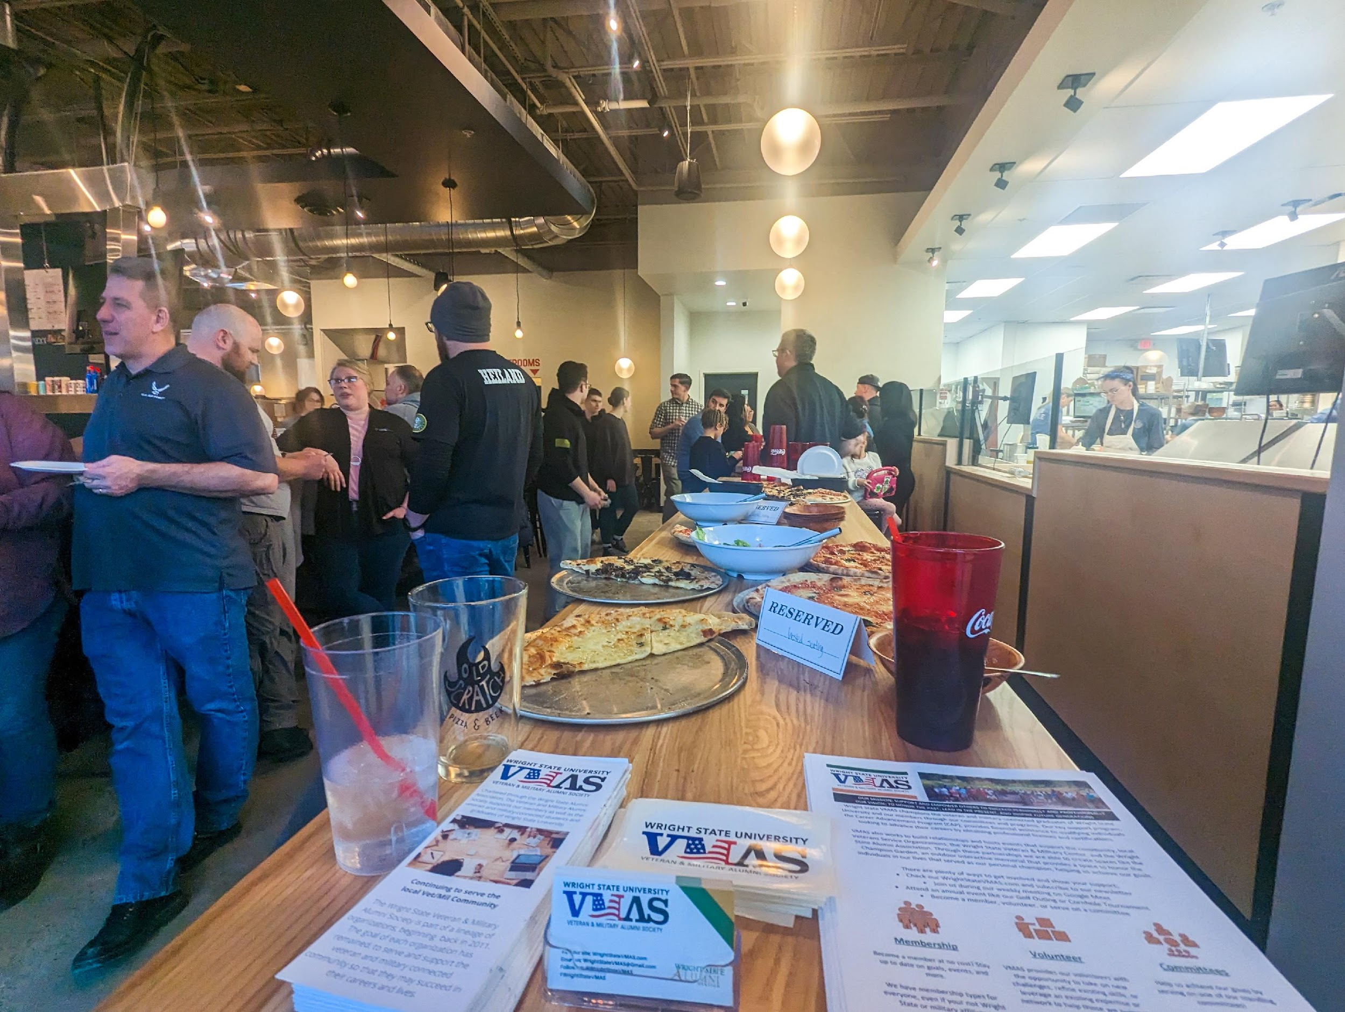


Slide 39
Who are your partners
Partner with other offices on campuses. Find Common Ground.
Multi-Cultural Affairs professionals are doing identity based programming just like you. Get to know them.
Counseling and Wellness and Student Support will work with your students whether you know it or not.
Student Legal will too.
Do Women Specific Programming. It’s ok for there to be a separate space for this even if some of your constituents don’t get it.
Since college is a place to learn; teach them to be interact with groups different then their own.
Notes:
Military.Transition.Org

Slide 40
Drivers of Practical Success
Compliance
Education
Engagement
Assessment
Advocacy
Notes:
This is one way to tell this story.

Slide 41
Assessment
What can you easily count that will demonstrate what you do?
If you can, know how many student use benefits and the economic impact of that population.
Evaluate your workshops and events
Ask. Them. What. They. Want.
  Don’t be surprised when they don’t show up.
Survey your population:
  Short is better than long – make sure it can be done on a phone
  Look at:
    Their benefit use experience
    Their Sense of belonging
    The services they use; the services they want

Slide 42
Drivers of Practical Success
Compliance
Education
Engagement
Assessment
Advocacy
Notes:
This is one way to tell this story.

Slide 43
Advocacy
Where does your campus evaluate high risk students?
  Be there if you can be. E.g. Care and Concern Committee; Mental Health Task Force
Train your students to reach out to you before they get angry.
  They all know how to be polite and persistent.
Be as honest as you can with your students about likely outcomes.
Don’t promise anything.
Do not assume the students perception of the issue is correct until you hear the other side. Most often – being the translator can solve it.
Get to know your colleagues in the Bursar’s Office, Financial Aid, Registrar, Student Support, and Conduct.

Slide 44
Fundraising
Know the what and why you need funds before you start doing this.
Make Friends with your foundation. Give them your “why” presentation. Let them raise money for you.
Create funds for different things:
  Keep your options as broad as possible - e.g. student wages
  Annual Reporting Fee Funds – make sure it does not get hoovered
  VMC Excellence Fund – Discretionary
  Boots to Books – Emergency
  Scholarship – Discretionary around bills; Cost of Attendance
  Project or issue specific:
    WPCU Student Success Fund (Endowed)
    Veteran Voices Project Fund

Slide 45
Sources of Funds
Alumni
Fraternal Organizations:
  You have young veterans; they have money.
Corporations
Grants – look in unlikely places like Humanities etc.
  LOTS of work; Lots of Strings
Gifts to your funds
  The more open ended the better
Other offices – partnerships can yield funds

Slide 46
Break

Slide 47
Pitfalls and Possibilities

Slide 48

Notes:
Motivation for doing this session

Slide 49
Agenda
Why talk about failure
Who did I talk to
Is there a there… there?
Lessons Learned
Reflective Practice
Discussion

Slide 50

Hazards in the Workplace

Slide 51
Experimentation and Exploration
Getting Veterans Together
Allowing for a kind of “flexible professionalism”
Getting Veteran Together and having them acknowledge each other
Asking for them to exercise better “situational awareness”
Removing gathering spaces for inappropriate behavior.

Slide 52
“Is there a there there?”
Patti Lather
Initial qualitative exploration

Slide 53
Three questions:
1.What practices, tactics, or strategies did you utilize when you first began working with student veterans that did not work out as planned?
2. What did you learn from those experiences?
3.Did any other those challenges become other opportunities for growth?

Slide 54
Who did I talk to…
Non-Veteran former VA counselor now Director at a mid-sized regional public
Current Army Reservist and a Director at a Private Non-Profit
Former Guard member, served 12 years as a Director/ Assistant Dean in large Public
Retired Marine Col. Working at a flagship Large Public Research 1
Non-Veteran recently took on SCO duties at a metropolitan private Non-Profit
Army Veteran worked with veterans and now develops statewide policy
Army Veteran Director at regional undergraduate public flagship
Non-Veteran Director at Large Regional Public
Non-Veteran who had worked with veterans but is not currently
Army veteran and former VA student worker and GA reviewed this presentation

Slide 55
Lesson 1: Tradition only matters if it matters
Doing it before doesn’t have to mean doing it now.
Just because another school is doing it – doesn’t mean you have to as well (aka Keeping up with Jones’)
“Stay focused on the mission; not on reputation”

Slide 56
Lesson 2: It’s ok to have standards & boundaries.
Dealing with entitled veterans who may take advantage of empathy, and goodwill.
“Being naïve about believing everything they say.”
“Sometimes student veterans have bad ideas.”
Not everything they did in the military will work in higher education.
“Don’t let the inmates run the asylum.”
  Aka “this isn’t a real job.”
Try to meet them where they are.
  Teaching how to adapt
Notes:
.

Slide 57
Lesson 3: Trust both your instincts AND the Data
Observation is good – but not for as long as you may think. It is ok to act right away if you think so.
If you don’t know – ask.
  Survey; hold focus groups.
  Build what they ask for … within reason – sometime the same students who are asking for things will not attend what you build.

Slide 58
Lesson 4: Higher Education is different.
More passionate about the mission than higher education may be comfortable with.
Align yourself where you can get the most advocacy and support for your student population.
Be Political if it will benefit your work.
Be Seen

Slide 59
Lesson 5: Find the tension between structure and unstructured
Trying hard to create a peer mentorship program requires students to want to participate in something formal – sometimes too formal.
“Lumping all Veterans into a single box that resulted in poor, ineffective, and alienating programming. - Developed too many narrowly focused programs”
Create opportunities for informal mentorship aka friendships
  Need to know where the resources are and how to find them when they need them

Slide 60
Lesson 6: Communication needs to be personal and multi-modal
How we communicate with veterans matters and can be frustrating when we use all avenues (email, phone, personal invitations, print, etc…) and still see small results.
Students want and respond to more personalized emails and holistic practices.
Creating a singular and accessible point of contact can make all the difference.
“many veterans were very happy that an event occurred even if they did not attend it. The fact that the event occurred brought them a sense of belonging.” – Report out how the event went.
  Lack of attendance is not deterrence; veterans don’t go to things the first time.

Slide 61
Lesson 7: Galvanize your network
Student veterans may or may not respond directly to programming or support from the veteran office.
When systems of support are flawed – the impact on student veterans is noticeable.
“Green Zone” trainings, structured conversation, and re-occurring updates can disseminate your message and engage others in providing support to veterans.

Slide 62
“If you are not making mistakes, you are not trying?”
Will Austin, President Warren County Community College
Engage in Reflective Practice – the process of critically analyzing past practice to create a cycle of adaptation and learning.
  After Action Reviews
  Keeping a Journal
  Creating a managerial space where discussing mistakes is cultivated and rewarded rather than demeaned.

Slide 63
Discussion
What are the failures that taught you the most?
What did you learn?
Has that manifested into programs/services/etc…?

Slide 64
seth.gordon@wright.edu
Director
Veteran and Military Center
937-775-5553

