Slide 1
Factors in Building a Physical Veteran and/or Military Connected Student Center
NASPA Veterans Conference
February 9th, 2015

Slide 2
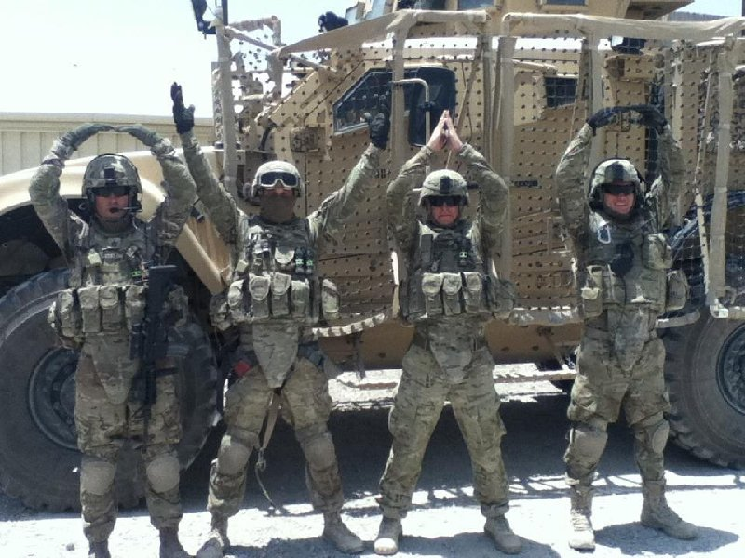
Office of Military & Veterans Services
• Mike Carrell • Assistant Provost & Director

Slide 3
Issues facing the University
Does This Sound Familiar?
Growing Number of Military & Veteran Students
Rising complaints from the cohort
Lack of Dedicated Resources--Who is the advocate?
Lack of Understanding from Faculty & Staff, but desire to help
Growing Regulation/Guidance from Federal & State
University Concern/Desire
Better Serve These Students
Don’t Re-invent the Wheel
Leverage our Strengths and Current/Previous Efforts
Want to be more Effective and Efficient
Position for the Long-Term

Slide 4

Strategy for Action
How to better deliver Military & Veterans Services?
Why are we doing this? VITAL !
What do our students want/need?
What external requirements are levied on us?
How do we compare to our peers and in Ohio?
Roadmap to make OSU The choice for Military & Veterans
Academic Success
Build Trust with Veterans, Military, & Families

Slide 5
Importance of “Why”
Where does this office “sit” administratively?
Who Funds it?
How do we decide Priorities when pulled in several directions?
What do we do when we don’t have enough money?
Who will help us or Champion us?
Other Issues
Veteran Lounge
Co-Locate or Not to Co-Locate / In or Out of the Union/Hub?
Centralized Location or Better Space?
Development Balance
Community Involvement

Slide 6
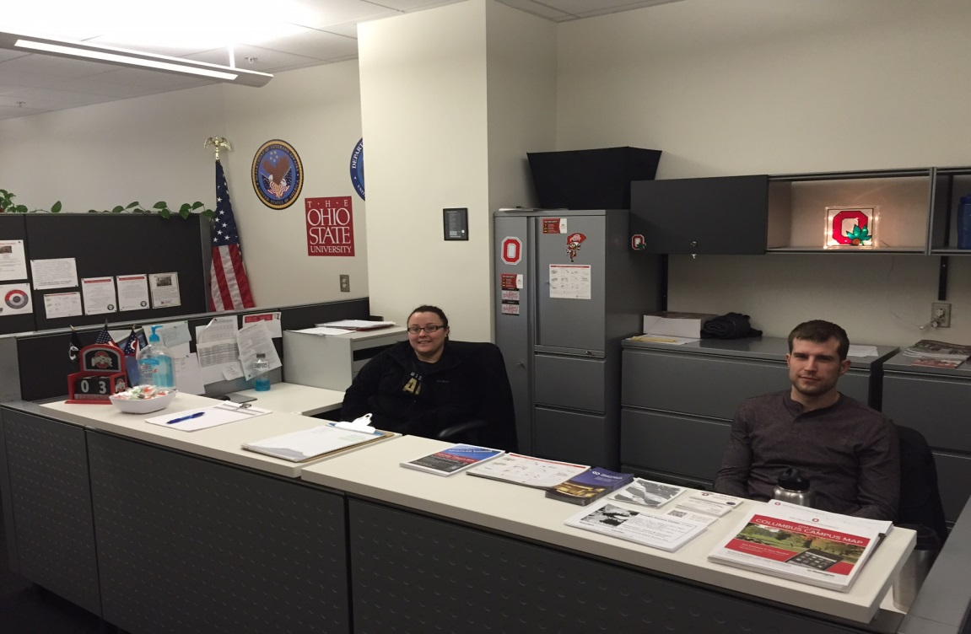
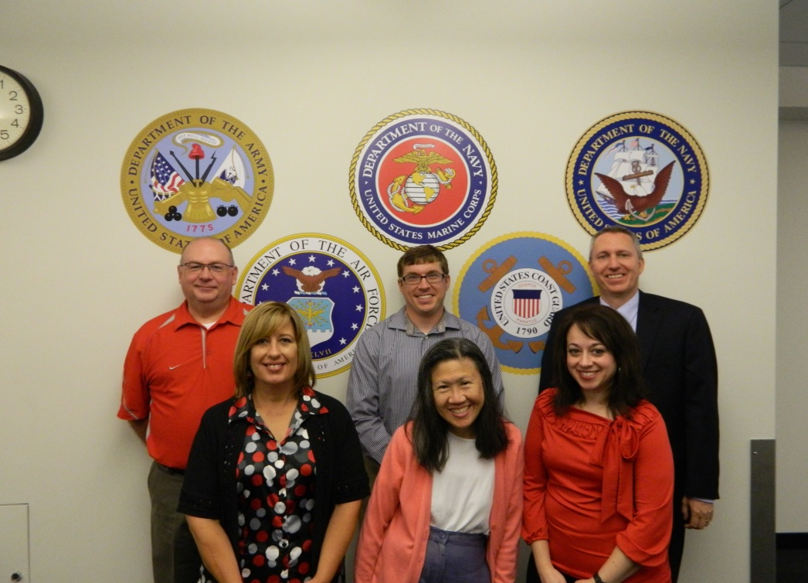
Military & Veterans Services
New Office, Expanded Roles
Seamless Benefits Processing
Collaboration on Provided Services within and outside of OSU
Educate & Train Faculty & Staff
Cut Through Bureaucracy/Red Tape for Students -- Advocate
Serving Our “Buckeye Military Family”

Slide 7
Provost
New Office Construct
VP Student Life
Vice Provost / UE Dean
VP Strategic Enrollment Planning
Counseling & Consultation
Asst Provost for Military & Veterans Services
VA “Vet Success on Campus” Employee
Visiting Counselor
Director Veterans Transition & Services
Academic Advisor
University Exploration
Sr Veterans Benefits Specialist
VA-Funded Work Study Students
Veterans Benefits Specialist

Slide 8
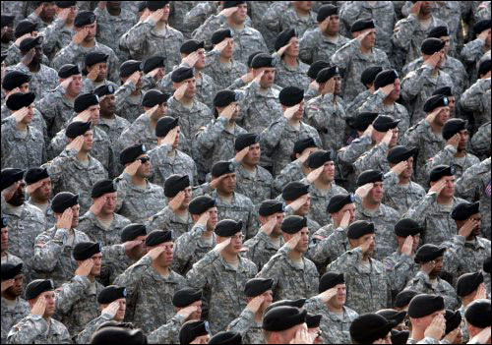
Military & Veterans Services
“We truly believe that no one office should ‘own’ military or veteran students in a university, but rather everyone must, as every entity makes a critical contribution towards their success.”

Slide 9
Nontraditional and Transfer Student Services
… at BGSU includes Veterans and the “under construction” Veterans Center
Barbara Henry, Ph.D.
Assistant Vice President NTSS

Slide 10
Benchmarking for Your Institutional Type
High Impact/Best Practices
Do your research
Anticipate the Tough Questions
Location, Location, Location
Know who your students are…
Peer Institutions - What are they doing?
National “best of the best” examples

Slide 11
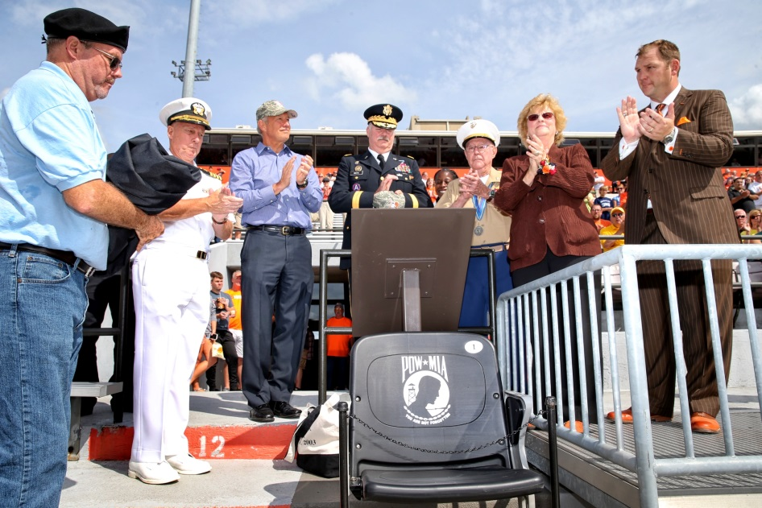
Identify Your Political Allies and Supporters
Administration
Alumni
Board of Trustees
Faculty and Staff
Community
State Government
Student Veterans and Military Community
Capitalize on Best for Vets/Military Friendly

Slide 12
Identify Your Barriers and Challenges
Funding
Space/Location
Access
Lack of understanding of the “Why”
Status of Student Veteran Club

Slide 13
Advocacy
Fund Raising (add to your proposal)
Alumni, local organizations, politicians
Space/Location (reality vs. dreams)
Key stakeholders
Know the role of “rankings’ on your campus
Use media stories
Voice of the students

Slide 14
The Most Important Resource for Success
Our Students:
Veterans, Service Members and their Families
Our Alumni
Continuing the conversation
Tenacity

Slide 15
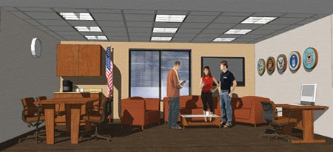
“UNDER CONSTRUCTION” VETERANS CENTER

Slide 16

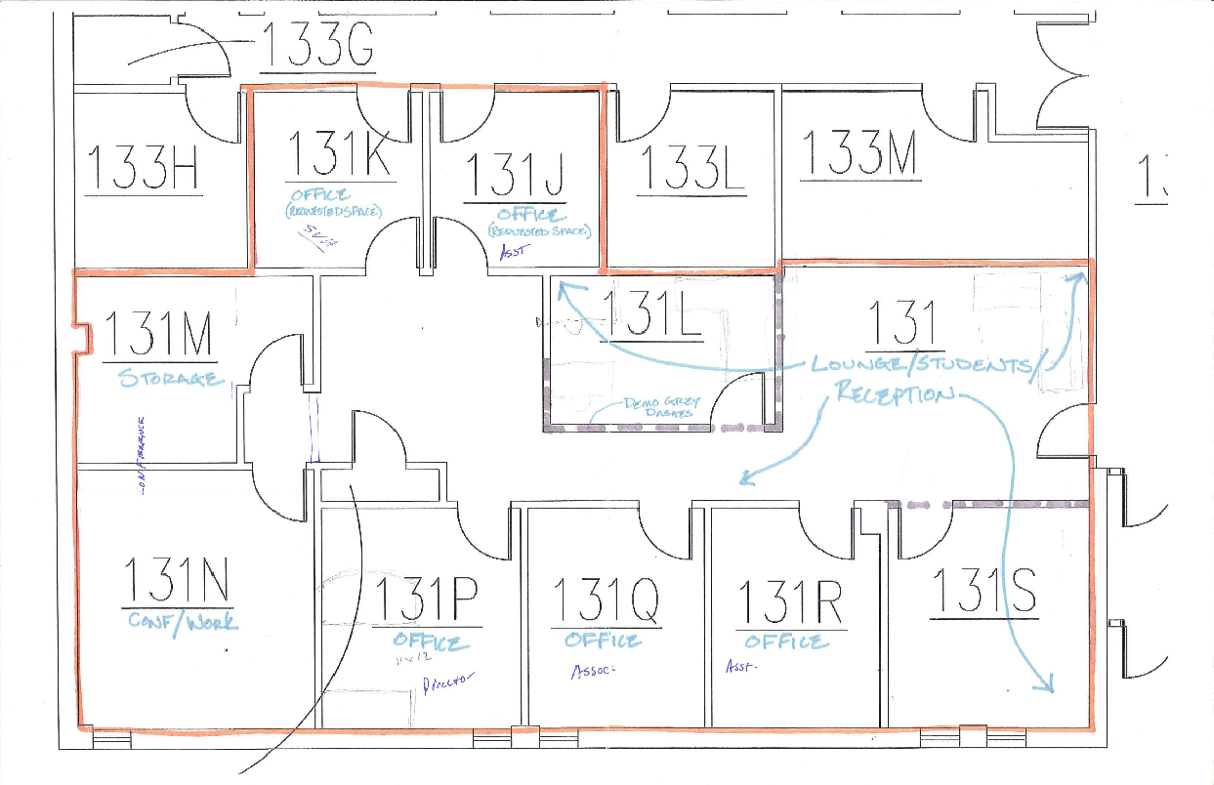
Building A Center
We mold clay into a pot but it the emptiness inside that makes the vessel useful.
Lao zu, Tao Te Ching 11
Seth Gordon, Ph.D
Director, Veteran & Military Center
NASPA Veterans Conference, Louisville, KY
Notes:
Talk about WSU; founding of the VMC. Aug 2013
Always told a space was forthcoming
Resources not an issue
Certify benefits for 750 students; plus the unknown.
Temporary Space was in a good location; would not renovate for 18 months

Slide 17
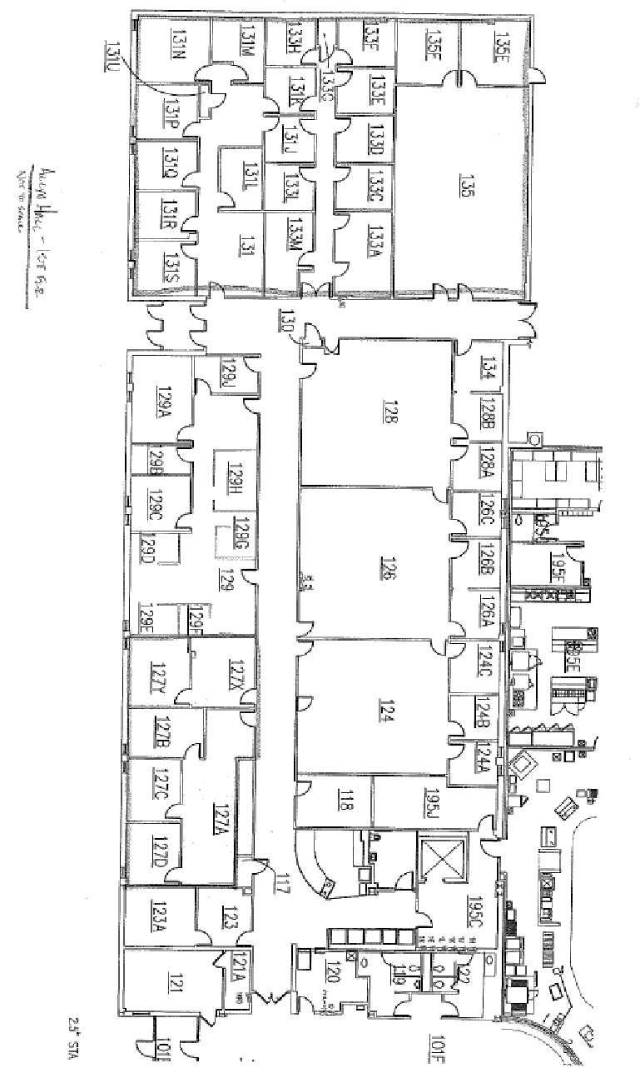
Renovation Considerations
Space needed to support:
Benefits Processing
Academic Success
Career and Leadership Development
Community Engagement
Veterans Leading Veterans
Important:
Location, location, location
Close to classes
Temp Space
Isolated/Private
Notes:
Means we needed space to meet with students privately; we needed a file room; we needed computer stations.
We needed and it was requested of us to have quiet study space. This was the number one requested item.
We needed a space to offer programming and presentations. A classroom or conference area.
We needed a space where veterans could gather, relax, and meet. We also needed a space that allowed for external community members to meet.

Slide 18
Gathering Information
Survey of Students:
54 students completed
Comfortable Seating
TV
Lockers
Quiet Study Area
Computers
Study Rooms/ Private Rooms
Study Cubicles
One Day Charrette
ODS Director
STAC Director
“Like a USO in Philadelphia”
Military Look and Feel
Free Coffee
Free Printing
Day Room
Snack Bar and Kitchenette
Notes:
Decision to move fast.
Timeline: 150 days from design to move in.
VERY Fast.
Surveyed Students
Did a one day charrette; had about 25 students come; some brought pictures of what they wanted; rated the pictures; yes/ no; some hurt feelings; but overall a good day. Provided food. Breakfast; lunch; and snacks;

Slide 19
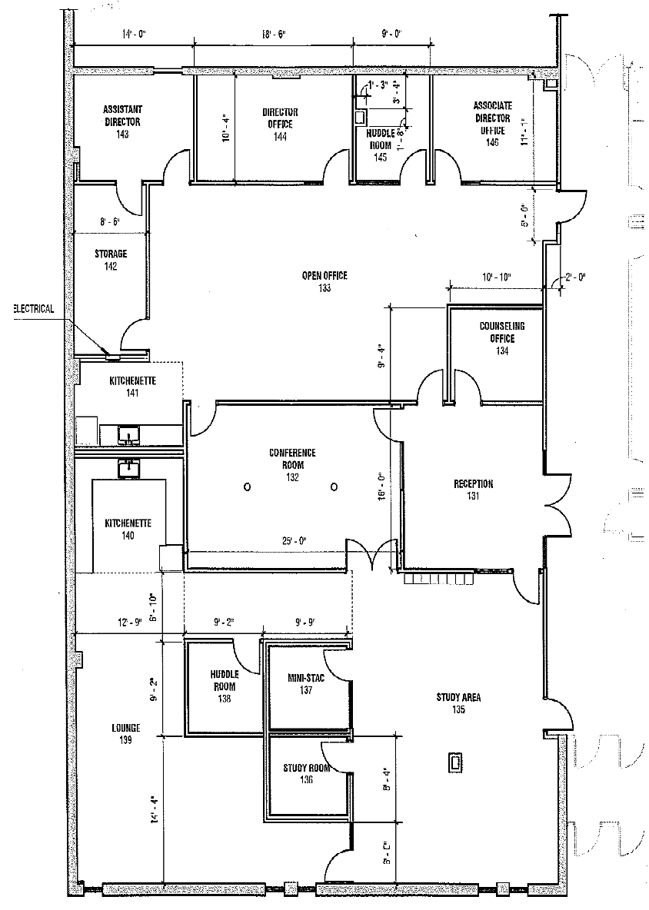
Questions
First comes your layout.
Consider:
Where is your light?
What are the space limitations? (e.g. Columns)
How do you work?
How do you want to work?
Can you commit to the changes you believe you will make?
Notes:
Obsessions with Red Pen.
Discuss the Layout. What’s happening here.
Change will happen.
Trust your designer. Trust yourself. Trust your students more.

Slide 20
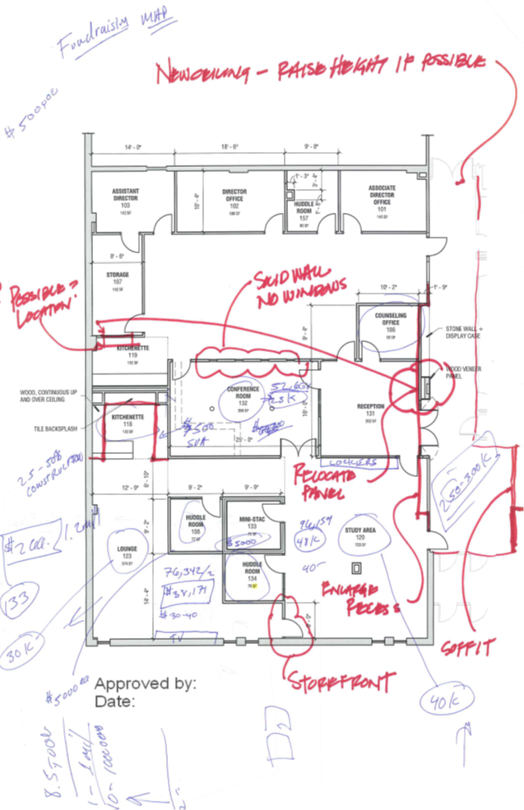
Design Elements
Privacy between Admin and Student Space: Each space is self contained
Light!
Academic Space is open
Lounge is Cozy
Privacy for FTE Staff
“Collision Space” for student workers
Key Card Access for Student Space
Visitor Private Advising Space
Conference Room as Buffer
Plan for Growth
Storage (over estimate)
Branding – We needed a logo
Art!
Acoustic Tile … or not!
Remember Egress!
Things CHANGE! Visit your build site!
Give tours from the moment you can get a hard hat!

Slide 21
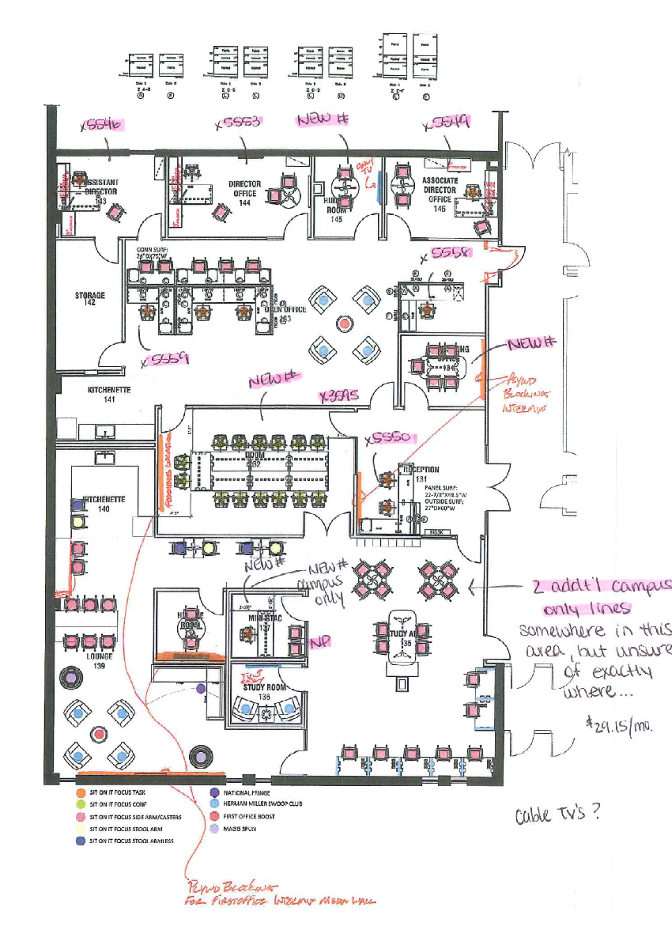
Furniture is your Friend… sort of
Get a sense of square footage
Visit with your furniture if you can. Make sure your staff does too.
Visit spaces that work
Describe spaces that don’t.
“White” Boards and Bulletin Boards
ADA
Stay away from white surfaces.
Cool colors. Not hot.

Slide 22
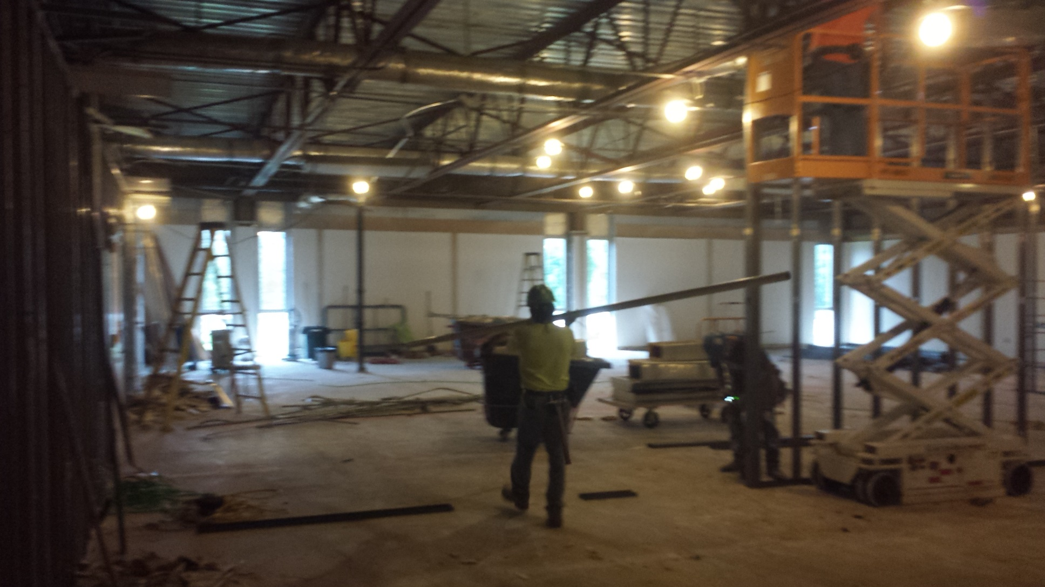
Construction Begins

Slide 23
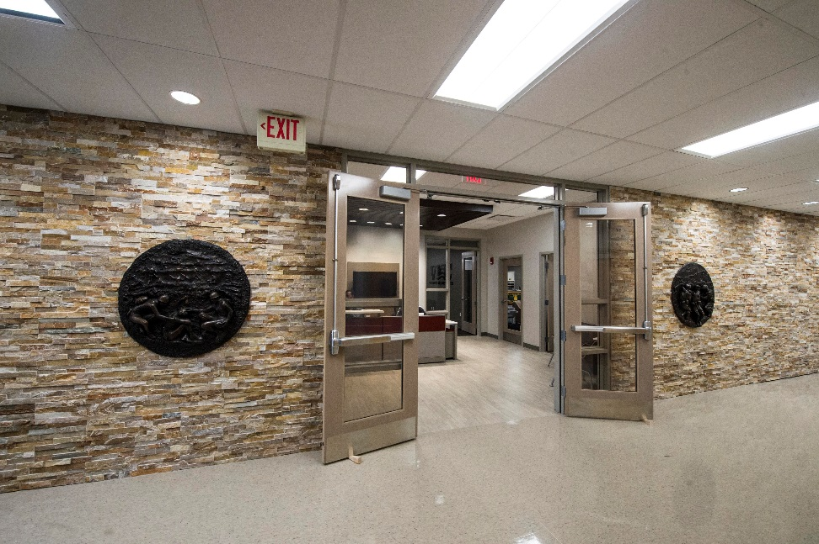
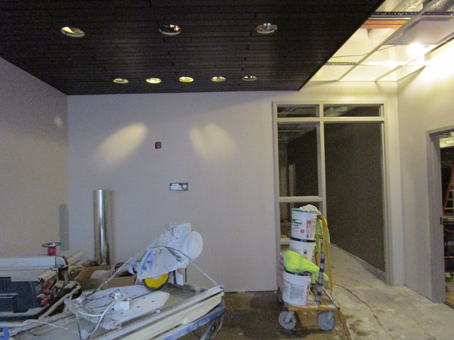
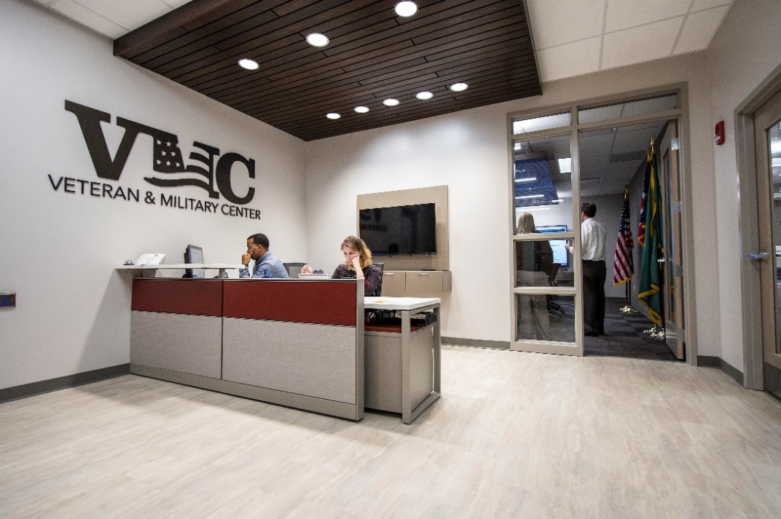

“Moving is a process, not an event.” Bill Shepard, VP for Development

Slide 24
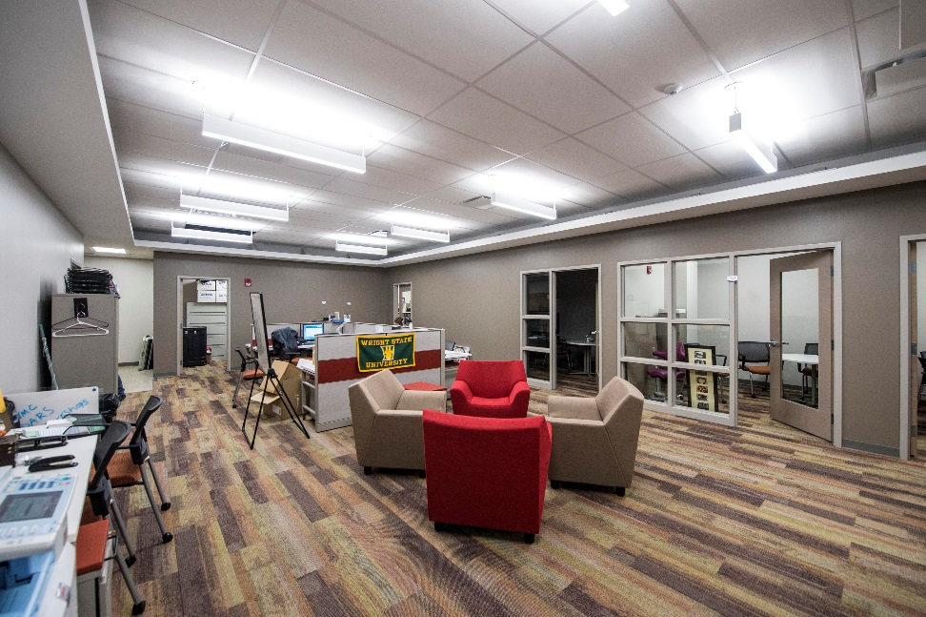
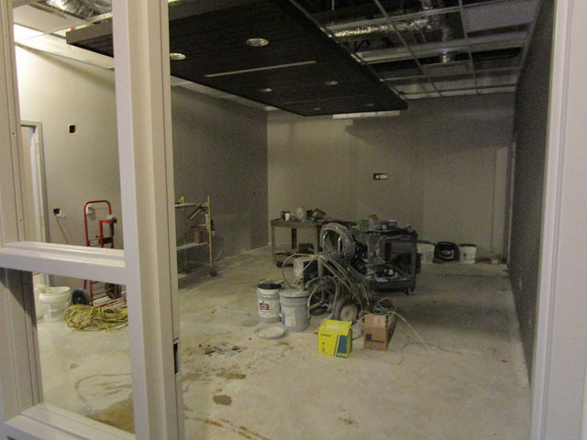
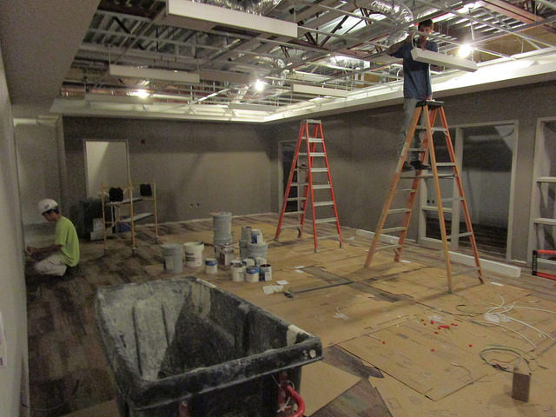
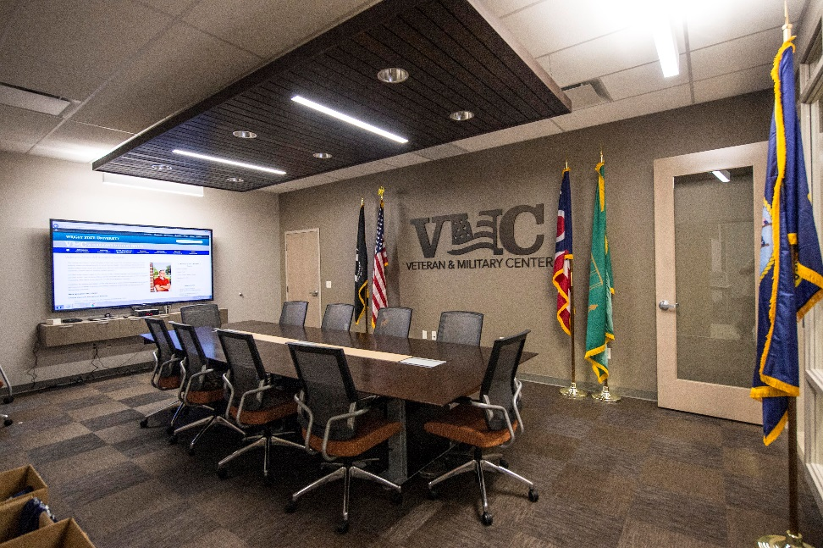
Admin and Conference Room

Slide 25
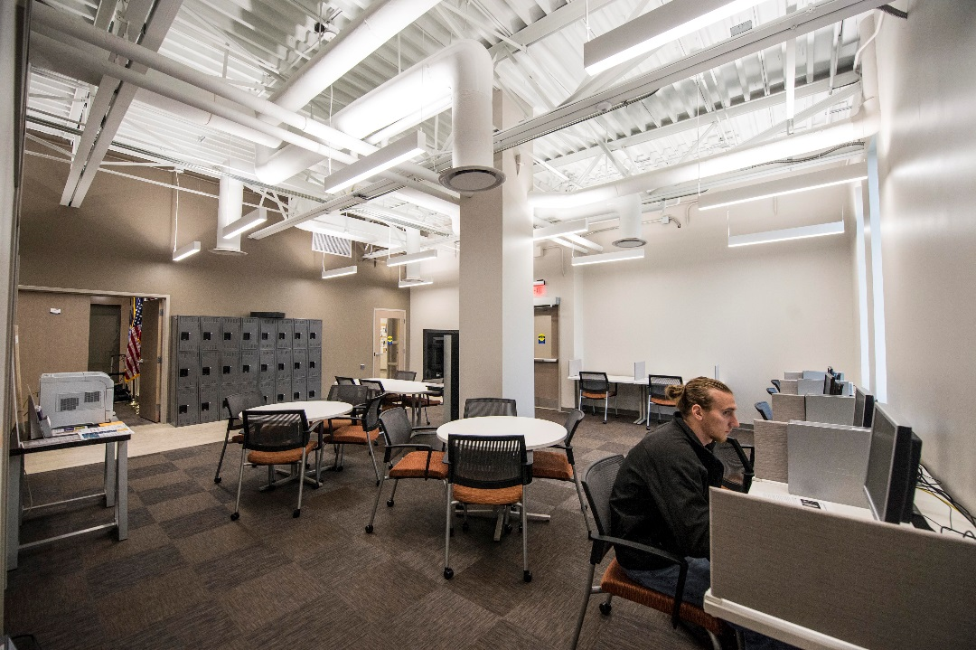
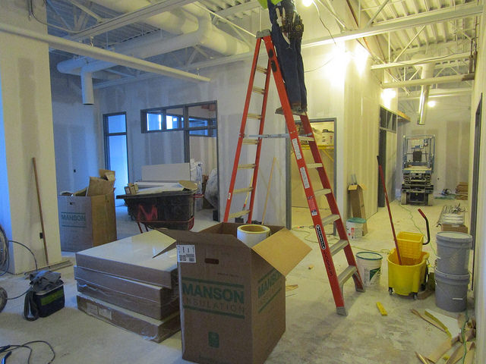
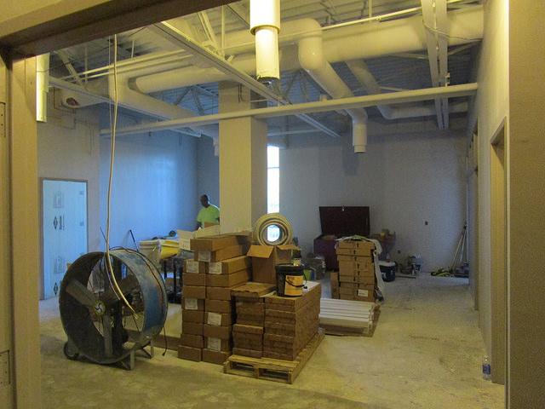
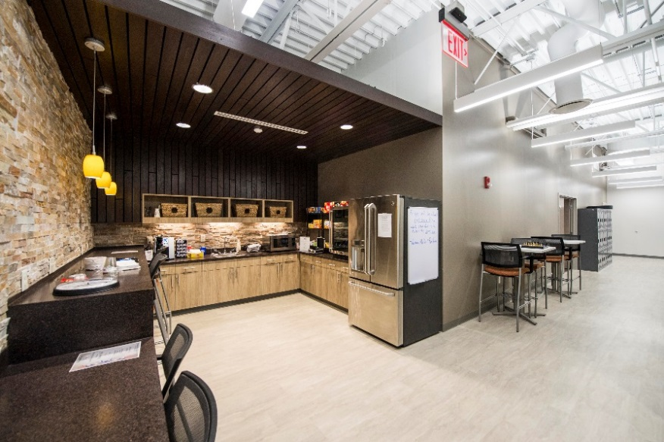

Slide 26
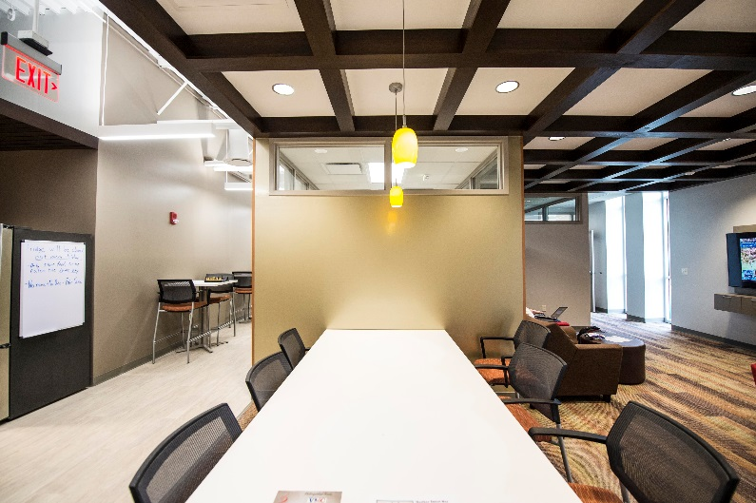
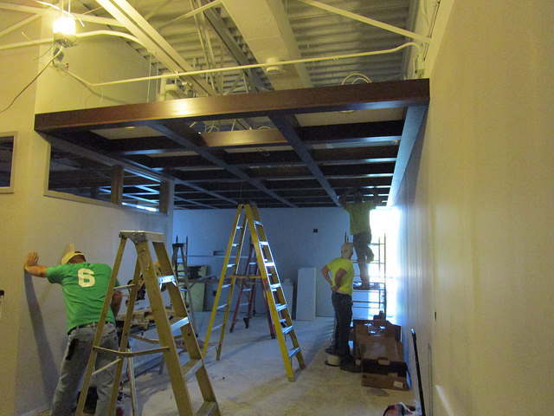
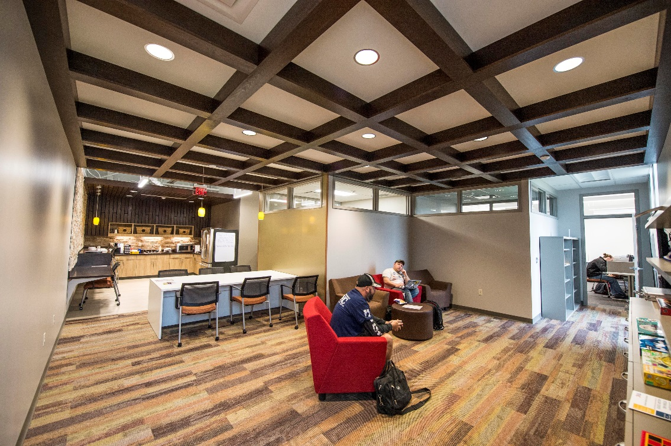
Lounge

Slide 27
Future Challenges
Relevancy—How to maintain the “Sea of Good Will”
Funding
Lounge Example
Process/Policy
Regulation/Guidance
Answers
The “Why”
Relationships
How do we contribute to Your mission and help solve Your Problems?

Slide 28
Future Challenges
Competing Demands
Sustainability after the “Grand Opening”
Maintaining Staffing
Professional Development and Training
Data Collection
Building Business Processes
How Do We Define Success

Slide 29
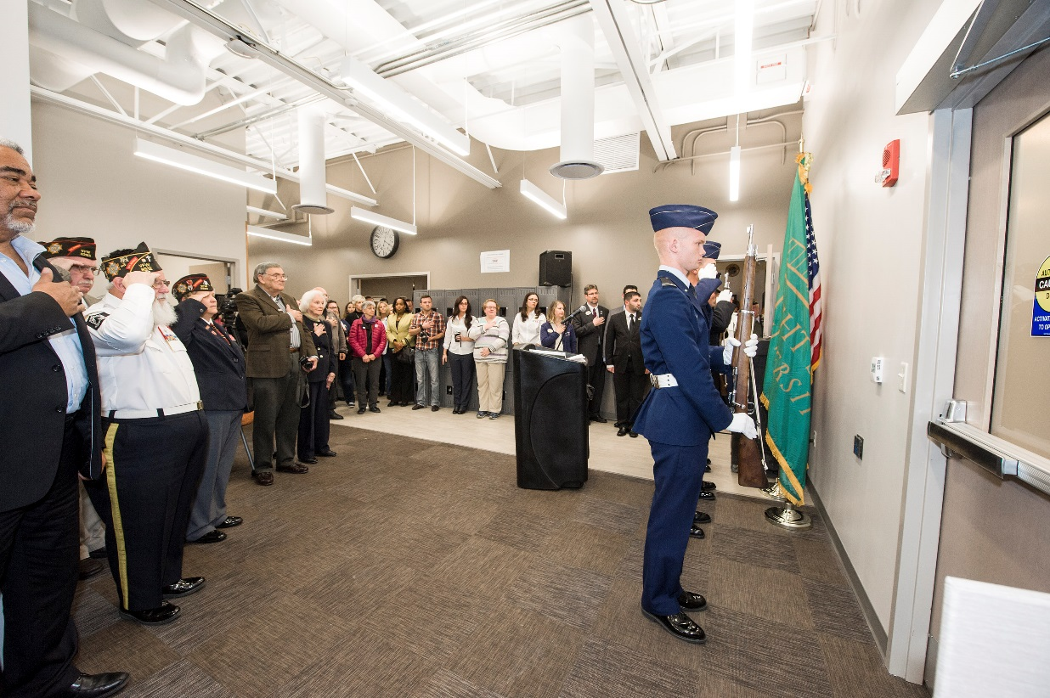

Future Challenges
Programming
Staffing
New processes/ handbooks/ training
Transferring/Sharing Ownership with Students
Increased Visibility. Million Dollar Mile.
Roof Leaks/ Too Cold
Technology Integration
Outdoor Patio

Slide 30
Michael W. Carrell, Colonel, USAF (Ret)
Assistant Provost & Director
Office of Military & Veterans Services 614-292-3898 (Direct)
614-247-VETS (Office) carrell.8@osu.edu
Barbara L. Henry, Ph.D.
Assistant Vice President
Non-Traditional and Transfer Student Services
Bowling Green State University
419 372-8136
bhenry@bgsu.edu
Seth E. Gordon, Ph.D.
Director
Veteran & Military Center
Wright State University
937-775-5550
seth.gordon@wright.edu

