Slide 1
Turning Requirements in Opportunities: A Short Course in Assessment for Military- Connected Offices
NASPA
Sunday, February 19, 2023
Glenn Phillips, Watermark

Slide 2






Presenter

Slide 3
Learning Objectives
Participants will be able to identify the foundational parts of a traditional assessment cycle.
Participants will be able to differentiate between indirect and direct measures.
Participants will be able to differentiate between student learning and administrative outcomes.
Participants will be able to strategize long-term assessment approaches that maximize data and minimize additional effort.

Slide 4
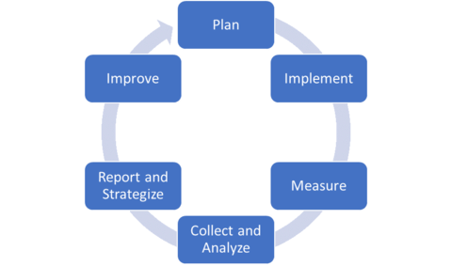
Assessment Cycle

Slide 5
Why Assessment?
Continuous improvement
Accreditation
Funding
Use case
Needs analysis
Data for stakeholders

Slide 6
Practical Steps
Mission
Make sure that your mission is aligned with your institutional mission and strategic plan.
Outcomes
Activate your mission by clarifying what it is you do. Identify learning and administrative outcomes.
Measure
Create measurable and meaningful measures that have time-restricted, quantitative results.

Slide 7
Reporting Needs
Mission
Outcomes
3-5 measures
A description for each measure
A target for each measure
Results after your predetermined cycle
An action item that links your results to continuous improvement

Slide 8
Example Measures
80% of students receiving benefits will have their enrollment certified two weeks before the start of the semester.
The 85/15 report will be completed within five days of Add/Drop.
90% of students will agree of strongly agree with the statement “I believe that XXXXX University cares about veterans.”
70% of recipients open our weekly informational email.
We host at least 400 visitors on our website each week.
90% of students will agree or strongly agree with the statement “I believe that Veteran Services goes the extra mile to serve me.”

Slide 9
Making Assessment Sustainable
Look in your own backyard
Ask around
Create monthly dashboards
Partner with your institutional assessment office
Empower graduate students or student workers to work on your assessment plan
Build out a strategic assessment plan (you don’t have to measure everything every time)
Work with student affairs professionals to identify assessment opportunities

Slide 10

Things You Should Do This Week
Meet with your Institutional Research Team
01
Find out how veterans and military-affiliated students are tracked
02
Learn what resources your institution has to capture new information (Qualtrics, Aviso, etc.)
03
Make a list of what you know, what you’d like to know, and what you need to know
04

Slide 11
Learning Objectives (Revisited)
Participants will be able to identify the foundational parts of a traditional assessment cycle.
Participants will be able to differentiate between indirect and direct measures.
Participants will be able to differentiate between student learning and administrative outcomes.
Participants will be able to strategize long-term assessment approaches that maximize data and minimize additional effort.

Slide 12
Contact gphillips@watermarkinsights.com
(979) 412-1691 or find me on LinkedIn®

