Slide 1

PLA’s and the Forgotten Impact on Student Veterans
Tiffany Baker-Strothkamp, CRC
February 24-26, 2021 | Virtual
Notes:
Good Afternoon! Thank you all for joining me today for this learning lap, Prior Learning Assessments and the forgotten impact on Student veterans. Please use the functions to communicate, ask questions, and generally be as engaged as possible in this remote setting. If I don’t see something, please interrupt me.

Slide 2
Agenda
Introduction
PLA example
Impact within Higher Education
Q&A
Notes:
For this learning lab I’m going to start with an introduction and background information. I have a PLA example that I hope will feed into the discussion and practical implications of PLA’s in higher education

Slide 3
Contact Information
Tiffany Baker, CRC
Transition and Support Coordinator
Veteran & Military Student Services
University of Colorado Denver | Anschutz Medical Campus
tiffany.baker-Strothkamp@ucdenver.edu 303-315-7300
EdD Candidate, Equity for Leadership in Higher Education
University of Colorado Denver
Notes:
I am Tiffany Baker. I am a Certified Rehabilitation Counselor. I am currently work as the Transition and Support Coordinator for veteran and military student services at the University of Colorado Denver and Anschutz Medical Campus. I also served in the United States Army for 10 years before being medically retired. I am child of marine corps veteran and I have been a spouse of a veteran as well. I am also a doctoral candidate in Equity for Leadership within higher education.
This topic is my research focus for my dissertation as it is very near and dear to my heart.

Slide 4
Prior Learning Assessments (PLA) in higher education are a way for students to progress their journey in higher education at a quicker pace. Student Veterans are one of the largest growing demographics in higher education. Even with the current emphasis on student development, little is known about how military experience translates into higher education. So where do PLA's fit into this and how prepared are institutions to support transitions veterans to successful students with credit awarding?
Notes:
Why I chose this area is due to how impactful prior learning assessments can be for students when they are adequately supported and understood within higher education. Although student veterans are one of the largest growing sub-populations in higher education, there is little to no training for admissions, advisors, and administration personnel surrounding student veterans, and more specifically how PLA’s can be properly leveraged for this sub-population

Slide 5
PLA Definition
Prior Learning Assessments acknowledge adults’ formal, informal and non-formal learning through the award of academic credit
* Stenlund, S. (2013). Agreement in assessment of prior learning related to higher education: An examination of interrater and intrarater reliability. International Journal of Lifelong Education, 32(4), 535-547. https://doi.org/10.1080/02601370.2013.778077
Notes:
For this presentation as well as my research, I am using Stenlund’s definition of prior learning assessment, that they are an acknowledgement of adult’s formal, informal, and non-formal learning through the awarding of academic credit.

Slide 6
Types of PLA
PLA’s
Military Specific
CLEP
  College-Level Examination Program ®
Portfolio
  Evidence of proficiency
Interview Evaluations
  Demonstration of knowledge
JST
  Joint Services Transcript
CCAF
  Community College of the Air Force
MEF
  Military Experience Form
Notes:
If you are unfamiliar with PLAs there are many types. These are just the most common. On the left-hand side are PLAs that can be used for all students and the right are the student veteran specific ones.
It’s important to note that even with the ones on the left, there are some differences with student veterans. Most notably is that many veterans utilize DANTES CLEP, a funded version of the CLEP offered only to military personnel. It has been my experience and it has popped up in my research that institutions get confused and then burden the student to provide clarification.

Slide 7
PLA and Student Veterans
Military Credit Evaluation is a typical requirement within higher education
  Misconception that all student veterans are utilizing VA Education Benefits
Notes:
Most HEI have a requirement as part of the admission process that students that self identify as a veteran have to have their military experience evaluated…usually this is the submission of the JST or for those who served in the Air Force the CCFA transcript. Part of this requirement comes from the myth that all student veterans are using VA Education Benefits, and there is a requirement associated with those benefits. These unfortunately leads to a “check the block” situation that doesn’t actually benefit the student.

Slide 8
PLA Example
JST
  Most common PLA
  Comes with ACE recommendations
  Not available for all veterans
  Federal and State evaluations policy
Notes:
As JST is the most common, this is going to be our example for today. Higher Education love the JST, who wouldn’t? it comes in a nice neat little package that includes American Council of Education credit recommendation. Who cares that it isn’t available to all veterans, or that there is limited regulation over its actual usage and implication. It makes the school look good, it checks that box when it comes time to get the military friendly designator or compliance audits.

Slide 9
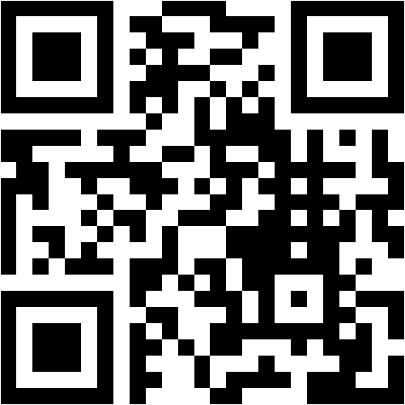
Menti.com 87 92 54 7 https://www.menti.com/ypte1a79t9
Who is evaluating the JST?
  Admissions/Registrar
  Veteran Student Services
  Advisors
Do the know what they are looking at?
Notes:
To make this a little more interactive, I have a couple of questions on menti.com. If you aren’t familiar you can type in menti.com and put the code 87 92 54 7 or use the QR Code.
I pose this question, who at your institution is accountable for the JST? Is it the admission office or the registrar? Is it in the Veteran student services, or the advisors?
Do they know what they are looking at?
https://www.menti.com/ypte1a79t9

Slide 10
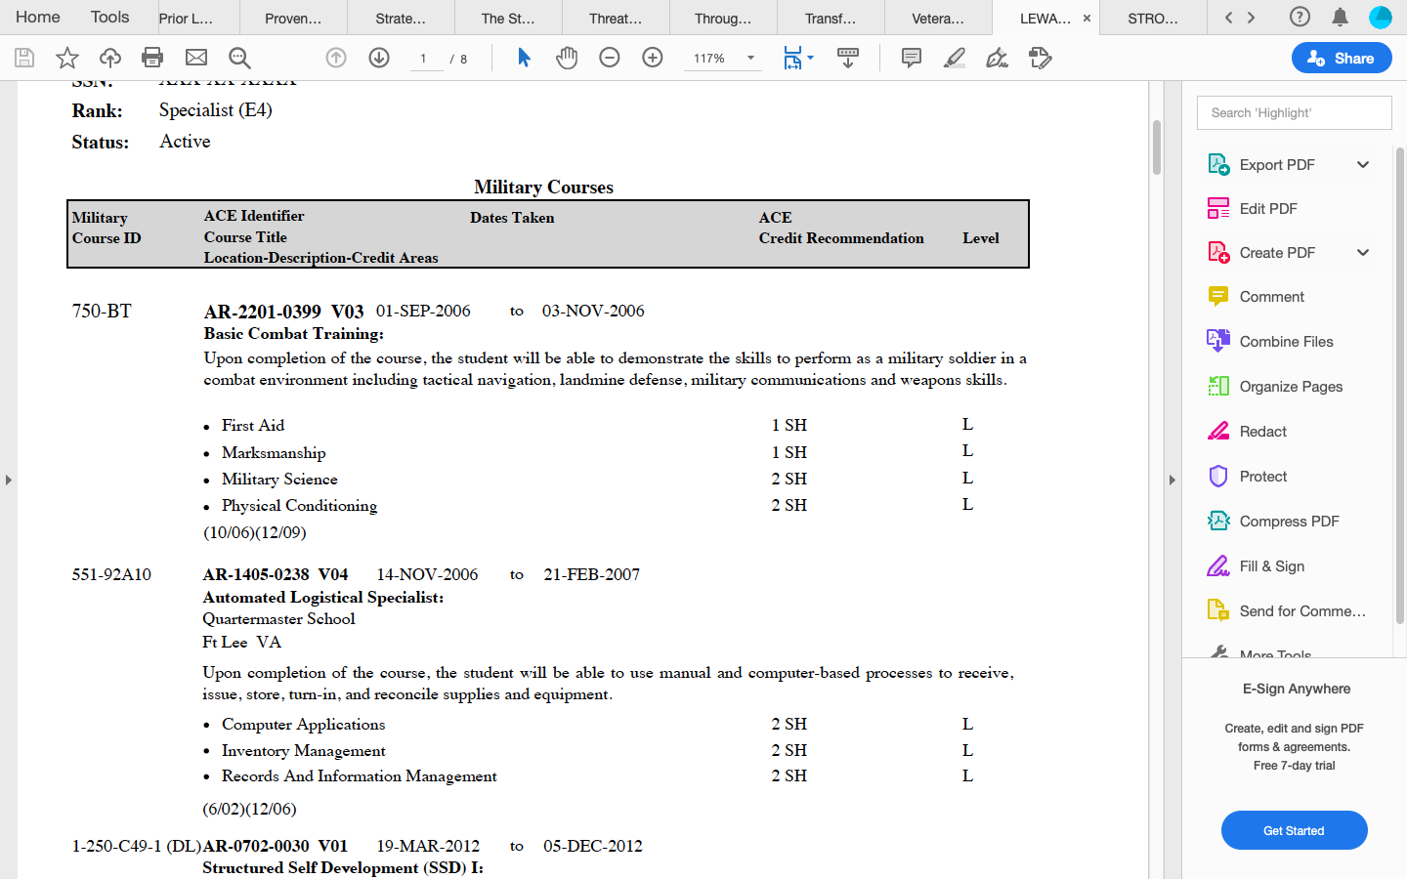
Army JST for BCT
Notes:
Here is a common JST for a student veteran. They completed basic. They were an E4. As you can see there are ACE credit recommendations for the completion of basic. Lets look at those a little more

Slide 11
Credit Recommendation
Notes:
For basic, it is divided into four sections. First Aid, Marksmanship, Military Science, and Physical Conditioning. The first two it is difficult to award credit in these areas. The last one is the go to.
This is the credit that HEIs love to award. It’s the, you don’t have to take underwater basic weaving thank you for serving credit

Slide 12


Credit Award
Notes:
But what about this military science recommendation tucked into the basic training course? Is there an equivalent course?

Slide 13
Military Science Credit
Academic Minor
  ROTC affiliation
Assumptions:
  Must be part of the ROTC
  Student Veterans do not want to serve again
Notes:
There are assumptions with this minor. One being that you have to be part of the ROTC program to be eligible to pursue the minor. That’s not true. In fact, most ROTC programs would be thrilled to have veterans in the minor, it’s a networking opportunity. Additionally, unless you accept an ROTC scholarship, there is no contract of service attached to the program.

Slide 14


Credit Award
How often is this credit awarded?
Notes:
So how often do you think credit is awarded to student veterans for military science? Not often enough for there to be qualitative data available. Now you might be thinking 2 credits isn’t a lot, and you would be right. However,

Slide 15
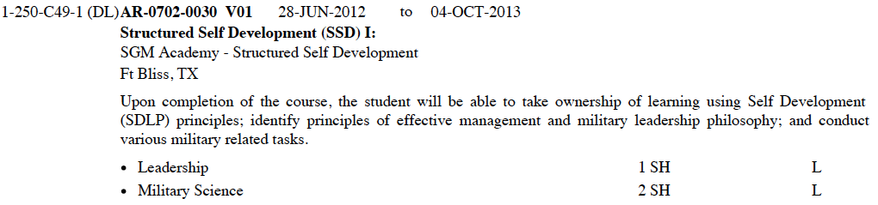


More Military Science Credit
Notes:
The availability of military science credit is not just under basic training, it also shows up in other places on the JST. I apologize for this picture being a little fuzzy. This is from the same student veteran. This is for SSD 1, a course that most E4s take, and is a requirement for progression of rank in the Army. This one student veteran now has a recommendation for 4 credits.

Slide 16
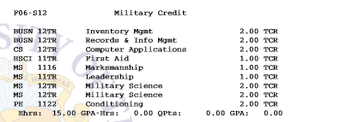
Credit Awards
ACE Recommendation
Degree Credit
Physical Conditioning
  2 semester hours
Military Science
  4 semester hours
Physical Education
  Course waived
Military Science
  none
Notes:
So how was this student veterans credit evaluated and awarded?
The student had their physical education requirement waived.
They were never told of the possibility to have at least 4 credits awarded toward a minor. And that is before even looking at their military occupational specialty…

Slide 17
Impact
Student Awarded minimal credit from ACE recommendation
Student pursued a minor w/out knowing they had available credit
Notes:
So what is the impact for the student. Yes they got some credit but no where near the ACE recommendation.
The student ended up pursing a minor but had no idea they had credit towards a minor that they could have used to save time and money.

Slide 18
Other PLA Impacts
Military Experience
Portfolio/Interviews
Credit for deployments under multi-culturalism or Humanities elective
Credit for years in services under business experiential learning
Demonstrate knowledge in land-navigation for credit within geography department
Notes:
This was just one student and one PLA.

Slide 19
Campus Impact
Training for those Evaluating PLA
Education for students to self-advocate
More Research
Notes:
So how do you make PLA’s impactful for student veterans on your campus.
Training, train those that evaluate PLA’s to know what to look for, know the language, and know and this is so important what options are available for the student.
You also have to the student self-advocate, they need ownership and autonomy for their education. They need to look at the credit actually being awarding, see where it fits into their degree plan and speak up if they don’t see something, if they see a degree requirement that they have already completed. In my position, I am here to support and assist, not to do it for them.
I

Slide 20

Questions
Notes:
So I know that that was a lot of information and that I talk really fast. So what questions do you have or clarification do you need?

Slide 21
Contact Information
Tiffany Baker-Strothkamp, CRC
Transition and Support Coordinator
Veteran & Military Student Services
University of Colorado Denver | Anschutz Medical Campus
tiffany.baker-Strothkamp@ucdenver.edu 303-315-7300
Notes:
Thank you again for attending this learning lab and I hope you enjoyed.

