Slide 1
Vets 201: Veteran Culture, Identities and Growth
Christine M. Black, J.D.
VKC Co-Chair
Assistant Director,
Office of Equity and Diversity
University of Scranton
Crisann Hanes, M.Ed.
VKC Co-Chair
Graduate Advisor – Evening and Online MBA Programs
Colorado State University

Slide 2

What happens when an unstoppable force hits an immovable object?
Student-Veteran Identity

Slide 3
Visualizing a Veteran
Kahoot!

Slide 4
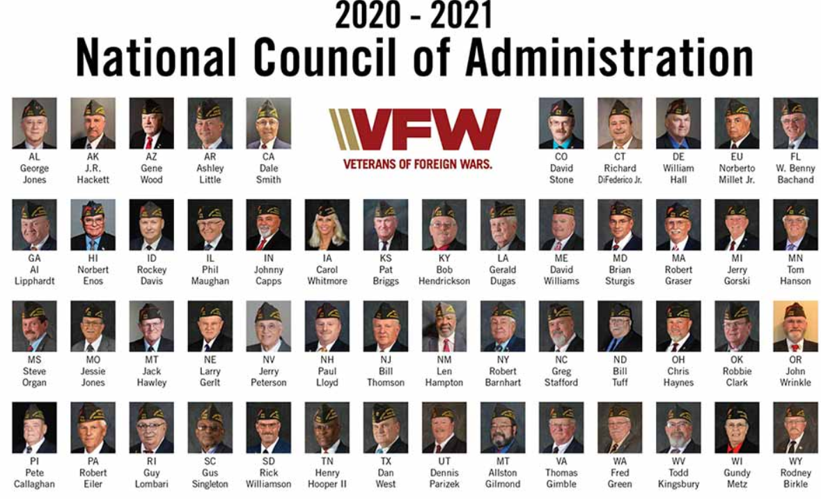
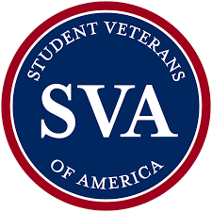
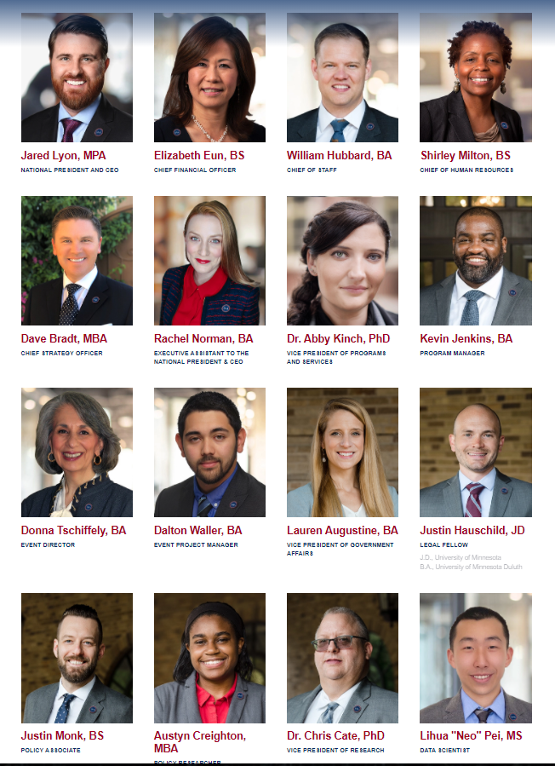
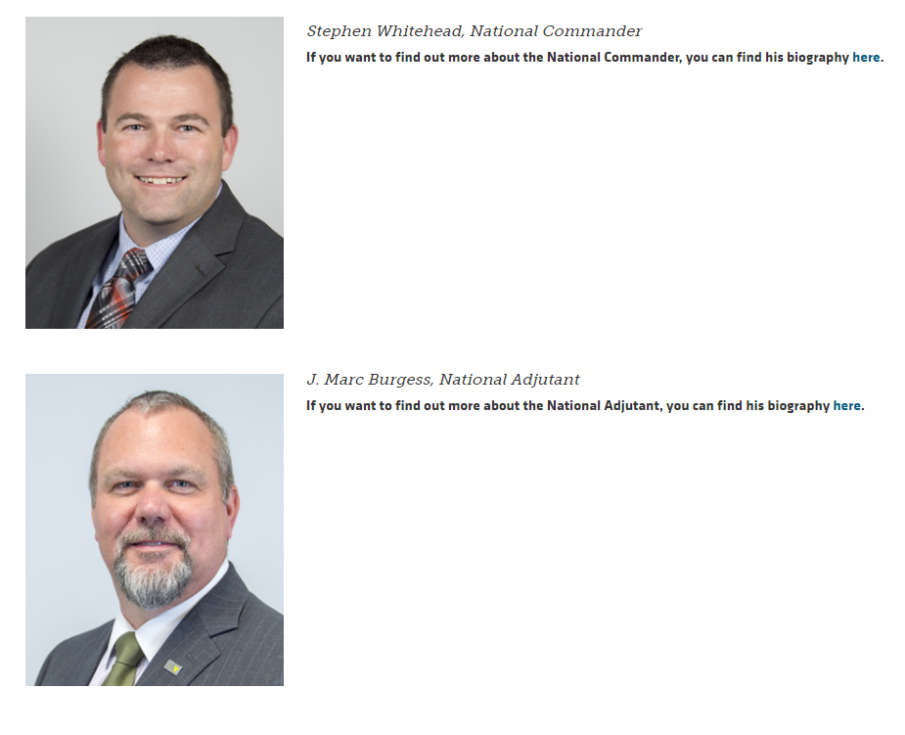


Slide 5
Friction points for the Veterans Center
What is the population of your veterans center like?
What does the population that is drawing VA Education Benefits (in any form) look like?
Where is the overlap?
Who is not in the center?
What part of that is intentional?
Where do you think the students not mentioned or identified are? Who are they?
Notes:
CRIS ANN – explain the theory behind it being a good idea to not need the veterans center all the time

Slide 6
What makes your campus and recruiting area unique?
Proximity to local base?
Specific links to a unit?
Only program of a certain type in the area that is certified by the VA?
No active duty, heavy emphasis on National Guard or Reserve?
Does your state have strong veteran benefits that pull these folx in?

Slide 7
Friction Point - Other Services
Are you a one stop shop?
Intentionally?
What offices do you most commonly work with?
Which people or offices are you actively partnered with?
What centers or services do you want a closer relationship with?
What centers or services outside your own do your students access most frequently? (Do you know? How?)
Notes:
Use NATCON question, and Seth at WSU/alignment

Slide 8
Who do we actually serve?
Diversity among Student Veterans

Slide 9
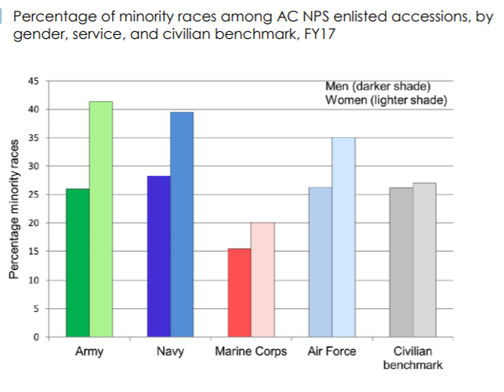
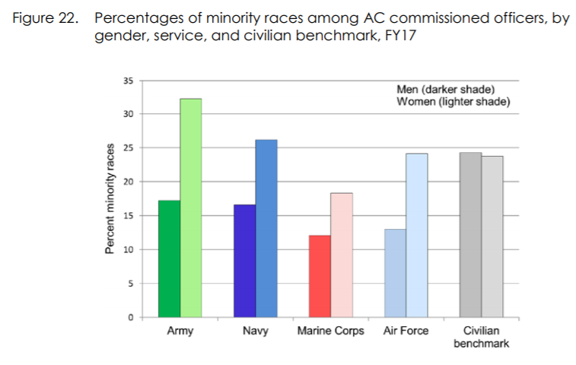
Folks of Color
Notes:
As shown in Figure 16, in every service, male accessions (represented by the darkly shaded left bar for each service) are less racially diverse than female accessions (represented by the lightly shaded right bar for each service).

Slide 10
Disabled Vets (Not the same as Disabled)
Disabled vs. Disability Rating

Slide 11
Student Veteran Populations
Hispanic Vets
Black/African American Vets
Indigenous Vets
Asian-American & Pacific Islander Vets
Native American Vets
…Who else is on your campus?

Slide 12
Student Veteran Populations
LGBTQ+
Women Vets
First Generation Vets
…Who else is on your campus?

Slide 13
Intersections of Identity
Based on Abe, Jones, & McEwen’s Model of Multiple Dimensions of Identity
Identity is salient – so how does Veteran identity influence or impact students on your campus? How do you see this reflected in your work? Do you only consider the veteran identity?

Slide 14
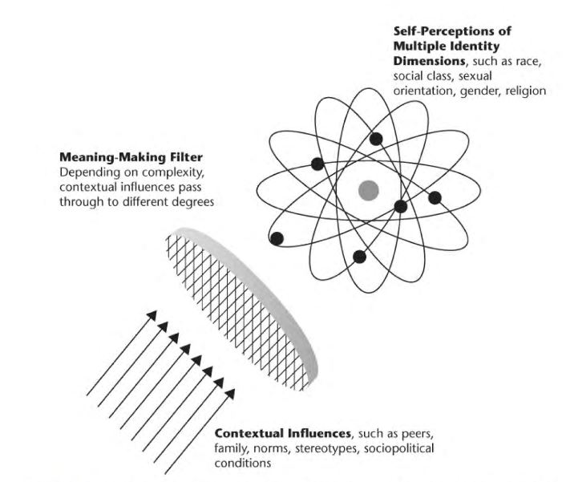

Slide 15
Intersections of Identity
Have you considered this among student veterans on your campus ?
How should this impact your programming and support services?
Have you considered the saliency of veteran identity and it’s impact on development and growth?

Slide 16
What is unconscious bias?
Bias is a prejudice in favor of or against one thing, person, or group compared with another usually in a way that’s considered to be unfair. Biases may be held by an individual, group, or institution and can have negative or positive consequences. There are two types of biases
Conscious bias (also known as explicit bias) and
Unconscious bias (also known as implicit bias)

Slide 17
What is unconscious bias?
It is important to note that biases, conscious or unconscious, are not limited to ethnicity and race. Though racial bias and discrimination are well documented, biases may exist toward any social group. One’s age, gender, gender identity physical abilities, religion, sexual orientation, weight, and many other characteristics are subject to bias.
What are the assumptions we make about the Marine Corps? The Air Force?

Slide 18
What is unconscious bias?
What are the assumptions we make about the Marine Corps? The Air Force?
What do we assume they did?
What skills do we assume are transferrable?
How do race/gender play into that?
If someone says they were infantry, what do we assume? What if they say intel?

Slide 19
What is unconscious bias?
Unconscious biases are social stereotypes about certain groups of people that individuals form outside their own conscious awareness. Everyone holds unconscious beliefs about various social and identity groups, and these biases stem from one’s tendency to organize social worlds by categorizing. Unconscious bias is far more prevalent than conscious prejudice and often incompatible with one’s conscious values. Certain scenarios can activate unconscious attitudes and beliefs. For example, biases may be more prevalent when multi-tasking or working under time pressure.

Slide 20
Unconscious Bias
What are some unconscious biases happening on your campus or community?

Slide 21
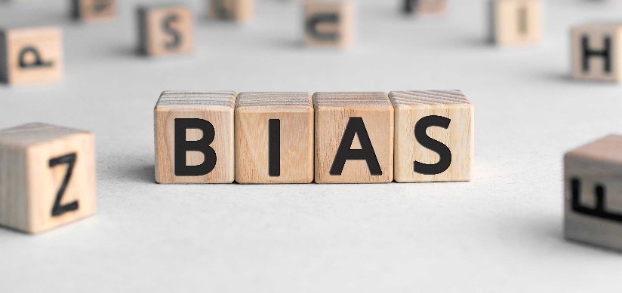
Semantics
Protected Status | -ism
Sex/Gender | Sexism, Misogyny, Misandry
Race | Racism
National Origin | Xenophobia; Nativism
Age | Ageism
Disability | Ableism
Gender Expression | Sexism, Transphobia;
Sexual Orientation | Homophobia
Status | -ism
Socioeconomic Class | Classism
Jewish/Judaism | Anti-Semitism
Muslim/Islam | Islamophobia
Other Social Groups/In-Group Bias | Tribalism; Bigotry; Favoritism
Skin Color | Colorism

Slide 22
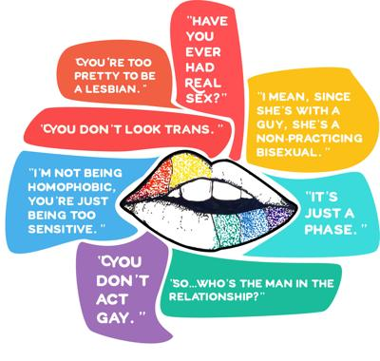
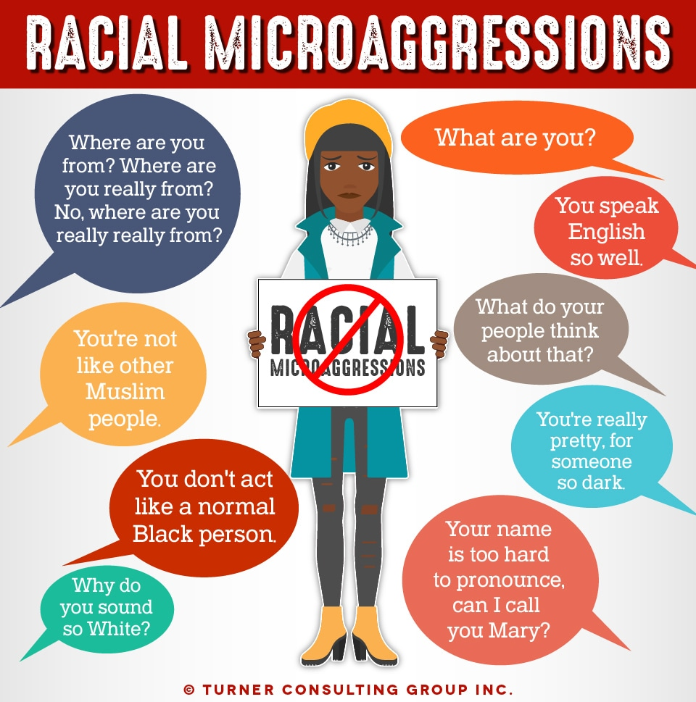
Microaggressions Defined
Microaggressions: everyday encounters of subtle discrimination that people of marginalized/minority groups (people of color, religious minorities, women, people with disabilities, LGBTQ individuals, etc.) experience throughout their lives.
Notes:
Jose
So what are microaggressions? They are the subtle comments, actions, and behaviors that convey varying expectations and stereotypes, formulated by our biases and prejudices, and can be really harmful.
Focus on subtly and fact that they are born out of implicit bias and prejudice

Slide 23
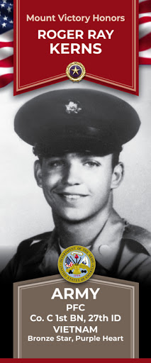
Microaggressions Defined
Can be verbal, behavioral, or environmental
Communicate hostile, derogatory, or negative viewpoints
Usually unconscious and unintentional
Despite this, the impact is still real
Perpetuate a worldview of majority group supremacy and superiority

Slide 24
Challenging Implicit Bias
Become aware of your biases so you can interrupt them
Do an “audit:” pay attention to how you engage with others, or the instantaneous thoughts or actions you take when confronted with others
Identify areas where you need additional training or exposure, and seek those out
Take some Implicit Association Tests: https://implicit.harvard.edu/implicit/takeatest.html
Based on reaction time
Learn with and from others, and work to learn new patterns of thinking

Slide 25
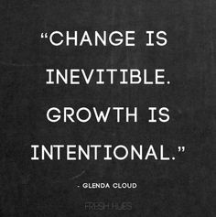
Why Does Intentional Inclusion Matter?
If we fail to be intentional about inclusion, our biases and habits may lead us to be exclusionary or minimizing
We all carry subconscious (implicit) prejudices and biases shaped by our lived experiences
These lead us to make assumptions based on stereotypes, misinformation, and generalizations
Why is this important?
Prejudice, bias, assumptions, stereotypes, misinformation, and generalizations are the root of microaggressive behaviors

Slide 26
Why does Intentional Inclusion Matter?
What are the assumptions faculty make on your campus when they hear “student veteran”?
Do you “see” or assume the veteran identity first?
Do you choose to interact or support primarily the veteran identity?
What assumptions do the administration make about your veteran’s needs?
What stereotypes are they basing those on?
Who are the squeaky wheels – who do the administration know by name, and who tends to advocate?

Slide 27
Why Does Intentional Inclusion Matter?
When we allow these microaggressions to go unchecked in our community, we accept them as part of our culture, and we tacitly endorse those concepts.

Slide 28
Who do we center?
Student-Identity, and what it represents within Student Populations

Slide 29
What face do you put forward?
Physical Space
Purpose
Bonfrenbrenner’s Theory of Developmental Ecological
Decorations
Forms
Gendered Assumptions
Legal Issues
Policy Issues
Local/Community Representation

Slide 30
What face do you put forward?
Are you supporting students through your lenses? Does your programming or supports really serve you or the institution, more than the students?
Veterans Service Organizations:
Balancing act – are they helpful for your goals for a student (job/employment) versus what are you endorsing – what is their image
Speakers
Are you only honoring their service/rank? Are they helpful models for transition? Do they represent stereotypes of the population or do they represent your population?

Slide 31
What is our role on campus?
Challenging Existing Campus Cultures

Slide 32
Breakout Sessions
Based on this presentation – how do you define your role on campus?
How should the saliency of identity impact your campus programming & support services – and how can you accomplish this?
What current biases or cultural issues is your center/campus/space/department battling?
How can you create & use cross-campus collaboration/partnerships to change current cultural issues?

Slide 33
Thank You!
Christine Black, J.D – Christine.black@Scranton.edu
Crisann Hanes, M.Ed. – Crisann.Hanes@colostate.edu
Interested in joining the VKC Advisory Board? Apply on NASPA’s Volunteer Central!

Slide 34
Questions?
Open Q&A

