Slide 1
Purposeful Programming
Knowing your Audience

Slide 2

Meet The Team
Russ Chavez
Director of Veterans Affairs South Dakota State University
Connie Johnson
Coordinator/Student Success Advisor South Dakota State University

Slide 3

Let's Break it Down
Knowing Your Audience
What is Purposeful Programming
Programming
Handouts and Review

Slide 4

Knowing Your Audience
Academic Calendar
Student Needs

Slide 5

What is Purposeful Programming
Student Engagement Theory
Ecotherapy

Slide 6
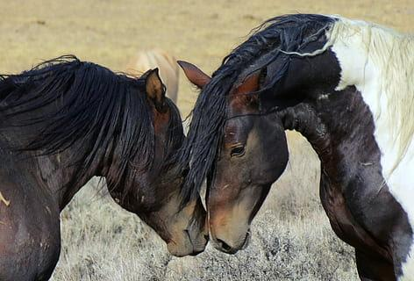
Purposeful Programs
Horses for Heroes
Warrior Week
Veterans Retreat
Warrior Wellness Week
Golf Tournament

Slide 7

Handouts and Review
Thank you!

