Slide 1
Change the Conversation: Motivational Interviewing and Vaccine Hesitancy

Slide 2
Why am I here today?
20 years at Sanford Health
Practiced several years in primary care and on our CL hospital service
Practicing psychologist and department chair
15+ years of MI training to various healthcare professionals
We have a very difficult task today that I hope we can embrace together

Slide 3
Challenging Interactions
(Rosengren, 2018)
Think about a recent patient or parent interaction you struggled with that involved vaccine hesitancy.
The kind of interaction that…
Makes you internally sigh and tell yourself, “Oh no, here we go…”
Results in a frustration/sadness/disappointed reaction
Makes you feel anxious/personally or professional challenged
Where are you now in your work with this patient/parent?
Where would you like to be?
What’s getting in the way of that happening?

Slide 4
Challenging interactions: part 2 (Rosengren, 2018)
Now imagine that you are this patient/parent. Really put yourself inside this person’s shoes.
Where are you now in your work with this health care professional?
Where would you like to be?
What’s getting in the way of that happening?
Podcast Suggestion: Hidden Brain “Win Hearts, Then Minds” from February 5, 2024

Slide 5
Beliefs that can obstruct our work
(Mason and Butler, 2010)
This person OUGHT to change
This person WANTS to change
Health is the prime motivating factor for patients
If the patient does not decide to change, the consultation has failed
Patients are either motivated to change or not
Now is the right time to consider change
A tough approach is always best
I’m the expert. He or she must follow my advice
Motivational Interviewing always works

Slide 6
Motivational Interviewing (MI) is a particular way of talking with patient about change and growth to strengthen their own motivation and commitment.
Motivational – whatever gets someone moving
Interviewing – a particular kind of interaction in which one party has a guiding role
Miller and Rollnick (2023)

Slide 7
Taste of MI (Part1)
Speaker: Choose something you are thinking about changing, should change, want or need to change. Think of something you are ambivalent about.
Listener: Tell your partner how much they need to change, why they need to change and give them reasons. Tell them how to do it, and finish with a good old, "Now get out there and do it!"
Debrief: How was this? What worked? What didn't?

Slide 8
Taste of MI (Part 2)
Speaker Role: Same topic of change.
Listener Role: Give no advice at all. Ask the following questions and listen respectfully:
  Why would you want to make this change?
  How might you go about this to succeed?
  What are some good reasons for this change?
  How important is it for you to make this change and why?
  So...what do you think you'll do?
DEBRIEF

Slide 9
Brief History of MI
Began in 1982, Norwegian psychologists and social workers focused on ways to change harmful use of alcohol and drugs
Carl Rogers (1902 –1987) - person-centered: genuineness, accurate empathy, unconditional positive regard
2000+ controlled clinical trials of MI
MI is even more effective with patients from diverse backgrounds!
MI Network of Trainers (http://motivationalinterviewing.org)
Constantly honing MI - like science should!

Slide 10
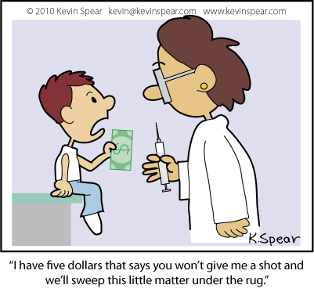
Vaccine Hesitancy and MI

Slide 11

What to do?
“As a healthcare provider I just don’t have it in me to talk about vaccines anymore. I feel like these parents should trust my years of experience over Dr. Google.”

Slide 12
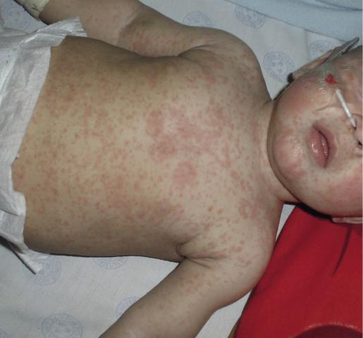
MMR Study (Nyhan, Reifler, Richey & Freed, 2014)
Which works the best?
Corrective information about lack of evidence for MMR causing autism
Text describing dangers of diseases prevented by MMR
Images of children with diseases MMR prevents
Narrative of near death experience of an infant with measles

Slide 13

Why doesn’t explaining work?
We have been trained to explain
Explication assumes the key problem is lack of the “right” information
There is limited support for repeating evidence
Even worse! Extreme risk negation messages have increased perceptions of vaccine risk

Slide 14

Attraction to Conspiratorial Beliefs
Humans and animals are about predicting danger for the sake of survival
Shadowy networks of people executing evil hoaxes on the public in near-perfect secrecy
If it helps me make sense of the world, I hang on to it!
EXAMPLES:
State workers who manage funds for disability payments knowingly and systematically lie
During COVID, Sanford information about # of people hospitalized, immunized, on ventilators
Nanotechnology Tracking in the vaccine

Slide 15
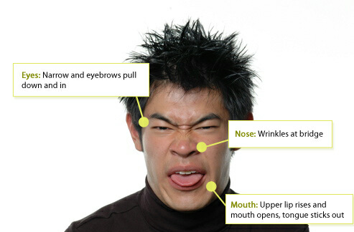
Disgust and Anti-science beliefs
Subclinical fears and phobias often underpin anti-science beliefs
We avoid what we fear!
Disgust leads to develop of attitudes that give people permission to avoid the triggers for the disgust
EXAMPLES: Hospitals, blood, needles

Slide 16

Reactance
We rebel when others try to control us!
  I am a nonconformist
  I am skeptical of consensus view
  I don’t let others tell me how to think
Rejecting consensus views (e.g., it is good to be immunized) is a way to communicate my nonconformist identity
“We don’t do masks, and we don’t do vaccines”
People who have this tendency are high in “reactance”

Slide 17
Hornsey, Harris, and Fielding (2018) conclusions from 24 nation study
Survey of 5000+ people from 24 countries on vaccine beliefs
Anti-vaccination beliefs were highest in people who strongly identified with following:
  Conspiratorial beliefs
  Reactance
  Disgust toward blood and needles
Education level was not a significant factor

Slide 18
Enhancing your MI framework...
Goal is for you to understand MI well enough to try something new with next patient

Slide 19

Improving Provider Confidence (Dybsand, Hall, Ulven & Carson, 2019)
Compared MI to presumptive CASE (Corroborate, About Me, Science, and Explain/Advise) with 5 pediatricians
At start of study, most did not have a strategy on how to communicate with vaccine hesitant parents prior to the study
Providers had more confidence, less anxiety, and were less likely to avoid talking about vaccinations after MI training
https://journals.sagepub.com/doi/10.1177/0009922819884572

Slide 20
The Spirit of MI (about 75% of the effectiveness of MI)
Partnership
  Patients are experts of themselves
  Our expertise is health
Acceptance
  Nonjudgmental
Compassion
  Intention to alleviate suffering and support positive growth
Empowerment
  Autonomy Support

Slide 21

Following (e.g., listening, going along)
Directing (e.g., instructing, leading)
Guiding (e.g., encouraging, motivating)

Slide 22
Your Well-Being and Guiding Style
(Rollnick et al, 2023)
“Good practice means not just looking after patients but looking after yourself” (pg. 16)
Embodying the attitude of a committed and caring guide…
  Means that responsibility to change is shared
  Consultation has less pressure and disagreement because it is the patient’s choice in the end
  You get to see each patient as unique.
  You get to avoid repeating the same messages in the same way again and again!
  Your role is to support, inform, and encourage them to find their best route to better health

Slide 23
4 Fundamental Tasks in MI
Engaging: "Can we walk together?"
Focusing: "Where are we going?"
Evoking: "Why would you go there?"
Planning: "How will you get there?"

Slide 24

Engaging: Can we walk together?
Help patients feel comfortable and safe
Establish trust so patients are willing to share their true concerns
Gather essential information for your work with patients

Slide 25
Tools of Engaging
Mirroring
OARS
  Open questions
  Affirmations
  Reflections
  Summarizing

Slide 26
Mirroring (a.k.a., Reflecting) can be a powerful listening skill
In MI, listening is active; we listen with our words
Patients get our full attention, our bodies turned toward them
Mirroring is making guesses about what the person is saying
Helps people slow down and listen to what they've said

Slide 27
Mirroring Example (Miller & Rollnick, 2023)
Speaker: I really don't want to get vaccinated.
Listener: You're not concerned about getting sick.
Speaker: I am worried about getting sick, from the vaccine!
Listener: You've heard some stories about people who got it.
Speaker: I've just heard it's dangerous.
Listener: Like the vaccine might be worse than the virus itself.
Speaker: I just don't like having things injected into my body.
Listener: It feels to you like being out of control, like it’s a lot to trust, a leap of faith.
Speaker: Well, I've had vaccinations before. I just don't know about this one.
Listener: Something seems different to you about this one. It worries you.

Slide 28
Guidance from CDC using MI...
4 Steps to apply MI during a patient visit
Embrace an attitude of empathy and collaboration.
Ask permission to discuss vaccines. “If it is okay with you, I’d like to discuss take a moment to discuss vaccines and your family.”
    If patient says no, respect their decision. “I respect that. I care about all aspects of your health. Would you be open to discussing in the future?”
    OR, allow yourself to be curious with the purpose of helping YOU understand. “Would you help me understand why you don’t wish to discuss this topic?”
    If the patient says yes, move to step 3.
Motivational Interviewing – Ask a scaling question, “On a scale from 1 to 10, how likely are you to get a COVID-19 vaccine? (1 = never, 10 = appointment is scheduled).” Then explore…
Respond to questions from the patient that are within your scope of practice

Slide 29
Helpful MI Resources
https://motivationalinterviewing.org/ - Website for the Motivational Interviewing Network of Trainers
Rollnick, Miller, & Butler (2023). Motivational Interviewing in healthcare: Helping patients change behavior (2nd Ed.). The Guilford Press, New York.
Miller & Rollnick (2023). Motivational Interviewing: Helping people change and grow (4th Ed.). The Guilford Press, New York.

Slide 30
Thank you
Jon Ulven, PhD, LP
Sanford Health
jon.ulven@sanfordhealth.org

