Slide 1
Innovations in Diabetes Care: 2025 ADA Standards and Pregnancy Updates
Diana Isaacs, PharmD, BCPS, BC-ADM, BCACP CDCES, FADCES, FCCP
Co-Director, Endocrine Disorders in Pregnancy
Director, Education and Training in Technology
Endocrinology Medical Specialty Institute
Cleveland Clinic

Slide 2
Disclosures
Diana Isaacs, PharmD is a speaker or consultant for the following companies:
Abbott, Ascensia, Dexcom, Medtronic, Sanofi, Novo Nordisk, Lilly, Mannkind, Tandem, Cequr
All relevant financial relationships have been mitigated.

Slide 3
Pharmacist Learning Objectives
Describe key updates in the 2025 ADA Standards of Care related to medications, monitoring, and technology
Examine recent innovations in diabetes management, including new medications, continuous glucose monitoring (CGM), and insulin delivery systems
Discuss the latest guidelines and recommendations for managing diabetes in pregnancy
Design a treatment plan taking into account individualized factors to address acute and chronic complications
Notes:
1. Describe key updates in the 2025 ADA Standards of Care related to medications, monitoring, and technology
2. Examine/State recent innovations in diabetes management, including new medications, continuous glucose monitoring (CGM), and insulin delivery systems
3. Discuss the latest guidelines and recommendations for managing diabetes in pregnancy
4. Design/Review a treatment plan taking into account individualized factors to address acute and chronic complications
Also, if the course will be application-based, learning objective #4 will need to be changed for technicians, as they do not design treatment plans. Here is one suggestion and can be changed per faculty preference:
4. Support the pharmacist in designing a treatment plan that takes into account individualized factors to address acute and chronic complications

Slide 4
Technician Learning Objectives
Describe key updates in the 2025 ADA Standards of Care related to medications, monitoring, and technology
Examine recent innovations in diabetes management, including new medications, continuous glucose monitoring (CGM), and insulin delivery systems
Discuss the latest guidelines and recommendations for managing diabetes in pregnancy
Support the pharmacist in designing a treatment plan that takes into account individualized factors to address acute and chronic complications

Slide 5
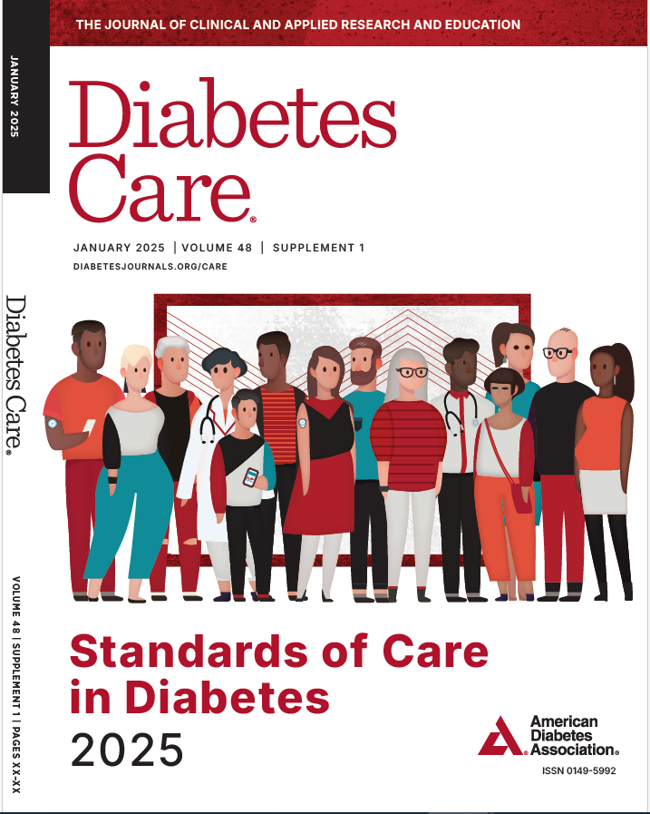
Standards of Care
Scientific diabetes literature over past year
Recommendations revised per new evidence
Professional Practice Committee
External peer review
Living Standards
Funded out of the ADA’s general revenues
Does not use industry support

Slide 6
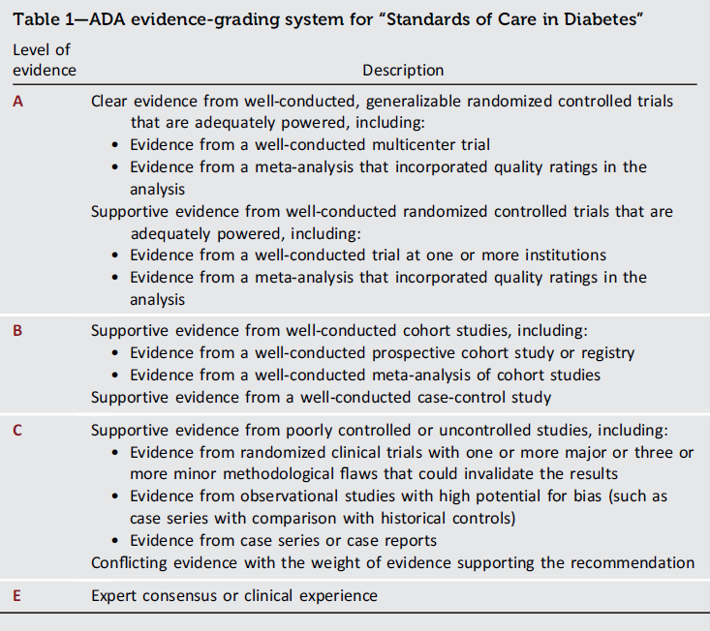
Table of Contents
Improving Care and Promoting Health in Populations
Diagnosis and Classification of Diabetes
Prevention or Delay of Diabetes and Associated Comorbidities
Comprehensive Medical Evaluation and Assessment of Comorbidities
Facilitating Positive Health Behaviors and Well-being to Improve Health Outcomes
Glycemic Goals and Hypoglycemia
Diabetes Technology
Obesity and Weight Management for the Prevention and Treatment of Type 2 Diabetes
Pharmacologic Approaches to Glycemic Treatment
Cardiovascular Disease and Risk Management
Chronic Kidney Disease and Risk Management
Retinopathy, Neuropathy, and Foot Care
Older Adults
Children and Adolescents
Management of Diabetes in Pregnancy
Diabetes Care in the Hospital
Diabetes and Advocacy

Slide 7
Type 1 Diabetes Screening
2. Diagnosis and Classification of Diabetes
2.6 Screening for presymptomatic T1D may be done by detection of autoantibodies to insulin, glutamic acid decarboxylase (GAD), islet antigen 2 (IA-2), or zinc transporter 8 (ZnT8). B
2.7 Autoantibody-based screening for presymptomatic T1D should be offered to those with a family history of T1D or otherwise known elevated genetic risk. B
2.9 Standardized islet autoantibody tests are recommended for classification of diabetes in adults who have phenotypic risk factors that overlap with those for T1D (e.g., younger age at diagnosis, unintentional weight loss, ketoacidosis, or short time to insulin treatment). E
3.2 In people with presymptomatic T1D, monitor for disease progression using A1C approximately every 6 months and 75-g oral glucose tolerance test (i.e., fasting and 2-h plasma glucose) annually; modify frequency of monitoring based on individual risk assessment based on age, number and type of autoantibodies, and glycemic metrics. E
Notes:
ica

Slide 8
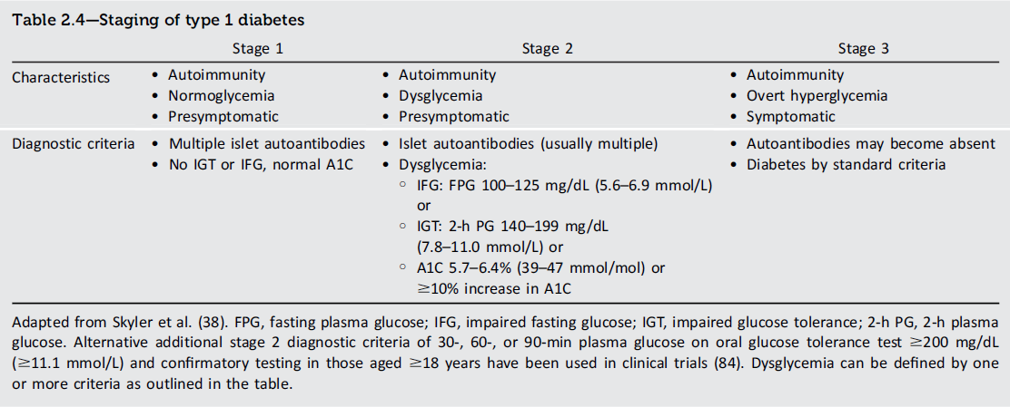
Type 1 Diabetes Staging
3.15 Teplizumab-mzwv infusion to delay the onset of T1D (stage 3) should be discussed with selected individuals aged ≥8 years with stage 2 T1D. Treatment should be in a setting with appropriately trained personnel. B

Slide 9
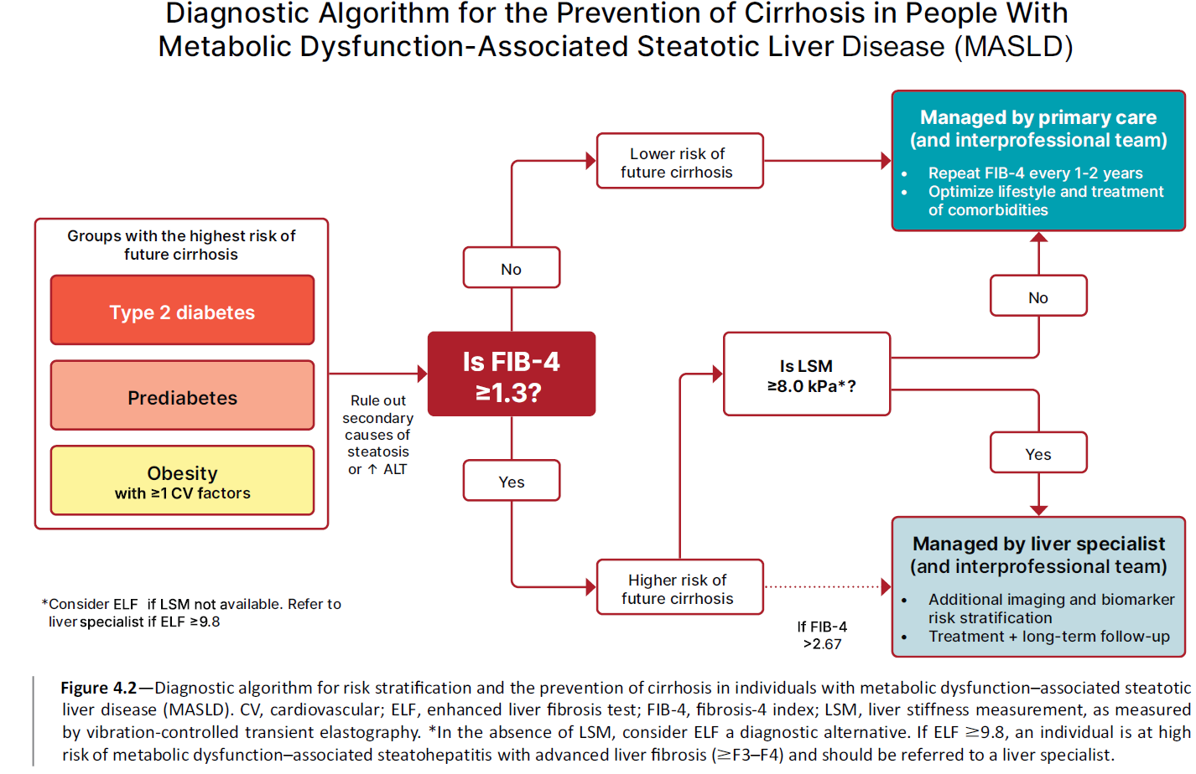
4. Comprehensive Medical Evaluation and Assessment of Comorbidities
Comprehensive Medical Evaluation and Assessment of Comorbidities: Standards of Care in Diabetes - 2025. Diabetes Care 2025;48(Suppl. 1):S59-S85
Notes:
enhanced liver fibrosis (ELF) test
4.22a Screen adults with T2D or prediabetes, particularly those with obesity or other cardiometabolic risk factors or established CVD, for their risk of having or developing cirrhosis related to metabolic dysfunction-associated steatohepatitis (MASH) using a calculated fibrosis-4 index (FIB-4) (derived from age, ALT, AST, and platelets [mdcalc.com/calc/2200/fibrosis4-fib-4-index-liver-fibrosis]), even if they have normal liver enzymes. B
4.22b Adults with diabetes or prediabetes with persistently elevated plasma aminotransferase levels for >6 months and low FIB-4 should be evaluated for other causes of liver disease. B
4.23 Adults with T2D or prediabetes with a FIB-4 ≥1.3 should have additional risk stratification by liver stiffness measurement with transient elastography, or, if unavailable, the enhanced liver fibrosis (ELF) test. B
4.24 Refer adults with T2D or prediabetes at higher risk for significant liver fibrosis (i.e., as indicated by FIB-4, liver stiffness measurement, or ELF) to a gastroenterologist or hepatologist for further evaluation and management. B

Slide 10
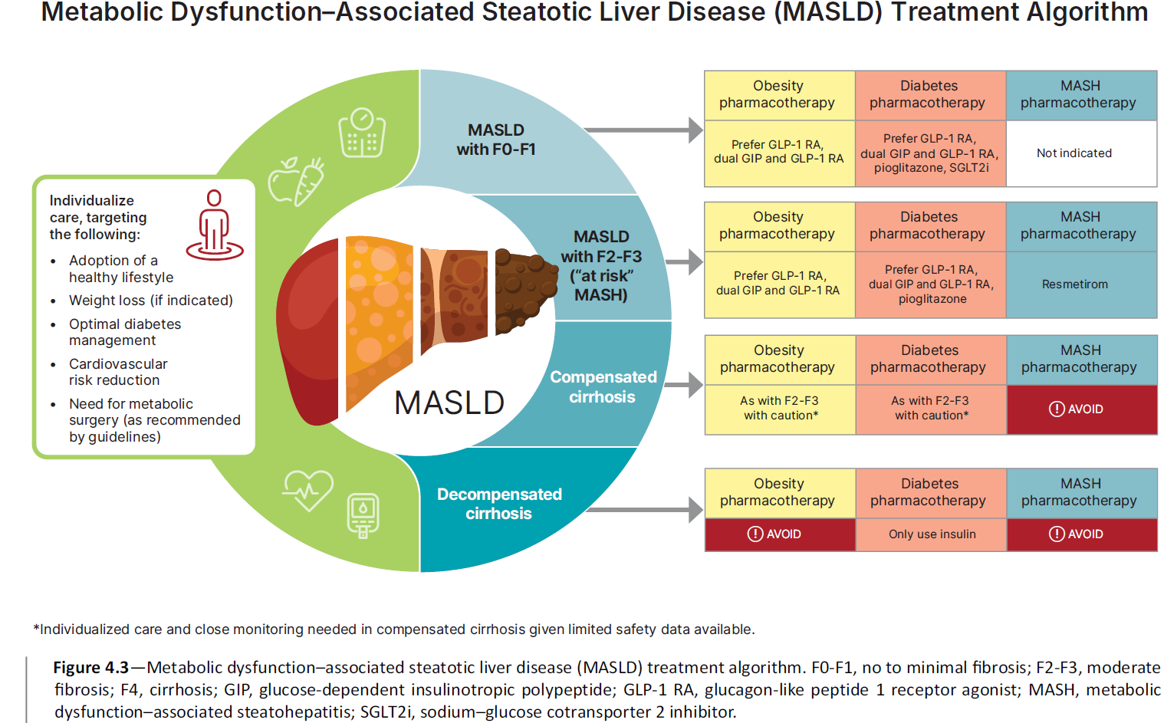
4. Comprehensive Medical Evaluation and Assessment of Comorbidities
Comprehensive Medical Evaluation and Assessment of Comorbidities: Standards of Care in Diabetes - 2025. Diabetes Care 2025;48(Suppl. 1):S59-S85

Slide 11
According to the 2025 ADA Standards of Care, which of the following medications is preferred if a patient has metabolic dysfunction–associated steatotic liver disease (MASLD)?
Sitagliptin
Pioglitazone
Metformin
Glipizide
Notes:
Justification: MASLD and MASH were recently added to the T2D treatment algorithm in 2025, and specifically mentions that pioglitazone or GLP-1/GIP RA should be used for patients with MASLD or MASH as long as they don't have cirrhosis.

Slide 12
According to the 2025 ADA Standards of Care, which of the following medications is preferred if a patient has metabolic dysfunction–associated steatotic liver disease (MASLD)?
Sitagliptin
Pioglitazone
Metformin
Glipizide
Notes:
Justification: MASLD and MASH were recently added to the T2D treatment algorithm in 2025, and specifically mentions that pioglitazone or GLP-1/GIP RA should be used for patients with MASLD or MASH as long as they don't have cirrhosis.

Slide 13
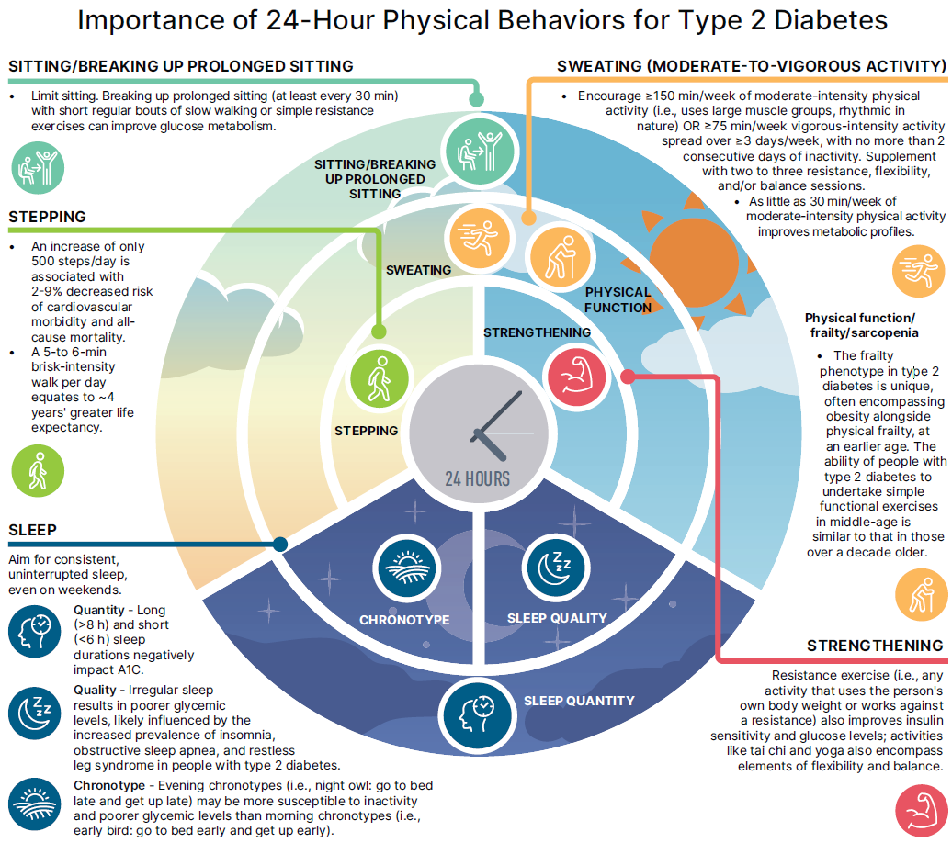
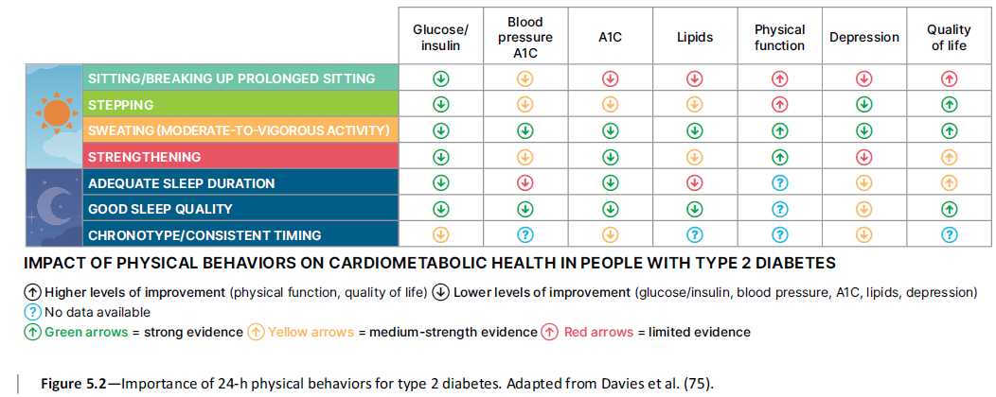
5. Facilitating Positive Behaviors and Well-being to Improve Health Outcomes
Facilitating Positive Heath Behaviors and Well-being to Improve Health Outcomes: Standards of Care in Diabetes - 2025. Diabetes Care 2025;48(Suppl. 1):S86-S127

Slide 14
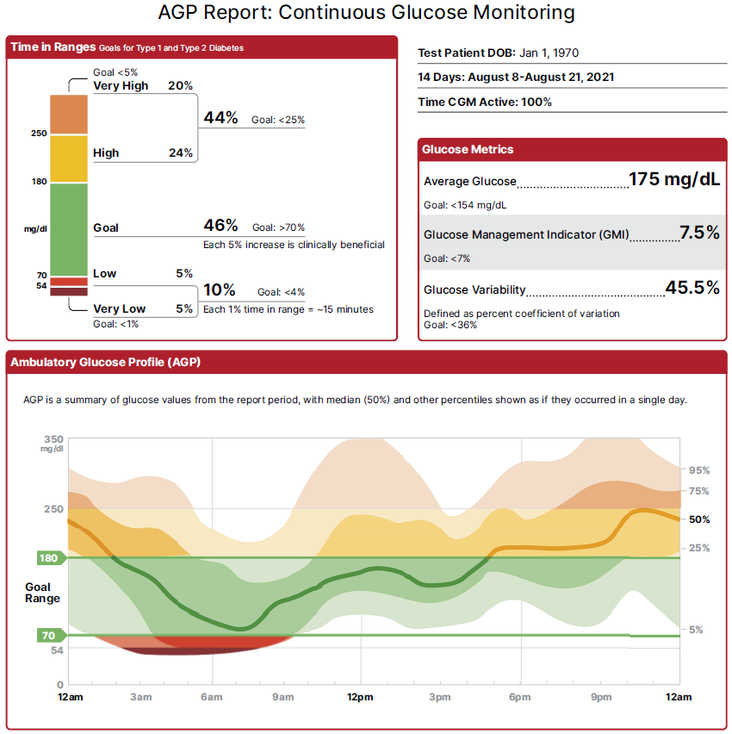
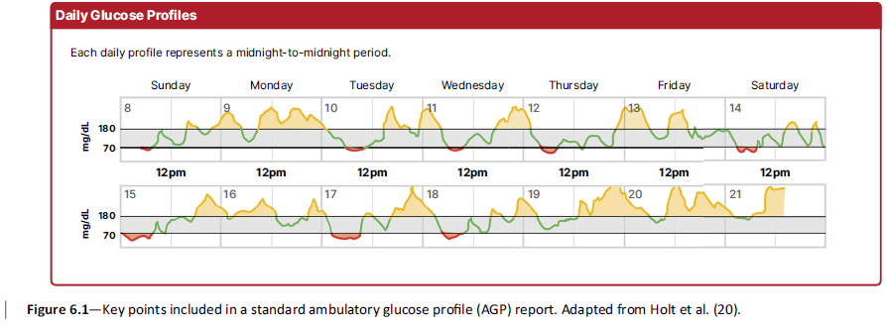
6. Glycemic Goals and Hypoglycemia
6.1 Assess glycemic status by A1C A and/or CGM metrics such as TIR, TAR, TBR. B Fructosamine or CGM can be used for glycemic monitoring when an alternative to A1C is required. B
6.14 Use of CGM is beneficial and recommended for individuals at high risk for hypoglycemia. A
Glycemic Goals and Hypoglycemia: Standards of Care in Diabetes - 2025. Diabetes Care 2025;48(Suppl. 1):S128-S145
Notes:
6.2 Assess glycemic status at least 2c times a year, and more frequently (e.g., every 3 months) for individuals not meeting glycemic goals or with recent treatment changes, frequent or severe hypoglycemia or hyperglycemia, or changes in health status, or during periods of rapid growth and development in youth. E

Slide 15
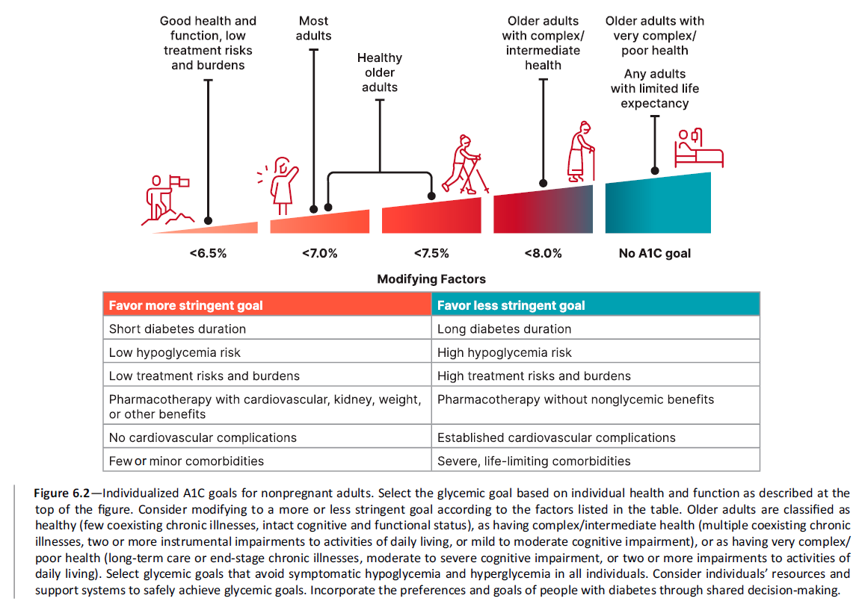
6. Glycemic Goals and Hypoglycemia
Glycemic Goals and Hypoglycemia: Standards of Care in Diabetes - 2025. Diabetes Care 2025;48(Suppl. 1):S128-S145

Slide 16
Diabetes Technology

Slide 17
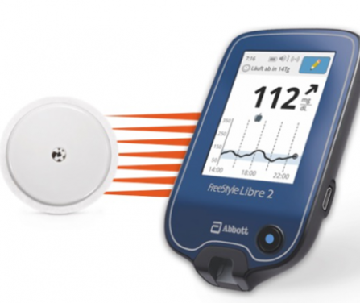
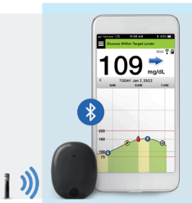

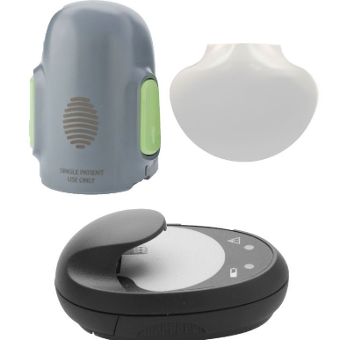

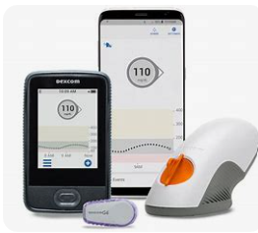

Personal CGM Options (Rx)
Coming soon
Freestyle Libre 2 and 2+
Freestyle Libre 3 and 3+
Eversense
Guardian 4
Simplera
Dexcom G6
Dexcom G7

Slide 18
CGM Comparison
​ | G6​ | G7​ | Libre 2​+ | Libre 3​+ | Guardian 4 | Eversense​ 365
Pump Integration​ | T:Slim X2, Omnipod5, iLet, Mobi | T:Slim X2 iLet, Mobi | T:Slim X2, Omnipod 5 | iLet | 780G | No​
Maximum wear time​ | 10 days​ | 10.5 days​ | 15 days | 14 days​ | 7 days​ | 365 days
Warm-up time​ | 2 hours​ | 30 min​ | 1 hour​ | 1 hour​ | Up to 2 hours​ | 24 hours​
Calibrations required​ | 0​ | 0​ | 0​ | 0​ | To enter auto mode | After 14 days, Weekly
Water depth | 8 feet, 24h | 8 feet, 24h | 3 feet, 30 min | 3 feet, 30 min | 8 feet, 30 min | 3.28 feet, 30 min
Viewing Data | Dexcom Clarity |  | LibreView |  | Carelink | Eversense Data Management System
Product user guides: Dexcom G6, Dexcom G7, Libre 2, Libre 3, Medtronic Guardian Connect, Guardian 3, Eversense

Slide 19
CGM Comparison (Continued)
 | G6 | G7 | Libre 2+ | Libre 3+ | Guardian 4 | Eversense
FDA approved sites​ | Abdomen (ages2+) Upper buttocks (ages 2-17)​ | Upper arm (ages 7+)​ Upper buttocks (ages 2-6)​ | Upper arm​ | Upper arm​ | Upper arm, abdomen​ Upper buttocks (ages 2-13)​ | Upper arm​
Approved in pregnancy | No​ | Yes​ | Yes​ |  | No​ | No
Transmitter | 3 months | Disposable | Disposable |  | Charge weekly | Charge daily
FDA approved ages (years)​ | ≥2​ | ≥2​ ​ | ≥2​ | ≥4​ ​ | ≥7 | ≥18​ ​
Drug interactions​ | Hydroxyurea​ | Hydroxyurea​ | Vitamin C​ | Vitamin C​ | Acetaminophen Hydroxyurea​ | Tetracycline antibiotics, mannitol​
Product user guides: Dexcom G6, Dexcom G7, Libre 2, Libre 3, Medtronic Guardian Connect, Guardian 4, Eversense

Slide 20


Dexcom Stelo
Glucose range: 70-250mg/dL
For people over 18 that don’t take insulin
Updates every 15 minutes, 30 minute warm-up
Stelo app + Dexcom Clarity
Spike detection, no high/low alerts
Education in app
https://www.dexcom.com/stelo

Slide 21
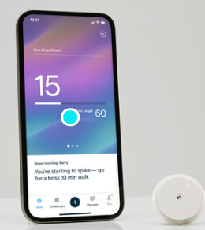
Abbott Lingo
For people over 18 not on insulin
Glucose range: 55-200mg/dL
Updates every minute, 1 hour warm-up
Lingo app
No real time alerts
Education in app, goal to stay under lingo count
www.hellolingo.com

Slide 22
OTC CGM
 | Dexcom Stelo | Abbott Lingo
Wear Time | 15.5 days | 14 days
Form Factor | Dexcom G7 | Libre 2
Ability to share data | Yes, Dexcom Clarity | No
Glucose range | 70-250mg/dL | 55-200mg/dL
Real-time alerts | Yes, spike detection only | No
Frequency of glucose readings | 15 minutes | 1 minute
Education within App | Yes | Yes
Patient age | ≥ 18 yr | ≥ 18 yr
Information from manufacturers websites: https://www.stelo.com/en-us, Lingo - Made by Abbott: Your body has the answers (hellolingo.com)

Slide 23
Use of CGM
7. Diabetes Technology
7.1 Diabetes devices should be offered to people with diabetes. A
7.2 Initiation of CGM should be offered to people with T1D early in the disease, even at time of diagnosis. A
7.15 Recommend CGM for diabetes management to youth C and adults B with diabetes on any type of insulin therapy.
7.16 Consider using CGM in adults with T2D treated with glucose-lowering medications other than insulin to achieve and maintain individualized glycemic goals. B
7.19 In circumstances when consistent use of CGM is not feasible, consider periodic use of personal or professional CGM to adjust medication and/or lifestyle. C
The choice of CGM device should be made based on the individual’s circumstances, preferences, and needs.

Slide 24
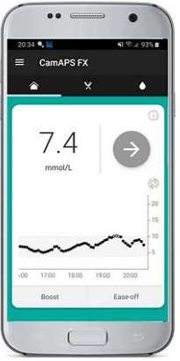
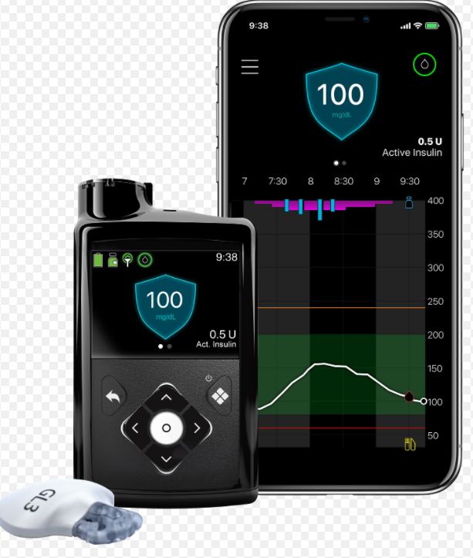
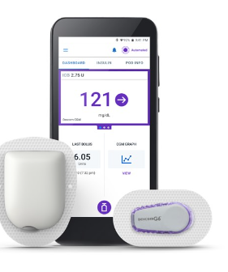
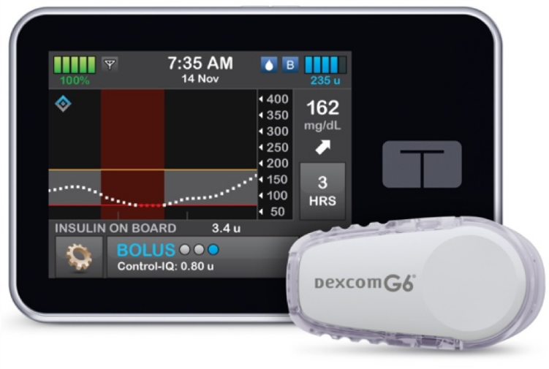
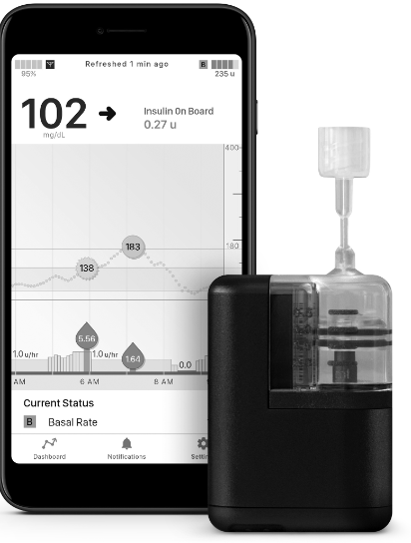
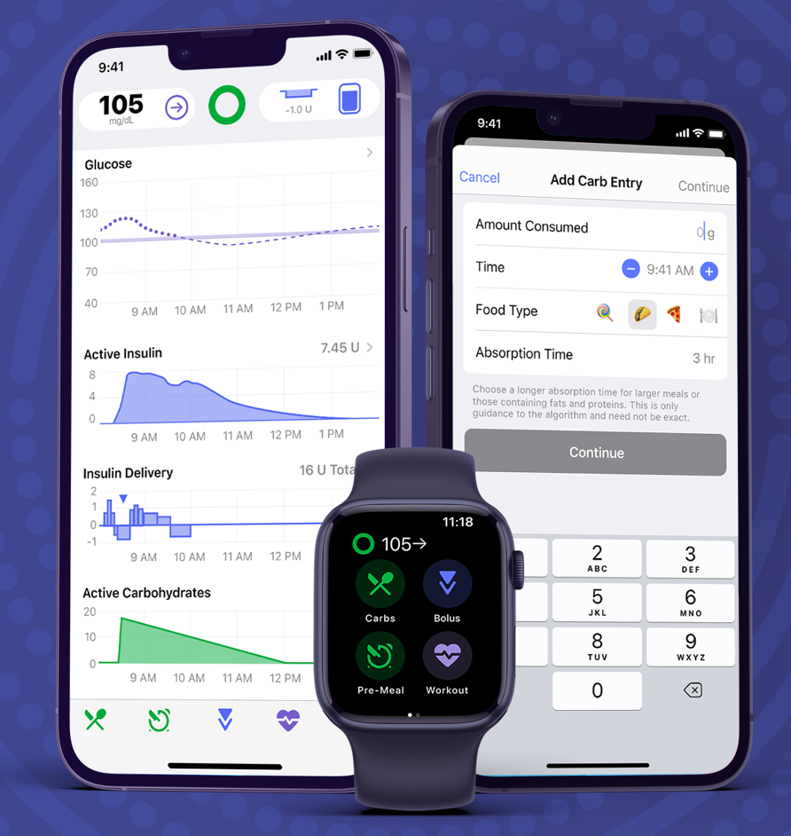

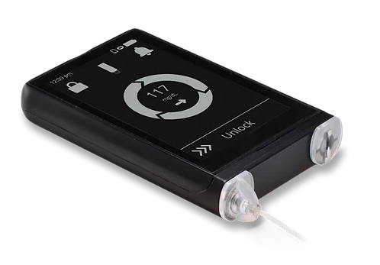
AID Systems
780G
(Medtronic)
T:slim X2 (Tandem)
Control IQ
CamAPS
Omnipod 5
(Insulet)
iLet
(Beta Bionics)
Mobi (Tandem)
Control IQ
Twiist (Sequel) Tidepool

Slide 25
Insulin Delivery (Pumps and AID)
7. Diabetes Technology
7.26 AID systems should be the preferred insulin delivery method to improve glycemic outcomes and reduce hypoglycemia and disparities in youth and adults with T1D A and other types of insulin-deficient diabetes E who are capable of using the device (either by themselves or with a caregiver). Choice of an AID system should be made based on the individual’s circumstances, preferences, and needs. A
7.27 Insulin pump therapy, preferably with CGM, should be offered for diabetes management to youth and adults on MDI with T2D who can use the device safely (either by themselves or with a caregiver). The choice of device should be made based on the individual’s circumstances, preferences, and needs. A
7.29 Support and provide diabetes management advice to people with diabetes who choose to use an open-source closed-loop system. B

Slide 26
Medication Updates

Slide 27
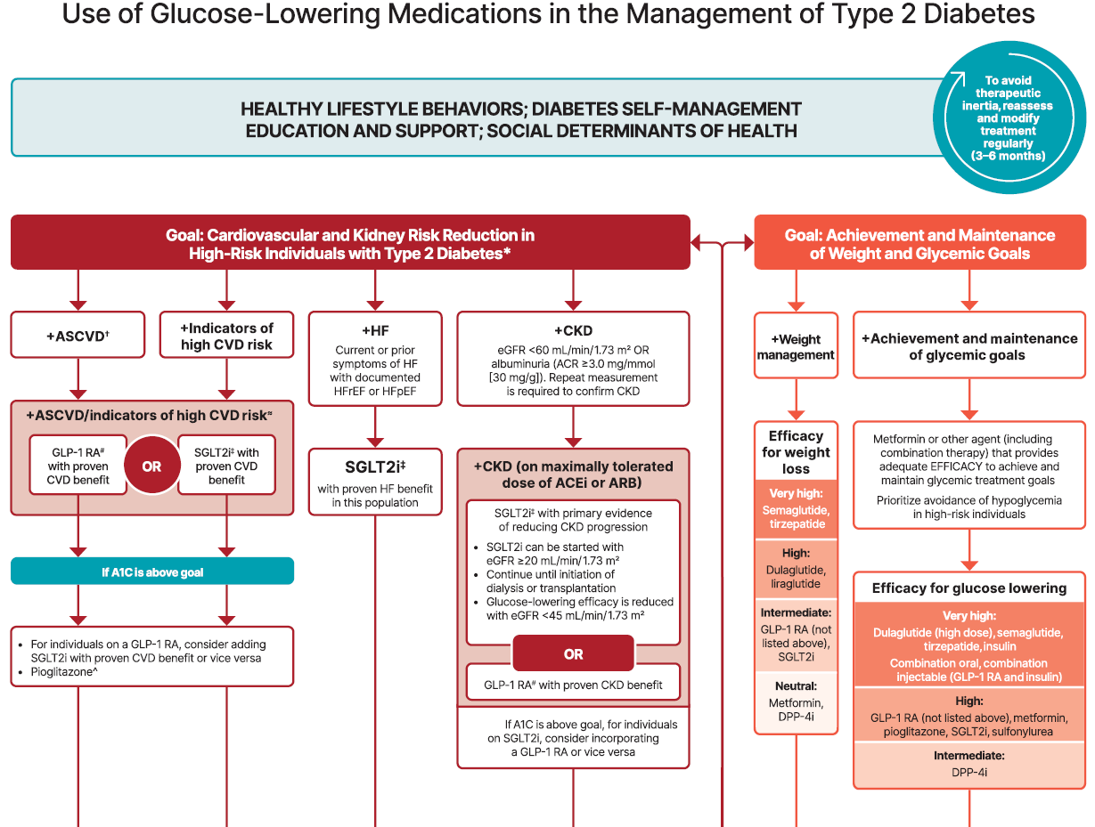
9. Pharmacologic Approaches to Glycemic Treatment
Pharmacologic Approaches to Glycemic Treatment: Standards of Care in Diabetes - 2025 Diabetes Care 2025;48(Suppl. 1):S181-S206

Slide 28
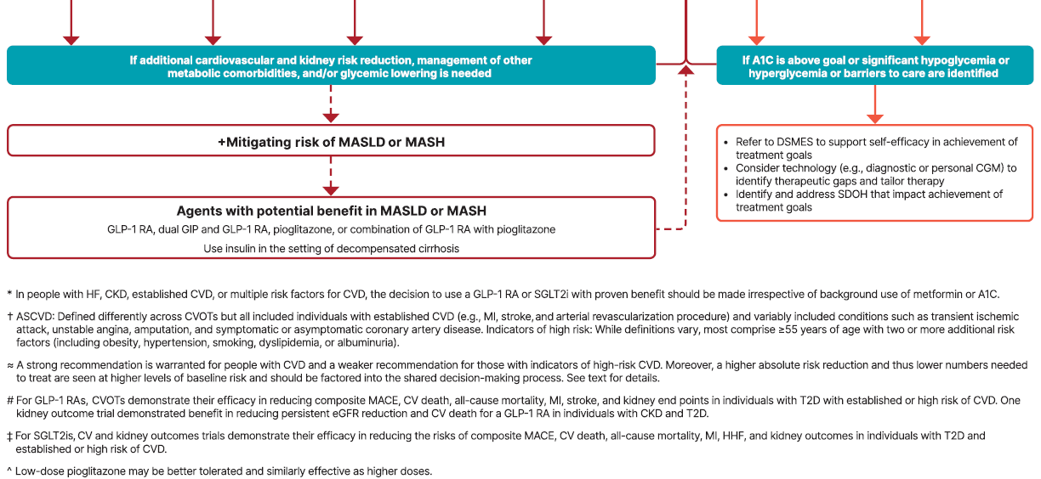
Figure 9.3 (continued)
9. Pharmacologic Approaches to Glycemic Treatment
Pharmacologic Approaches to Glycemic Treatment: Standards of Care in Diabetes - 2025 Diabetes Care 2025;48(Suppl. 1):S181-S206

Slide 29
KT has kidney disease, obesity, hypertension and type 2 diabetes. He currently takes metformin 500mg twice daily. Which of the following agents has the strongest evidence for improving kidney outcomes in people with type 2 diabetes?
Semaglutide
Ertugliflozin
Pioglitazone
Linagliptin
Notes:
Justification: Semaglutide has shown benefit in the FLOW trial, which was randomized controlled trial to assess kidney outcomes compared to placebo and it demonstrated benefit. The other agents listed have not shown benefit for kidney outcomes.

Slide 30
KT has kidney disease, obesity, hypertension and type 2 diabetes. He currently takes metformin 500mg twice daily. Which of the following agents has the strongest evidence for improving kidney outcomes in people with type 2 diabetes?
Semaglutide
Ertugliflozin
Pioglitazone
Linagliptin
Notes:
Justification: Semaglutide has shown benefit in the FLOW trial, which was randomized controlled trial to assess kidney outcomes compared to placebo and it demonstrated benefit. The other agents listed have not shown benefit for kidney outcomes.

Slide 31
GLP-1 Diabetes Indications
GLP-1 | FDA Indication
Liraglutide (Victoza) | As an adjunct to diet and exercise to improve glycemic control in patients 10 years and older with T2D; To reduce the risk of major adverse CV events (MACE) in adults with T2D and established CVD
Semaglutide (Ozempic) | As an adjunct to diet and exercise to improve glycemic control in adults with T2D To reduce the risk of MACE in adults with T2D and established CVD For adults with T2D and CKD to reduce the risk of kidney disease worsening, kidney failure and death due to CVD
Semaglutide oral (Rybelsus) Tirzepatide (Mounjaro) | As an adjunct to diet and exercise to improve glycemic control in adults with T2D
Exenatide (Bydureon) | As an adjunct to diet and exercise to improve glycemic control in patients 10 years and older with T2D
Dulaglutide (Truclicity) | As an adjunct to diet and exercise to improve glycemic control in patients 10 years and older with T2D; To reduce the risk of MACE in adults with T2D and established CVD or multiple CVD risk factors
Notes:
MACE: CV death, non-fatal myocardial infarction, or non-fatal stroke)
Perkovic et al. N Engl J Med 2024;391:109-121.
Gerstein HC, Sattar N, Rosenstock J, et al. N Engl J Med. 2021;385(10):896-907
Gerstein HC, Colhoun HM, Dagenais GR, et al. The Lancet. 2019;394(10193):121-130
Marso SP, Daniels GH, Brown-Frandsen K, et al. N Engl J Med. 2016;375(4):311-322
Marso SP, Bain SC, Consoli A, et al. N Engl J Med. 2016;375(19):1834-1844

Slide 32
SGLT-2 Inhibitor Dosing & Indication
Once an SGLT2i is initiated, it is reasonable to continue an SGLT2i even if the eGFR falls below 20 ml/min/1.73 m2 , unless it is not tolerated or kidney replacement therapy is initiated.
Drug | Dose | Renal Adjustment | FDA Approved Indications
Ertugliflozin (Steglatro) | 5-15 mg daily | Not recommended for eGFR < 45 | As an adjunct to diet and exercise to improve glycemic control in adults with T2D (All), 10 years and above (empa, dapa, cana)
Dapagliflozin (Farxiga) | 5-10 mg daily | Not recommended for eGFR <45 (glycemic control) or <25: avoid initiation, may continue for CV, CKD benefits | To reduce the risk of hospitalization for HF in adults with T2D and established CVD or multiple CV risk factors. To reduce the risk of CV death, hospitalization for heart failure, and urgent heart failure visit in adults with heart failure. To reduce the risk of sustained eGFR decline, ESKD, CV death, and hospitalization for HF in adults with CKD at risk of progression.
Empagliflozin (Jardiance) | 10-25 mg daily | Not recommended for eGFR<30mL/min (glycemic control) or <20 :avoid initiation, may continue for CV, CKD benefits | To reduce the risk of CV death in adults with T2D and established CVD. To reduce the risk of CV death and hospitalization for HF in adults with HF To reduce the risk of sustained decline in eGFR, ESKD, CV death, and hospitalization in adults with CKD at risk of progression.
Canagliflozin (Invokana) | 100-300mg daily | eGFR 30 to <60:: 100 mg once daily eGFR < 30: avoid initiation, may continue 100mg daily until ESRD | To reduce MACE in adults with T2DM and established CVD. To reduce the risk of ESKD, doubling of serum creatinine, CV death, and hospitalization for HF in adults with T2DM and diabetic nephropathy with albuminuria >300 mg/day.
Bexagliflozin (Brenzavvy) | 20mg daily | Not recommended for eGFR < 30 | As an adjunct to diet and exercise to improve glycemic control in adults with T2D
Package inserts, dailymed.nlm.nih.gov
Notes:
To reduce the risk of sustained eGFR decline, end-stage kidney disease, cardiovascular death, and hospitalization for heart failure in adults with chronic kidney disease at risk of progression.•To reduce the risk of cardiovascular death, hospitalization for heart failure, and urgent heart failure visit in adults with heart failure.•To reduce the risk of hospitalization for heart failure in adults with type 2 diabetes mellitus and either established cardiovascular disease or multiple cardiovascular risk factors

Slide 33
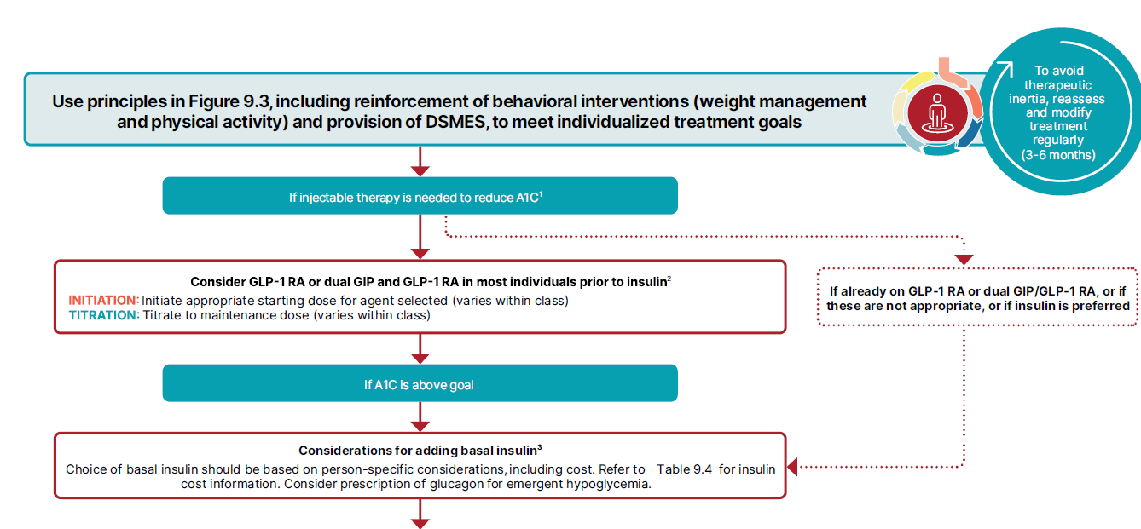
9. Pharmacologic Approaches to Glycemic Treatment
Pharmacologic Approaches to Glycemic Treatment: Standards of Care in Diabetes - 2025 Diabetes Care 2025;48(Suppl. 1):S181-S206

Slide 34
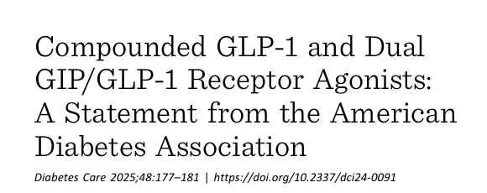
Compounded GLP1
9. Pharmacologic Approaches to Glycemic Treatment
9.31a Use of compounded products that are not approved by the FDA is not recommended due to uncertainty about their content and resulting concerns about safety, quality, and effectiveness. E
9.31b If a glucose-lowering medication is unavailable (e.g., in shortage), it is recommended to switch to a different FDA-approved medication with similar efficacy, as clinically appropriate. E
9.31c Upon resolution of the unavailability (e.g., shortage), reassess the appropriateness of resuming the original FDA-approved medication. E

Slide 35
Diabetes in Pregnancy Updates

Slide 36
Gestational Diabetes (GDM)
2. Diagnosis and Classification of Diabetes
2.26a Before 15 weeks of gestation, test individuals with risk factors B and consider testing all individuals E for undiagnosed diabetes at the first prenatal visit using standard diagnostic criteria if not screened preconception.
2.26b Before 15 weeks of gestation, screen for abnormal glucose metabolism to identify individuals who are at higher risk of adverse pregnancy and neonatal outcomes, are more likely to need insulin, and are at high risk of a later GDM diagnosis. B
2.26c Screen for early abnormal glucose metabolism with dysglycemia using FPG 110–125 mg/dL or A1C 5.9–6.4%. B

Slide 37
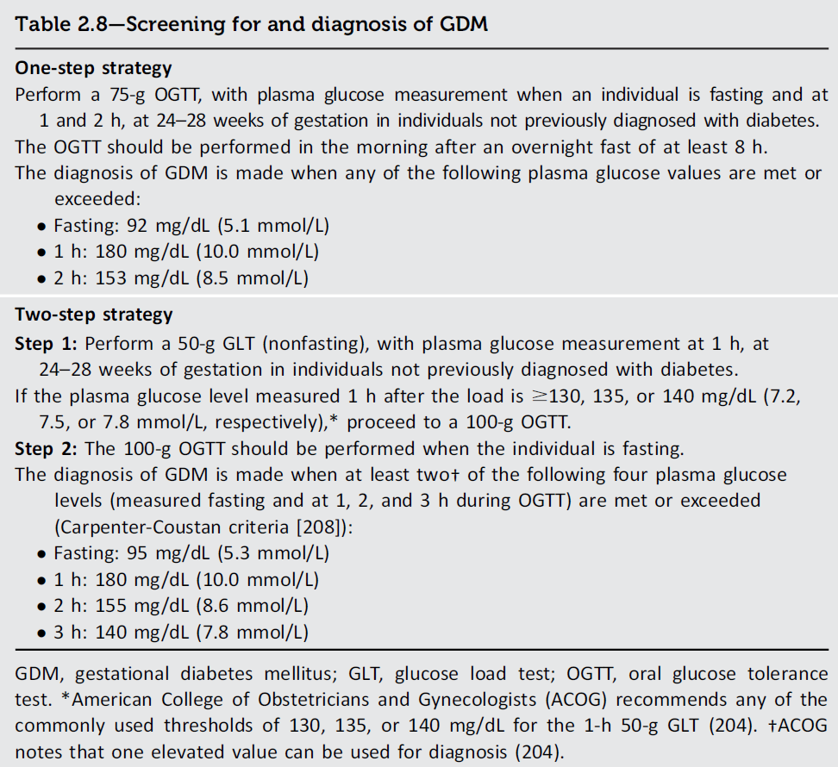
Diagnosing GDM
2. Diagnosis and Classification of Diabetes
Diagnose at 24-28 weeks with 1 or 2 step
The “one-step” 75-g OGTT derived from the IADPSG criteria, or
The older “two-step” approach with a 50-g (nonfasting) screen followed by a 100-g OGTT for those who screen positive

Slide 38
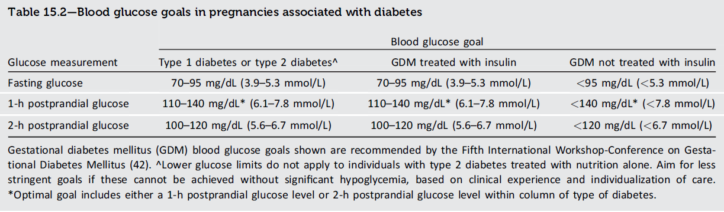
Glycemic Goals in Pregnancy
15. Management of Diabetes in Pregnancy
15.9 Due to increased RBC turnover, A1C is slightly lower during pregnancy in people with and without diabetes. Ideally, the A1C goal in pregnancy is <6% if this can be achieved without significant hypoglycemia, but the goal may be relaxed to <7% if necessary to prevent hypoglycemia. B
15.10 CGM can help to achieve glycemic goals (e.g., time in range, time above range) A and A1C goal B in T1D and pregnancy, and may be beneficial for other types of diabetes in pregnancy. E

Slide 39
ADA Standards of Care 2025 (CGM)
CGM can help to achieve glycemic goals in T1D and pregnancy and may be beneficial for other types of diabetes in pregnancy.
Recommend CGM to pregnant individuals with T1D.
In conjunction with aims to achieve traditional pre- and postprandial glycemic goals, rtCGM can reduce the risk for large-for-gestational-age infants and neonatal hypoglycemia in pregnancy complicated by T1D.
Commonly used estimated A1C and glucose management indicator calculations should not be used in pregnancy as estimates of A1C.
Notes:
15.11 Recommend CGM to pregnant individuals with type 1 diabetes. A In conjunction with aims to achieve traditional pre- and postprandial glycemic goals, real-time CGM can reduce the risk for large-for-gestational-age infants and neonatal hypoglycemia in pregnancy complicated by type 1 diabetes. A
15.12 CGM metrics may be used in combination with BGM to achieve optimal pre- and postprandial glycemic goals. E
15.13 Commonly used estimated A1C and GMI calculations should not be used in pregnancy as estimates of A1C. C
7.18 CGM can help achieve glycemic goals (e.g., TIR, TAR) A and A1C goal B in T1D and pregnancy and may be beneficial for other types of diabetes in pregnancy. E

Slide 40
What is the target range using CGM in pregnancy?
60-120mg/dL
70-180mg/dL
63-140mg/dL
70-140mg/dL

Slide 41
What is the target range using CGM in pregnancy?
60-120mg/dL
70-180mg/dL
63-140mg/dL
70-140mg/dL

Slide 42
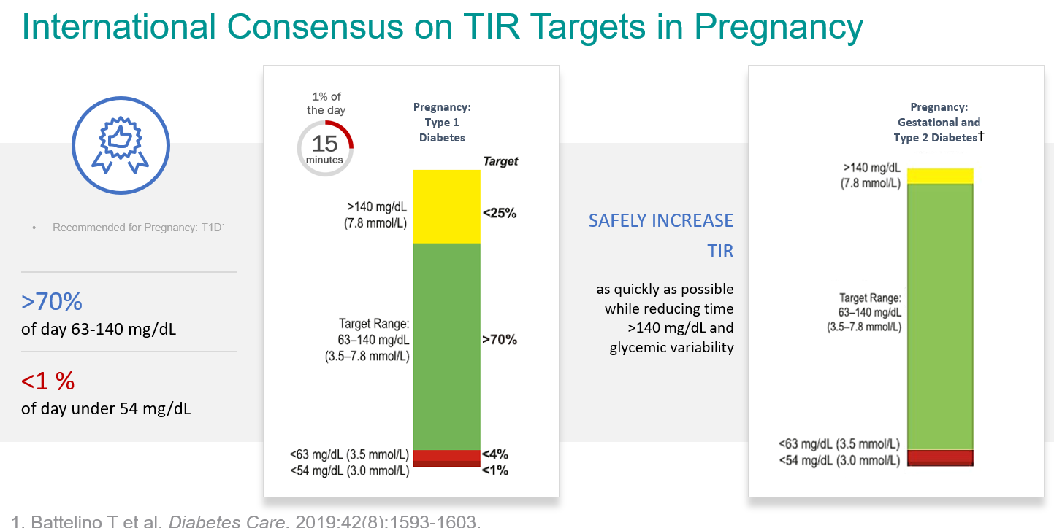

Slide 43
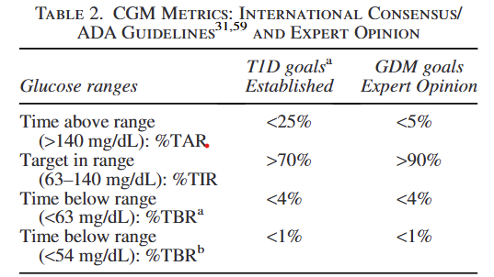
CGM in GDM Practical Considerations
A1GDM,managed with diet and exercise
A2GDM, treatment with antihyperglycemic medications
“Recommend CGM to all who are willing and able to safely use this technology”
Castorino K, Durnwald C, Ehrenberg S. et al; Continuous Glucose Monitoring for Gestational Diabetes Management Working Group. Practical Considerations for Using Continuous Glucose Monitoring in Patients with Gestational Diabetes Mellitus. J Womens Health (Larchmt). 2024 Oct 8.
Notes:
Given the demonstrated beneﬁts of CGM in improving glycemic management, and promoting healthy lifestyle GDM patients,51 we

Slide 44
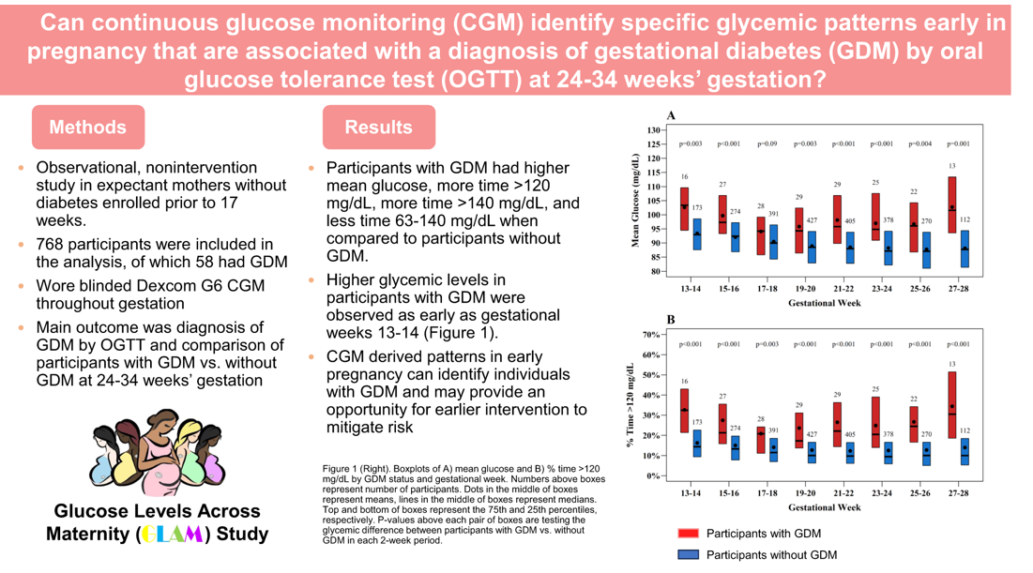
Durnwald C, Beck RW, Li Z, et al. CGM Profiles in Pregnancies With and Without GDM. Diabetes Care. 2024 Aug 1;47(8):1333-1341.

Slide 45
ADA Standards of Care 2025 (Insulin/Pumps)
Insulin is the preferred treatment for T2D and GDM in pregnancy.
AID systems with pregnancy-specific glucose targets are recommended for pregnant individuals with type 1 diabetes.
AID systems without pregnancy specific glucose targets or a pregnancy specific algorithm may be considered for select pregnant individuals with T1D when used with assistive techniques and working with experienced health care teams.

Slide 46
Which of the following automated insulin delivery algorithms is FDA approved for use in pregnancy?
Control IQ
Minimed 780G
Omnipod 5
CamAPS
Notes:
Justification: camAPS was FDA approved in 2024 based on the AiDAPT clinical trial. It is not yet available in the US but is expected to be in the future. the 2025 ADA Standards of Care recommend using a pregnancy approved algorithm when possible in pregnancy.

Slide 47
Which of the following automated insulin delivery algorithms is FDA approved for use in pregnancy?
Control IQ
Minimed 780G
Omnipod 5
CamAPS
Notes:
Justification: camAPS was FDA approved in 2024 based on the AiDAPT clinical trial. It is not yet available in the US but is expected to be in the future. the 2025 ADA Standards of Care recommend using a pregnancy approved algorithm when possible in pregnancy.

Slide 48
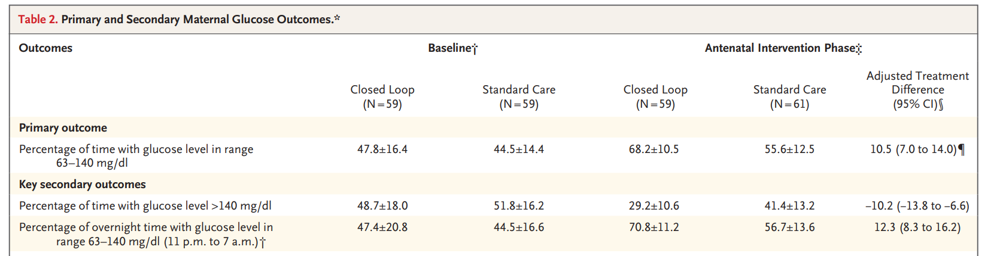
AiDAPT Study (T1D, Pregnancy)
N=124 T1D pregnant participants < 14 weeks gestation RCT AID vs standard care
Primary Outcome=% TIR 63 to 140 mg/dL from week 16 gestation until delivery
Utilized Dexcom G6 with CamAPS app on smartphone with Dana insulin pump, Glucose targets 81-90 mgL
Lee TTM, et al. N Engl J Med. 2023 Oct 5. doi: 10.1056/NEJMoa2303911.
Notes:
The hybrid closed-loop system comprised a smartphone (Galaxy S8 through S12, Samsung) provided to participants or, if participants preferred, their own smartphone, hosting the CamAPS FX application (CamDiab), which ran the Cambridge model predictive control algorithm (version 0.3.71). The smartphone communicated by means of Bluetooth with both the Dana Diabecare RS insulin pump (Sooil) and the Dexcom G6 continuous glucose monitor (Dexcom

Slide 49
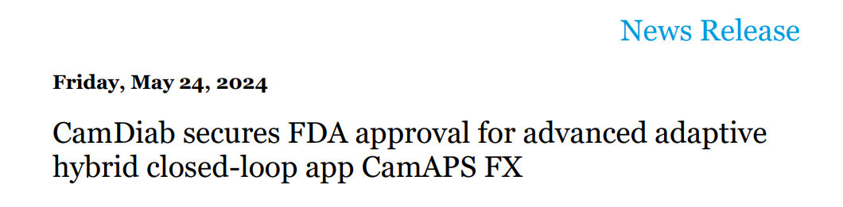
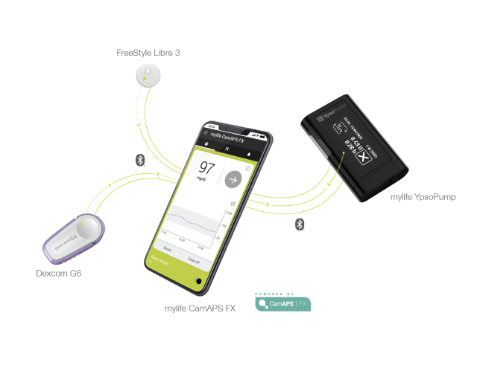
First US AID approved for use during pregnancy
CamAPS FX will be available on Android smartphones and indicated for T1D, ages 2+ years, including during pregnancy
Compatible pumps, not currently available in the US
YpsoPump (mylife)
Submitted to FDA 2024
DANA Diabecare RS and DANA-i (SOOIL)
https://camdiab.com/

Slide 50
AID Comparison
CamAPS: 80mg/dL
Tidepool: 87mg/dL
 | Omnipod 5 | Control IQ | 780G | ILet
Max fill | 200 units | 300 units | 300 units | 180 units
CGM compatibility | Dexcom G6, G7 | Dexcom G6, G7, Libre 2 | Guardian 4 | Dexcom G6, G7
Lowest algorithm target | 110mg/dL | 112.5-120mg/dL | 100mg/dL | 110mg/dL
Basal automation | Calculated from total daily insulin, updated each pod change, 60 min prediction | Increases or decreases from programmed basal rates, 30 min prediction | Calculated based on total daily insulin from past 2-6 days | Initiated based on user weight and adapts with glucose profile
Bolus adjustments | ICR, IAT, ISF. Glucose target | ICR, ISF | ICR, IAT | NA
Basal adjustments | Glucose target | ISF, glucose target range, basal rates | Glucose target | Glucose target
Automated corrections | No | 1/hour if glucose predicted >180 mg/dL, 60% of calculated dose | If glucose > 120 mg/dL and at max "auto basal" delivery, up to every 5 min | No
ICR: insulin to carbohydrate ratio, IAT: insulin action time, ISF: insulin sensitivity factor,
NA: not available
Notes:
Omnipod-5_User-guide.pdf
MiniMed_770G_System_User_Guide.pdf (medtronicdiabetes.com)
AW-1007704_B User Guide, Mobile Bolus, t:slim X2, Control-IQ, 7.6, mg/dL, Artwork.pdf (tandemdiabetes.com)
User manuals
Omnipod-5_User-guide.pdf
MiniMed_770G_System_User_Guide.pdf (medtronicdiabetes.com)
AW-1007704_B User Guide, Mobile Bolus, t:slim X2, Control-IQ, 7.6, mg/dL, Artwork.pdf (tandemdiabetes.com)
770g and 780 g max is 250 units.

Slide 51
Management of Diabetes in Pregnancy
15. Management of Diabetes in Pregnancy
15.17 Insulin should be used to manage type 1 diabetes in pregnancy A and is the preferred agent for the management of GDM A and type 2 diabetes B in pregnancy.
15.19 AID systems with pregnancy-specific glucose targets are recommended for pregnant individuals with T1D. A
15.20 AID systems without pregnancy-specific glucose targets or a pregnancy-specific algorithm may be considered for select pregnant individuals with T1D when used with assistive techniques and working with experienced health care teams. B
15.21 Metformin and glyburide, individually or in combination, should not be used as first-line agents for management of diabetes in pregnancy, as both cross the placenta to the fetus A and may not be sufficient to achieve glycemic goals. B Other oral and noninsulin injectable glucose-lowering medications lack long-term safety data and are not recommended. E
15.22 Metformin, when used to treat polycystic ovary syndrome and induce ovulation, should be discontinued by the end of the first trimester. A

Slide 52
Patient Case
Abby is a 34yoF newly diagnosed with T2D. Her A1C is 7.6%, FBG=145mg/dL and BMI=37kg/m2.
What drug if any would you start?
Metformin
Semaglutide
Sitagliptin
Empagliflozin

Slide 53
9. Pharmacologic Approaches to Glycemic Treatment
Pharmacologic Approaches to Glycemic Treatment: Standards of Care in Diabetes - 2025 Diabetes Care 2025;48(Suppl. 1):S181-S206

Slide 54
1 Year Later
Abby is 35yo, she takes semaglutide 2mg weekly and BMI is 33kg/m2. Her A1C=5.7% and FBG=104mg/dL. She just found out she is 5 weeks pregnant! What should be done with her current medication?
Stop semaglutide and monitor only
Continue semaglutide
Stop semaglutide and switch to insulin
Stop semaglutide and switch to metformin

Slide 55
Is Abby a candidate for CGM?
Yes
No

Slide 56
Summary
Recent updates includes when to screen for T1D and monitoring some in pre-stage 3 T1D
Standards of Care advocate more use of CGM and AID for people with diabetes
Screen early for hyperglycemia in pregnancy, insulin is #1 drug
Notes:
Describe key updates in the 2025 ADA Standards of Care related to medications, monitoring, and technology
Examine recent innovations in diabetes management, including new medications, continuous glucose monitoring (CGM), and insulin delivery systems
Discuss the latest guidelines and recommendations for managing diabetes in pregnancy
Design a treatment plan taking into account individualized factors to address acute and chronic complications

Slide 57

CPE Instructions for: Innovations in Diabetes Care: 2025 ADA Standards and Pregnancy Updates
1
2
2
3
Redeem your credit online at
CEimpact.com
*If this is the first time you have utilized the CEimpact Learning Management System (LMS) you will need to create an account.
From the CEimpact.com Homepage – enter the code provided in the ‘Enter Code’ box and click SUBMIT.
Complete the Exam & Evaluation as prompted; click SUBMIT to send your information to CPE Monitor. Follow instructions to access your CPE Statement of Credit on CPE Monitor or access your Certificate of Completion in MyCourses.
Pharmacist Code: BkTEAv
Technician Code: ULmMAw
The deadline for obtaining your CPE Credit is 30 days from today. The deadline is non-negotiable due to CPE Monitor reporting policies. For CME, access your certificate of completion in My Courses for this course.

Slide 58

Diana Isaacs, PharmD
isaacsd@ccf.org
Instagram/Twitter: dianamisaacs
Podcast: https://www.hcplive.com/podcasts/diabetes-dialogue

Slide 59
Extra slides

Slide 60
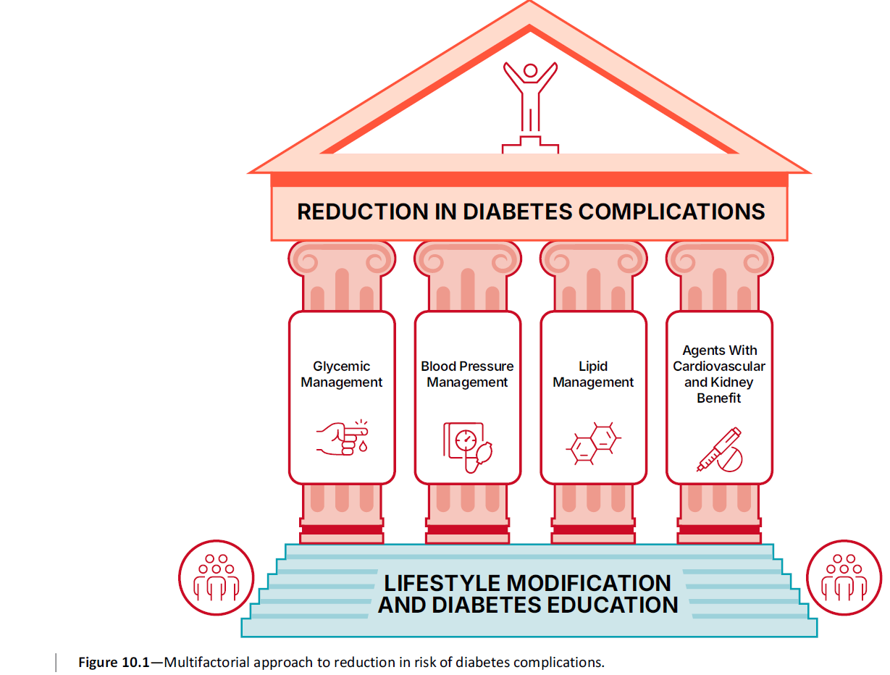
10. Cardiovascular Disease and Risk Management
Cardiovascular Disease and Risk Management: Standards of Care in Diabetes - 2025 Diabetes Care 2025;48(Suppl. 1):S206-S238

Slide 61
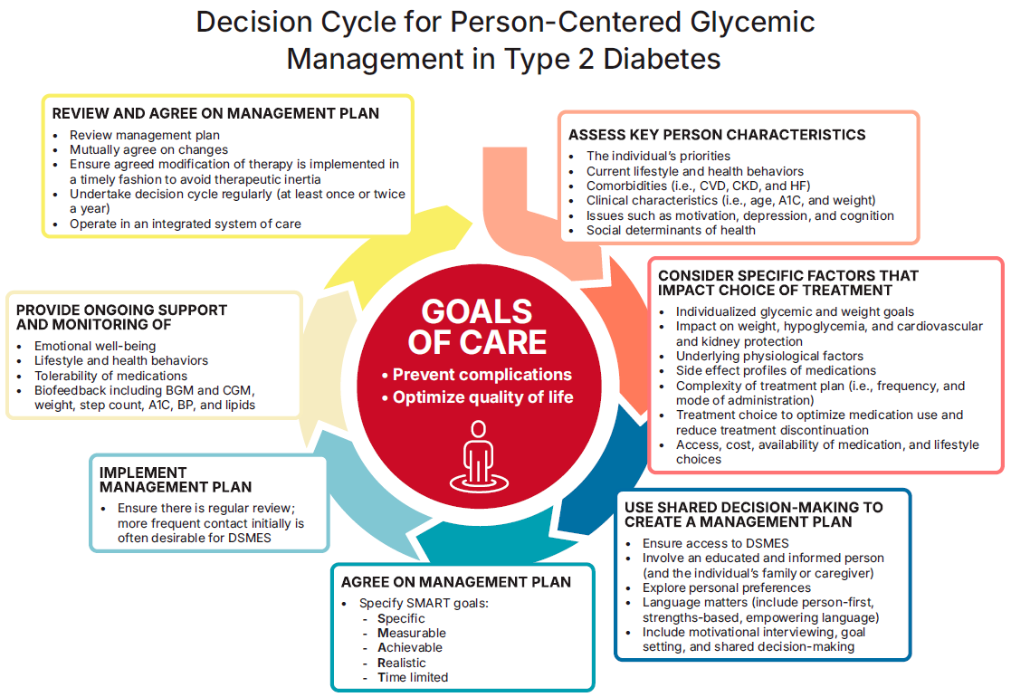
4. Comprehensive Medical Evaluation and Assessment of Comorbidities
Comprehensive Medical Evaluation and Assessment of Comorbidities: Standards of Care in Diabetes - 2025. Diabetes Care 2025;48(Suppl. 1):S59-S85

Slide 62
Pharmacologic Interventions to Delay Type 2 Diabetes
3. Prevention or Delay of Diabetes and Associated Comorbidities
3.7 Metformin for the prevention of type 2 diabetes should be considered in adults at high risk of type 2 diabetes, as typified by the DPP, especially those aged 25–59 years with BMI ≥35 kg/m², higher fasting plasma glucose (e.g., ≥110 mg/dL [≥ 6 mmol/L]), and higher A1C (e.g., 6.0% [≥42 mmol/mol]), and in individuals with prior gestational diabetes mellitus. A
3.8 Long-term use of metformin may be associated with vitamin B12 deficiency; consider periodic assessment of vitamin B12 level in metformin-treated individuals, especially in those with anemia or peripheral neuropathy. B

Slide 63
Metabolic-Associated Steatotic Liver Disease and Metabolic-Associated Steatohepatitis - Screening
4. Comprehensive Medical Evaluation and Assessment of Comorbidities
4.22a Screen adults with T2D or prediabetes, particularly those with obesity or other cardiometabolic risk factors or established CVD, for their risk of having or developing cirrhosis related to metabolic dysfunction-associated steatohepatitis (MASH) using a calculated fibrosis-4 index (FIB-4) (derived from age, ALT, AST, and platelets [mdcalc.com/calc/2200/fibrosis4-fib-4-index-liver-fibrosis]), even if they have normal liver enzymes. B
4.22b Adults with diabetes or prediabetes with persistently elevated plasma aminotransferase levels for >6 months and low FIB-4 should be evaluated for other causes of liver disease. B
4.23 Adults with T2D or prediabetes with a FIB-4 ≥1.3 should have additional risk stratification by liver stiffness measurement with transient elastography, or, if unavailable, the enhanced liver fibrosis (ELF) test. B
4.24 Refer adults with T2D or prediabetes at higher risk for significant liver fibrosis (i.e., as indicated by FIB-4, liver stiffness measurement, or ELF) to a gastroenterologist or hepatologist for further evaluation and management. B

Slide 64
MASLD & MASH- Management
4. Comprehensive Medical Evaluation and Assessment of Comorbidities
4.25 Adults with type 2 diabetes or prediabetes, particularly with overweight or obesity, who have metabolic dysfunction-associated steatotic liver disease (MASLD) should be recommended lifestyle changes using an interprofessional approach that promotes weight loss, ideally within a structured nutrition plan and physical activity program for cardiometabolic benefits B and histological improvement. C
4.26 In adults with type 2 diabetes, MASLD, and overweight or obesity, consider using a glucagon-like peptide 1 (GLP-1) receptor agonist (RA) or a dual glucose-dependent insulinotropic polypeptide (GIP) and GLP-1 RA for the treatment of obesity with potential benefits in Metabolic-Associated Steatohepatitis (MASH) as an adjunctive therapy to lifestyle interventions for weight loss. B
4.27a In adults with type 2 diabetes and biopsy-proven MASH or those at high risk for liver fibrosis (based on noninvasive tests), pioglitazone, a GLP-1 RA, or a dual GIP and GLP-1 RA is preferred for glycemic management because of potential beneficial effects on MASH. B
4.27b Combination therapy with pioglitazone plus GLP-1 RA can be considered for the treatment of hyperglycemia in adults with type 2 diabetes with biopsy-proven MASH or those at high risk of liver fibrosis (identified with noninvasive tests) because of potential beneficial effects on MASH. B

Slide 65
MASLD & MASH- Management(continued)
4. Comprehensive Medical Evaluation and Assessment of Comorbidities
4.28 For consideration of treatment with a thyroid hormone receptor-β agonist in adults with type 2 diabetes or prediabetes with MASLD with moderate (F2) or advanced (F3) liver fibrosis on liver histology, or by a validated imaging-based or blood-based test, refer to a gastroenterologist or hepatologist with expertise in MASLD management. A
4.29 Treatment initiation and monitoring should be individualized and within the context of an interprofessional team that includes a gastroenterologist or hepatologist, consideration of individual preferences, and a careful shared-decision cost-benefit discussion. B
4.30a In adults with type 2 diabetes and MASLD, use of glucose-lowering therapies other than pioglitazone or GLP-1 RAs may be continued as clinically indicated, but these therapies lack evidence of benefit in MASH. B
4.30b Insulin therapy is the preferred agent for the treatment of hyperglycemia in adults with type 2 diabetes with decompensated cirrhosis. C

Slide 66
Metabolic-Associated Steatotic Liver Disease and Metabolic-Associated Steatohepatitis – Management (continued)
4. Comprehensive Medical Evaluation and Assessment of Comorbidities
4.31a Adults with type 2 diabetes and MASLD are at increased cardiovascular risk; therefore, comprehensive management of cardiovascular risk factors is recommended. B
4.31b Statin therapy is safe in adults with type 2 diabetes and compensated cirrhosis from MASLD and should be initiated or continued for cardiovascular risk reduction as clinically indicated. B In people with decompensated cirrhosis, statin therapy should be used with caution, and close monitoring is needed, given limited safety and efficacy data. B
4.32a Consider metabolic surgery in appropriate candidates as an option to treat MASH in adults with type 2 diabetes B and to improve cardiovascular outcomes. B
4.32b Metabolic surgery should be used with caution in adults with type 2 diabetes with compensated cirrhosis from MASLD B and is not recommended in decompensated cirrhosis. B

Slide 67
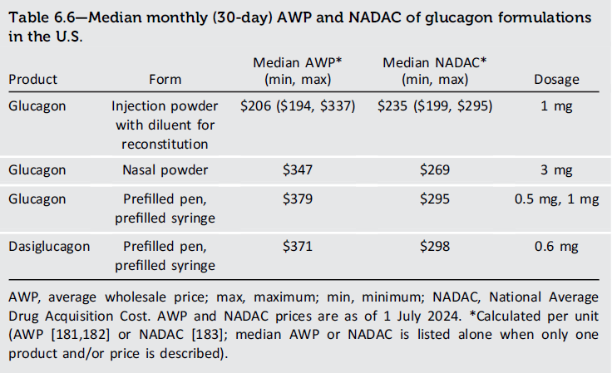
Hypoglycemia Assessment, Prevention, and Treatment
6. Glycemic Goals and Hypoglycemia
6.14 Use of CGM is beneficial and recommended for individuals at high risk for hypoglycemia. A
6.16 Glucagon should be prescribed for all individuals taking insulin or at high risk for hypoglycemia. A Family, caregivers, school personnel, and others providing support to these individuals should know its location and be educated on how to administer it. Glucagon preparations that do not have to be reconstituted are preferred. B

Slide 68
9.3 Early use of CGM is recommended for adults with type 1 diabetes to improve glycemic outcomes and quality of life and to minimize hypoglycemia. B
9.4 Automated insulin delivery systems should be offered to all adults with type 1 diabetes. A

Slide 69
9.16a In adults with type 2 diabetes and biopsy-proven MASH or those at high risk for liver fibrosis (based on noninvasive tests), pioglitazone, a GLP-1 RA, or a dual GIP and GLP-1 RA is preferred for glycemic management due to potential beneficial effects on MASH. B
9.16b Combination therapy with pioglitazone plus a GLP-1 RA can be considered for the treatment of hyperglycemia in adults with type 2 diabetes with biopsy-proven MASH or those at high risk of liver fibrosis identified with noninvasive tests) due to potential beneficial effects on MASH. B

Slide 70
Pharmacologic Therapy for Adults with Type 2 Diabetes (continued)
9. Pharmacologic Approaches to Glycemic Treatment
9.23 In adults with type 2 diabetes, initiation of insulin should be considered regardless of background glucose-lowering therapy or disease stage if symptoms of hyperglycemia are present or when A1C or blood glucose levels are very high (i.e., A1C >10% [>86 mmol/mol] or blood glucose ≥300 mg/dL [≥ 16.7 mmol/L]). E
9.24 In adults with type 2 diabetes and no evidence of insulin deficiency, a GLP-1 RA, including a dual GIP and GLP-1 RA, is preferred to insulin (Fig. 9.4). A
9.25 If insulin is used, combination therapy with a GLP-1 RA, including a dual GIP and GLP-1 RA, is recommended for greater glycemic effectiveness as well as beneficial effects on weight and hypoglycemia risk for adults with type 2 diabetes. Insulin dosing should be reassessed upon addition or dose escalation of a GLP-1 RA or dual GIP and GLP-1 RA. A
9.26 In adults with type 2 diabetes who are initiating insulin therapy, continue glucose-lowering agents (unless contraindicated or not tolerated) for ongoing glycemic and metabolic benefits (i.e., weight, cardiometabolic, or kidney benefits). A

Slide 71
Additional Recommendations For All Individuals with Diabetes
9. Pharmacologic Approaches to Glycemic Treatment
9.27 Monitor for signs of overbasalization during insulin therapy, such as significant bedtime-to-morning or postprandial-to-preprandial glucose differential, occurrences of hypoglycemia (aware or unaware), and high glycemic variability. When overbasalization is suspected, a thorough reevaluation should occur promptly to further tailor therapy to the individual’s needs. E
9.28 Glucagon should be prescribed for all individuals requiring intensive insulin therapy or at high risk for hypoglycemia. Family, caregivers, school personnel, and others providing support to these individuals should know its location and be educated on how to administer it. Glucagon preparations that do not require reconstitution are preferred. B
9.29 Routinely assess all people with diabetes for financial obstacles that could impede their diabetes management. Clinicians, members of the diabetes care team, and social services professionals should work collaboratively, as appropriate and feasible, to support these individuals by implementing strategies to reduce costs, thereby improving their access to evidence-based care. E
9.30 In adults with diabetes and cost-related barriers, consider use of lower-cost medications for glycemic management (i.e., metformin, sulfonylureas, thiazolidinediones, and human insulin) within the context of their risks for hypoglycemia, weight gain, cardiovascular and kidney events, and other adverse effects. E

Slide 72
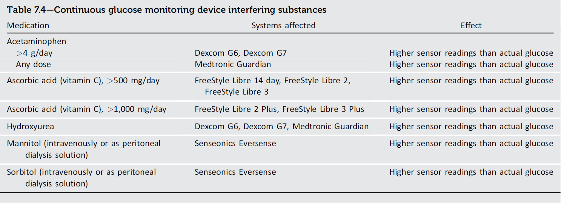
Continuous Glucose Monitoring Devices (continued)
7. Diabetes Technology
7.21 People who wear CGM devices should be educated on potential interfering substances and other factors that may affect accuracy. C
Diabetes Technology: Standards of Care in Diabetes - 2025. Diabetes Care 2025;48(Suppl. 1):S146-S166

Slide 73
Postpartum Care
15. Management of Diabetes in Pregnancy
15.26 Insulin requirements need to be evaluated and adjusted for individuals requiring insulin after delivery because insulin resistance decreases dramatically immediately postpartum. C
15.27 A contraceptive plan should be discussed and implemented with all people with diabetes of childbearing potential. A
15.28 Breastfeeding efforts are recommended for all individuals with diabetes. A Breastfeeding is recommended for individuals with a history of GDM for multiple benefits, A including a reduced risk for type 2 diabetes later in life. B
15.29 Postpartum care should include psychosocial assessment and support for self-care. E
15.30 Screen individuals with a recent history of GDM at 4–12 weeks postpartum, using the 75-g oral glucose tolerance test and clinically appropriate nonpregnancy diagnostic criteria. B
15.31 Individuals with a history of GDM should have lifelong screening for the development of type 2 diabetes or prediabetes every 1–3 years. B
15.32 Individuals with overweight or obesity and a history of GDM found to have prediabetes should receive intensive lifestyle interventions and/or metformin to prevent diabetes. A

Slide 74
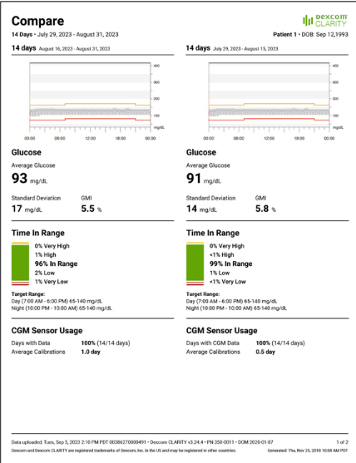
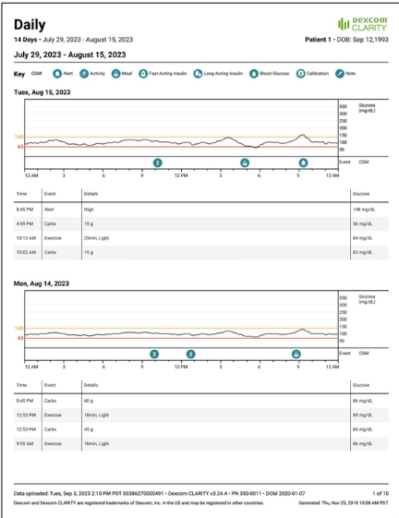
CGM Tips in Pregnancy
Utilize features such as notes, meals, insulin, and activity logging to better inform data interpretation
Compare feature can compare week over week

