Slide 1

Precision Agriculture
Technology
John Nowatzki
Extension Ag Machine Systems
Ag & Biosystems Engineering Dept.

Slide 2

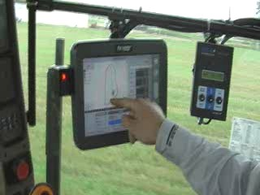
GPS and Computers
Guidance
Section and Row Control
Yield Monitoring and Data Management
Remote and In-Field Sensing
Variable Rate Application
Telematics
Autonomous Vehicles
Notes:
Variable-rate fertilizer application allows crop producers to apply different rates of fertilizer at each location across fields. The technology needed to accomplish variable-rate fertilization includes an in-cab computer and software with a field zone
application map, fertilizer equipment capable of changing rates during operation and the Global Positioning System (GPS). The fertilizer rate at specific locations within fields is based on the georeferenced field zone map on the in-cab computer.
The system includes a vehicle-mounted GPS unit to monitor field locations, allowing the computer to change the application rate between zones. Electronic communication between the in-cab computer and the rate controller on the application machine functions to change the fertilizer rate across the field.

Slide 3
Some Technologies Adopted Quickly!
Source: USDA/ERS
Dietrich Kastens
Notes:
(http://www.ers.usda.gov/Data/BiotechCrops/)
Dietrich Kastens
Kastens Inc. Farms
28339 Rd BB
Herndon, KS 67739
785-626-4600 Mobile
785-626-9284 Office
www.kastensinc.com

Slide 4
Some Technologies Adopted Slowly!
Source: U.S. Census of Agriculture
Source: U.S. Census of Agriculture
Dietrich Kastens
Notes:
(http://www.ers.usda.gov/Data/BiotechCrops/)
Dietrich Kastens
Kastens Inc. Farms
28339 Rd BB
Herndon, KS 67739
785-626-4600 Mobile
785-626-9284 Office
www.kastensinc.com

Slide 5
GPS Guidance
GPS-assisted
Autosteer
GPS Correction Options:
  Free GPS Corrections
  Commercial Options
  CORS – Internet-based
  RTK
Notes:
Variable-rate fertilizer application allows crop producers to apply different rates of fertilizer at each location across fields. The technology needed to accomplish variable-rate fertilization includes an in-cab computer and software with a field zone
application map, fertilizer equipment capable of changing rates during operation and the Global Positioning System (GPS). The fertilizer rate at specific locations within fields is based on the georeferenced field zone map on the in-cab computer.
The system includes a vehicle-mounted GPS unit to monitor field locations, allowing the computer to change the application rate between zones. Electronic communication between the in-cab computer and the rate controller on the application machine functions to change the fertilizer rate across the field.

Slide 6
Section and Row Control
Sprayers
Planters
Air Seeders
Notes:
Variable-rate fertilizer application allows crop producers to apply different rates of fertilizer at each location across fields. The technology needed to accomplish variable-rate fertilization includes an in-cab computer and software with a field zone
application map, fertilizer equipment capable of changing rates during operation and the Global Positioning System (GPS). The fertilizer rate at specific locations within fields is based on the georeferenced field zone map on the in-cab computer.
The system includes a vehicle-mounted GPS unit to monitor field locations, allowing the computer to change the application rate between zones. Electronic communication between the in-cab computer and the rate controller on the application machine functions to change the fertilizer rate across the field.

Slide 7
Yield Monitoring and Data Management
Yield Monitors with GPS
GIS Programs
Notes:
Variable-rate fertilizer application allows crop producers to apply different rates of fertilizer at each location across fields. The technology needed to accomplish variable-rate fertilization includes an in-cab computer and software with a field zone
application map, fertilizer equipment capable of changing rates during operation and the Global Positioning System (GPS). The fertilizer rate at specific locations within fields is based on the georeferenced field zone map on the in-cab computer.
The system includes a vehicle-mounted GPS unit to monitor field locations, allowing the computer to change the application rate between zones. Electronic communication between the in-cab computer and the rate controller on the application machine functions to change the fertilizer rate across the field.

Slide 8
Remote and In-field Sensing
Satellite Imagery
Aerial Photography
Electrical Conductivity (EC)
In-field Infrared
Chlorophyll Meters
Notes:
Variable-rate fertilizer application allows crop producers to apply different rates of fertilizer at each location across fields. The technology needed to accomplish variable-rate fertilization includes an in-cab computer and software with a field zone
application map, fertilizer equipment capable of changing rates during operation and the Global Positioning System (GPS). The fertilizer rate at specific locations within fields is based on the georeferenced field zone map on the in-cab computer.
The system includes a vehicle-mounted GPS unit to monitor field locations, allowing the computer to change the application rate between zones. Electronic communication between the in-cab computer and the rate controller on the application machine functions to change the fertilizer rate across the field.

Slide 9
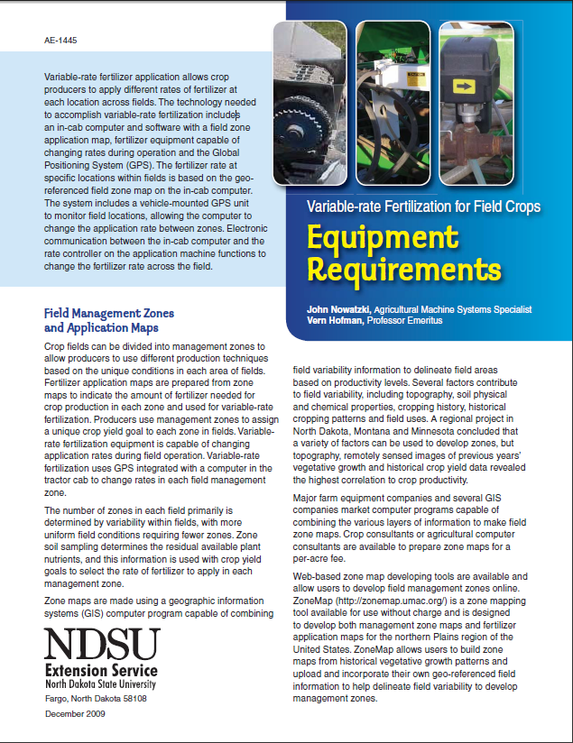
Variable Rate Fertilization
Equipment and Technology
  Zone Maps
  Equipment Capable of Changing Rates
  In-cab Computer Controller
  GPS
Farmer Equipment Options:
  Fertilizer Applicator
  Air Seeder – Planter
Commercial Options
  Consultant Services for Maps
  Fertilizer Companies
Notes:
Variable-rate fertilizer application allows crop producers to apply different rates of fertilizer at each location across fields. The technology needed to accomplish variable-rate fertilization includes an in-cab computer and software with a field zone
application map, fertilizer equipment capable of changing rates during operation and the Global Positioning System (GPS). The fertilizer rate at specific locations within fields is based on the georeferenced field zone map on the in-cab computer.
The system includes a vehicle-mounted GPS unit to monitor field locations, allowing the computer to change the application rate between zones. Electronic communication between the in-cab computer and the rate controller on the application machine functions to change the fertilizer rate across the field.

Slide 10
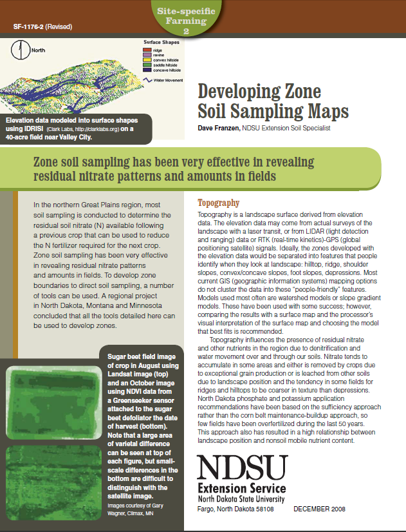
Field Management Zones
and Application Maps
(NDSU Soils Specialist Dave Franzen)
Management Zones – Areas of Uniformity
  Topography
  Remote Imagery
  Electrical Conductivity
  Yield Frequency Map
  Digital Soil
  LiDAR
  Grower Knowledge

Slide 11
Telematics
On-the-go Transfer of Data
Remote Diagnostics
Error Codes
Combine Threshing Efficiency
Machine Location
Notes:
Variable-rate fertilizer application allows crop producers to apply different rates of fertilizer at each location across fields. The technology needed to accomplish variable-rate fertilization includes an in-cab computer and software with a field zone
application map, fertilizer equipment capable of changing rates during operation and the Global Positioning System (GPS). The fertilizer rate at specific locations within fields is based on the georeferenced field zone map on the in-cab computer.
The system includes a vehicle-mounted GPS unit to monitor field locations, allowing the computer to change the application rate between zones. Electronic communication between the in-cab computer and the rate controller on the application machine functions to change the fertilizer rate across the field.

Slide 12
Autonomous Vehicles
Mechanical Weeding
Row Crop Tillage
Notes:
Variable-rate fertilizer application allows crop producers to apply different rates of fertilizer at each location across fields. The technology needed to accomplish variable-rate fertilization includes an in-cab computer and software with a field zone
application map, fertilizer equipment capable of changing rates during operation and the Global Positioning System (GPS). The fertilizer rate at specific locations within fields is based on the georeferenced field zone map on the in-cab computer.
The system includes a vehicle-mounted GPS unit to monitor field locations, allowing the computer to change the application rate between zones. Electronic communication between the in-cab computer and the rate controller on the application machine functions to change the fertilizer rate across the field.

Slide 13
Summary
Zone Maps – Imagery, EC, Multi-year Yield, Topography
  Consultants; Learn Software
Application Maps – Soil Test Each Zone
Application Maps
Modify Existing Equipment vs. New Equipment
Compare Variable Rate to Constant Rate

Slide 14
Questions - Comments
Office 701-231-8213 Cell 701-261-9842
John.Nowatzki@ndsu.edu
http://www.ag.ndsu.edu/agmachinery/precisionagriculture

